Slide 1



  Welcome to this year’s annual Advent calendar for teachers and chaplains to use in secondary schools.
  We are the Catholic Agency for Overseas Development, reaching out to people living in poverty with practical help, whatever their religion or culture. We also campaign for global justice, so that every person can live a full and dignified life.
  This calendar tells stories of people that we work with and of young people who support this work. Each day reflects on scripture from the Mass of the day and gives a question to ponder, a prayer and an action.
Notes:
Picture credit: Thom Flint
NB. 2023-24 is Year B in the Catholic Church’s liturgical cycle.
Advent weekday readings remain the same every year, apart from Solemnities, such as The Immaculate Conception.
From 17 December there are set weekday readings, the same every year.
Sunday readings change on a three-year cycle.

Slide 2
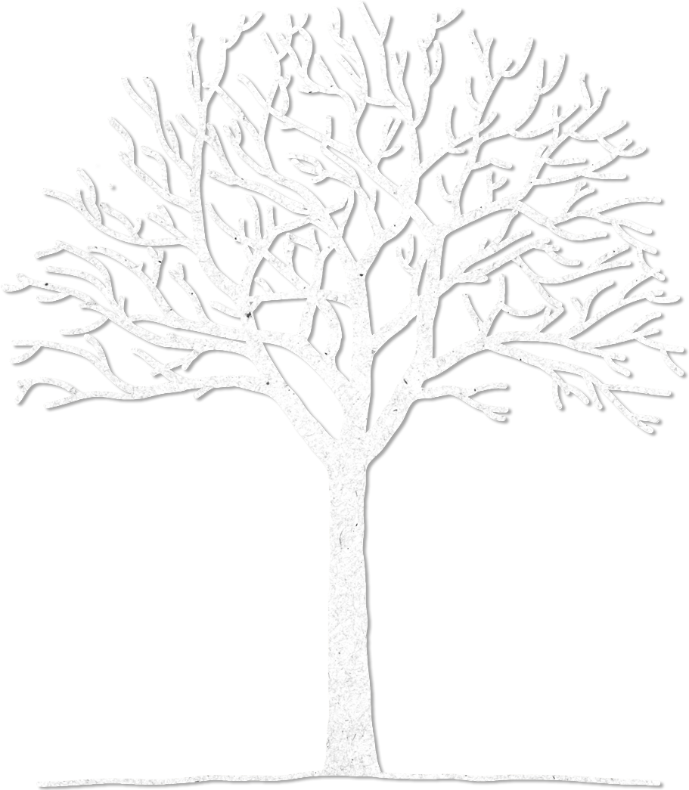



21
19
8
5
4
11
20
25
15
7
12
Advent calendar 2023
“The Word was the real light that gives light to everyone; he was coming into the world.” John 1: 9
3
24
6
18
22
14
13
Notes:
Picture credit: Achuoth Deng

Slide 3

Sunday 3 December
First Sunday of Advent
“You are to conceive and bear a son, and you must name him Jesus.”
Luke 1:31
  Get ready…
  Today we prepare for the season of advent, the first day of the Church’s new year.
  In the four weeks of Advent, we wait expectantly for Jesus – the light of the world. It’s also time to reflect on his birth in a stable, a poor migrant who became a light for everyone.
3
Notes:
Picture credit: Wallpaper Flare

Slide 4
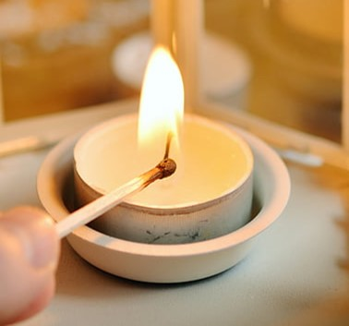
  Get ready! Are you starting to gather your Christmas decorations?
  In today’s reading we learn that Mary was also told to get ready. For Jesus. She was even given His name in advance!
  Advent busyness in our homes can distract us from what we’re really preparing for in our hearts. Why not light a candle and take 2 minutes to get ready for his arrival.
  Lord, we’re getting ready to welcome you. Help us remain focused on the real meaning of Advent.
  Amen
“You are to conceive and bear a son, and you must name him Jesus.”
Luke 1:31
27
Notes:
Picture credit: Pickpik

Slide 5
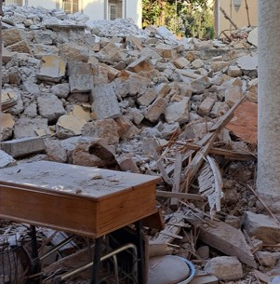
Monday 4 December
“The glory of the Lord
will be… refuge and
shelter from the storm...”
Isaiah 4:5-6
  Seeking shelter
  On the 6 February 2023 Turkey and Syria experienced a 7.8 magnitude earthquake. Overnight homes and buildings were reduced to rubble.
  One aid worker said; “We try to visit the families, especially the forgotten and isolated ones. Listening to their needs, we try to help them and to be together in the face of this tragedy. The other day, for example, in addition to food and basic needs, a child asked us for toys. He and his sisters had lost everything.”
4
Notes:
Picture credit: Withheld for security purposes

Slide 6
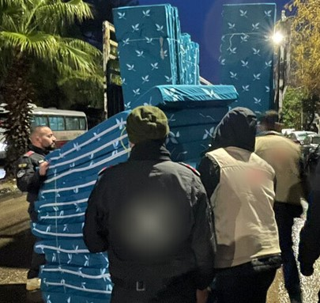
  Hombeline Dulière, CAFOD’s Programme Manager for Syria Crisis Response reported that local partners worked tirelessly ‘‘to support the search and rescue operation, as well as making sure people have water, hot meals, warm clothing and somewhere safe to go.”
  A CAFOD partner distributes mattresses, supported by an emergency response unit from a second CAFOD partner.
  Lord, we pray for those affected by disasters that affect their homes. May you provide them with safe refuge.
  Amen
“The glory of the Lord
will be… refuge and
shelter from the storm...”
Isaiah 4:5-6
4
Find out what happens in an emergency at CAFOD.
Notes:
Picture credit: Withheld for security purposes

Slide 7
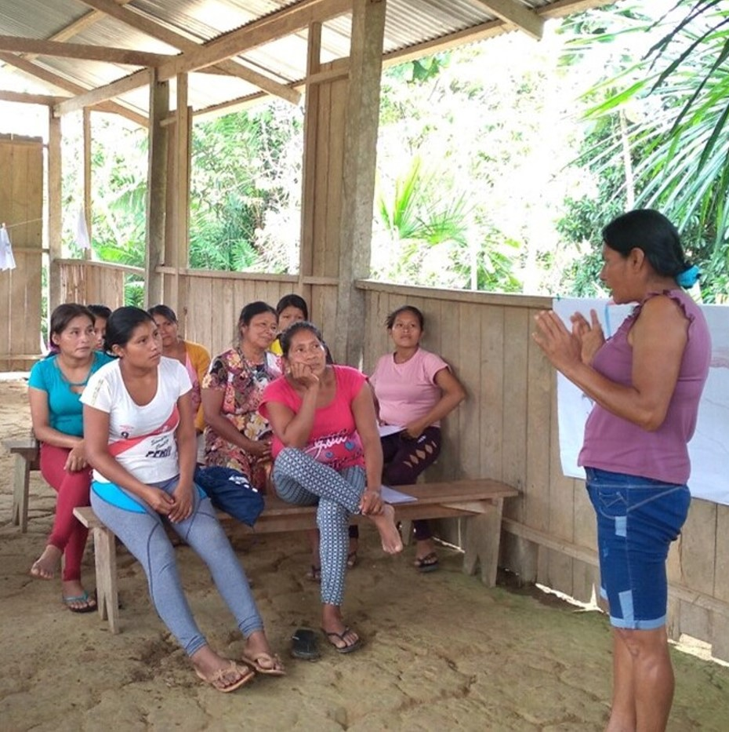
Tuesday 5 December
“In his days justice shall flourish,
and peace till the moon fails.”
Psalm 71
  May justice flourish
  On the 9 August we celebrated the International Day of the World’s Indigenous Peoples. In Peru, around 25% of the population identify as indigenous and it is common for their human rights to be violated.
  CAFOD partner CAAAP has been defending indigenous women’s rights in the Amazon by helping them to share and revalue their ancestral practices and express themselves through art.
5
Notes:
Picture Credit: Indigenous women learning about their indigenous culture and rights in Shapijim Community, Peru. Photo: CAAAP

Slide 8
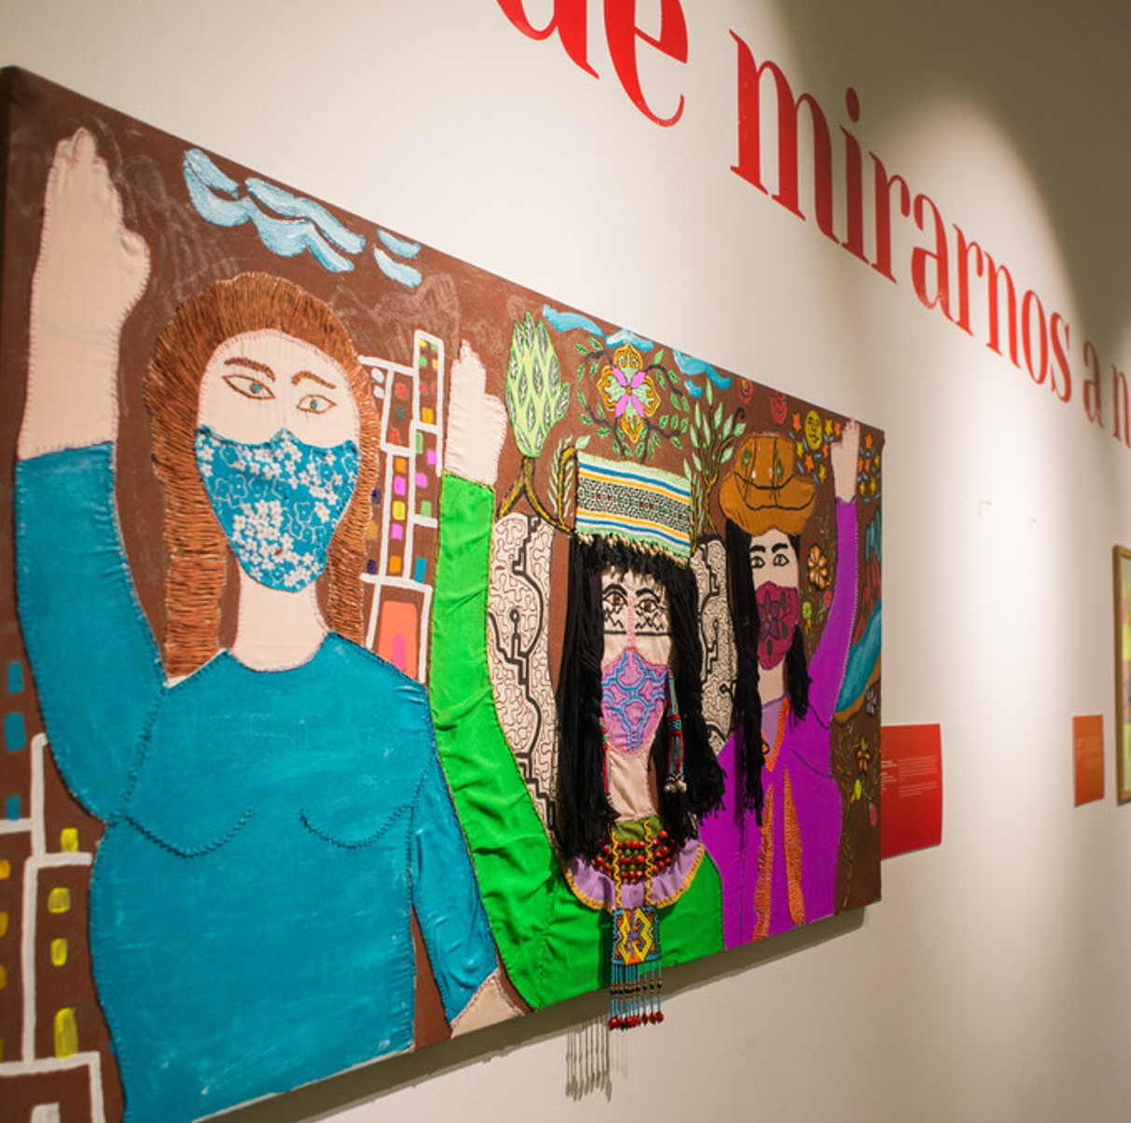
  The work of our partner organisation to bring justice means that these women are flourishing. The art exhibition was titled, “I can walk, I can fly!”
  God’s kingdom is already breaking through! But get ready, there’s more to be done…
  How can you help justice to flourish?
  Holy Spirit, as I spend a few minutes in prayer, place on my heart an issue where I can help justice to flourish. Amen.
“In his days justice shall flourish,
and peace till the moon fails.”
Psalm 71
5
What words do you associate with justice? Make a list with your class.
Notes:
Picture credit: “Equality” by indigenous artist Sadith Silvano, Peru.

Slide 9
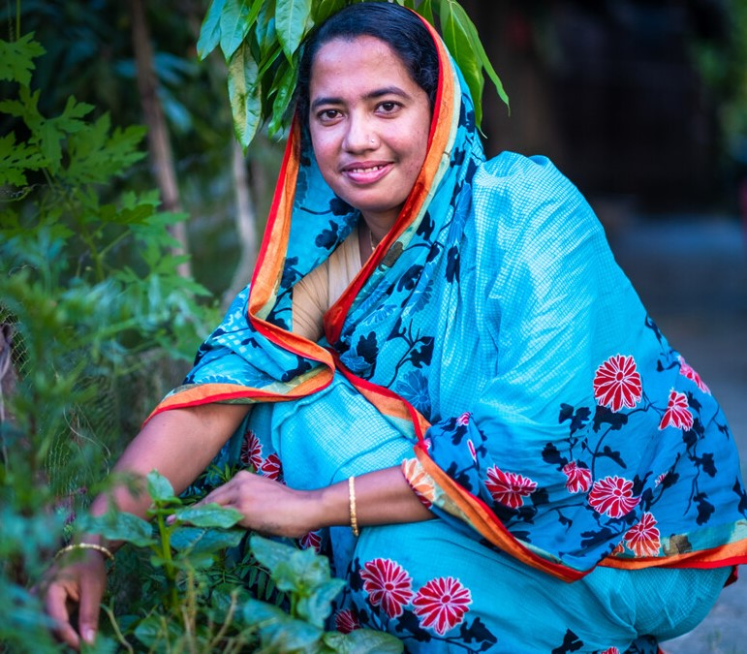
Wednesday 6 December
“The Lord of hosts will prepare for all peoples a banquet of rich food... rich and juicy”
Isaiah 25:6
  An abundant feast
  We’re preparing all the food for Christmas.
  Shukla lives in an eco-village in Bangladesh where she loves growing delicious fruits and vegetables, without the need for harmful chemicals. Being in the garden was a restorative activity after her husband's death triggered depression.
  God provides for people. Shukla had to provide food for her son, but eco-farming techniques transformed her life in multiple ways.
6
Notes:
Image: Amit Rudro

Slide 10
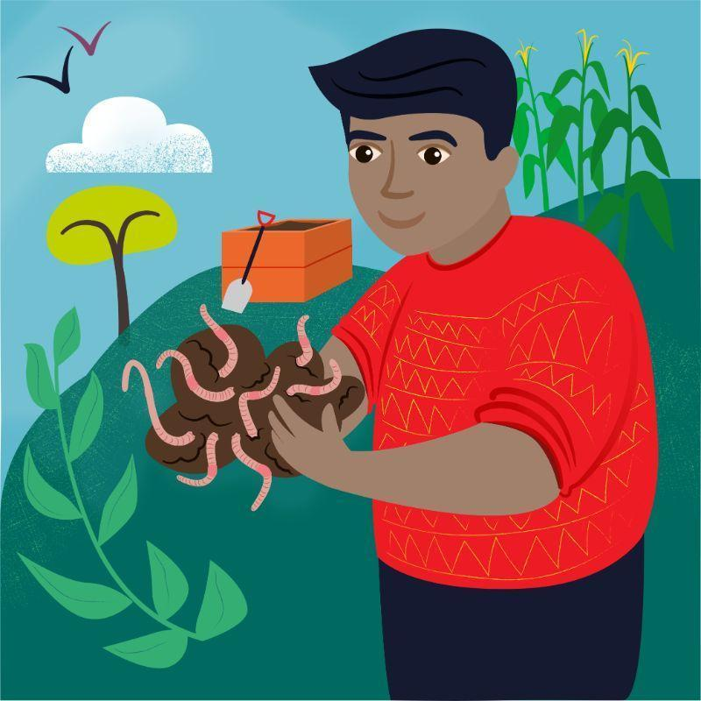
  The prophet Isaiah promises that God will prepare a feast for all people.
  CAFOD’s global network supports communities struggling with food poverty.
  You can give the gift of food to someone who really needs it through World Gifts. Why not buy a vegetable garden, a self-watering garden or… some worms for vulnerable farmers! Yes, worms!
  Lord, as you prepare the feast, I will lay the table. Let me take part in your big vision. Amen.
“The Lord of hosts will prepare for all peoples a banquet of rich food... rich and juicy”
Isaiah 25:6
6
Wonderful Worms
£10
Decide which of the World Gifts your class might buy as you prepare for Christmas.
Notes:
Image: World Gifts, CAFOD

Slide 11
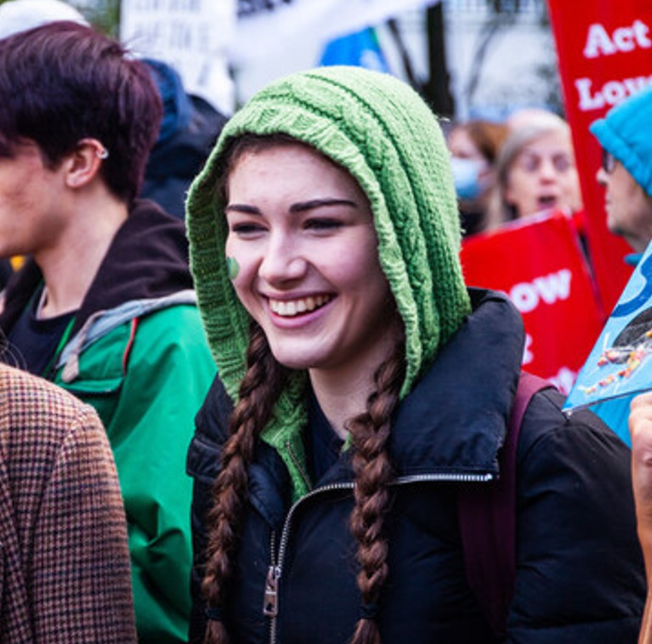
Thursday 7 December
“Everyone who listens to these words of mine and acts on them...”
Matthew 7:24
  Taking action
  First, we listen to Jesus’ words. Then we act. Listen to Matthew 7 being read out in full and then have a short discussion about the following themes:
  - integrity
  - being curious
  - wisdom
  And then we take action. CAFOD has been encouraging young people to demand change.
7
1
Notes:
Picture credit: Thom Flint/CAFOD

Slide 12

In Laudato Si’ Pope Francis says;
“Love, overflowing with small gestures of mutual care, is also civic and political, and it makes itself felt in every action that seeks to build a better world.”
Why not order a free CAFOD ‘Young People Demand Change’ poster using the link below and ask your class teacher to stick it in your classroom.
“Everyone who listens to these words of mine and acts on them...”
Matthew 7:24
7
1
  Lord, as we pause to consider your words, may we be inspired to reflect them in our actions.
  Amen.
Order a free ‘Young People Demand Change’ poster here.
Notes:
Picture credit: Thom Flint/CAFOD

Slide 13
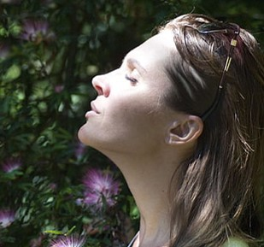
Friday 8 December
The Immaculate Conception
“Mary, do not be afraid...”
Luke 1:26-38
  Deep breaths
  Have you ever been afraid? How did you react?
  In the Bible there are many stories of how people reacted to being afraid. Mary responded by asking the angel, ‘How will it happen?’
  When we are afraid, we’re often encouraged to take deep breaths. To protect our air quality, we need to protect our trees. It is estimated there are over 400 billion trees in the Amazon.
8
Notes:
Picture credit: Wallpaper Flare
Facts: https://www.wwf.org.uk/learn/fascinating-facts/amazon

Slide 14
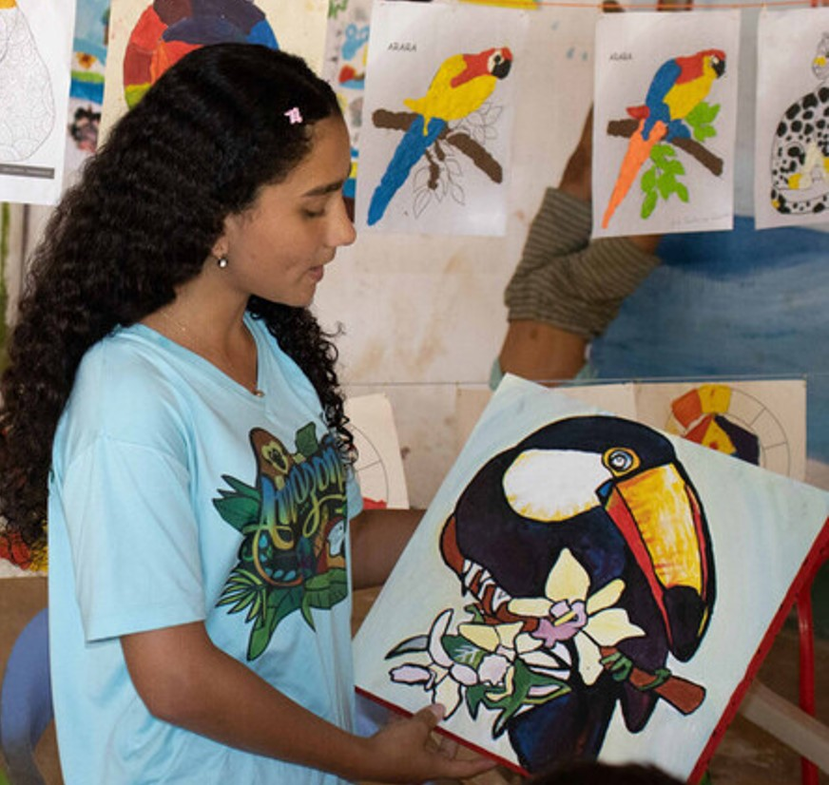
CAFOD’s partner, FUNVIPAS, have been running a project where “local communities are learning to protect and defend the Amazon” using “a sustainable, integral ecology approach”.
Some of the participants have been drawing pictures as part of the workshop. The President of the Children’s Council says it's important to protect the Amazon and the environment, “because it is the lungs of the world, the habitat of many animals, and it is our source of life.”
“Mary, do not be afraid...”
Luke 1:26-38
8
  Lord, sometimes we feel so overwhelmed. Help us to trust you so we respond in a way that honours you. Thank you for FUNVIPAS who are responding to global issues in practical and creative ways.
  Amen
Find out about our Forest School World Gift.
Notes:
Picture credit: FUNVIPAS

Slide 15
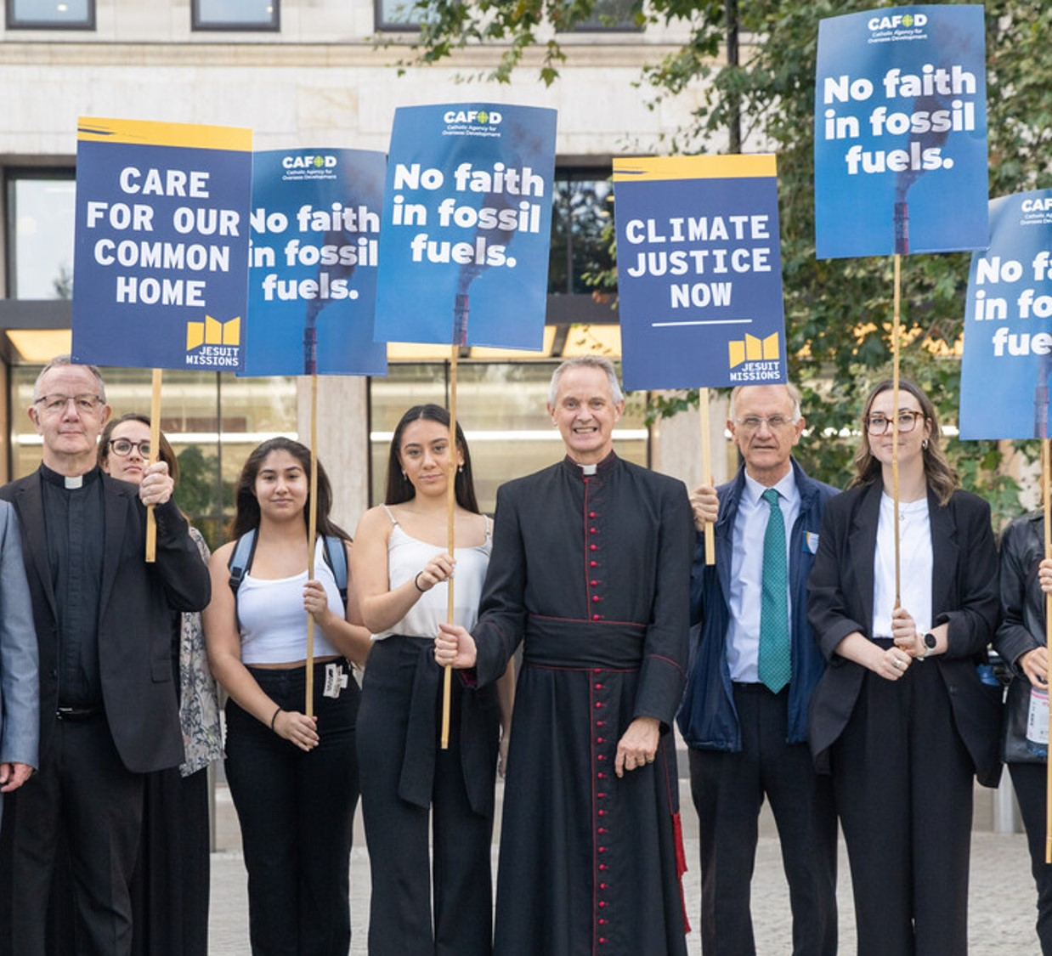
Monday 11 December
“We have seen
strange things today.”
Luke 5:26
  Stranger things
  No, not the TV show…! CAFOD’s campaign team did something strange recently. They marched to the headquarters of BP and Shell to present them with a fake blue plaque.
  Blue plaques are placed on buildings where someone famous has lived. You might have seen one when you have visited a major city.
  Walking through the streets of London with placards and plaques, many people look at you probably thinking “What are they doing?”
11
11
Notes:
Picture credit: Louise Norton, CAFOD

Slide 16

  This plaque is not celebrating a good thing though. These companies will be remembered for their negative impact on the climate.
  Jesus was very used to being told he was doing strange, unusual things. He often got into trouble with the religious leaders of the day – they could not understand why he spent his time healing people and forgiving sins.
  Lord, thank you for setting us an example. You weren’t scared to do your work on earth, even if others thought that was strange.
  Amen.
“We have seen
strange things today.”
Luke 5:26
5
11
Do some research and answer this question. What is the link between Shell and Fortnite?
Notes:
Picture credit: Louise Norton, CAFOD

Slide 17
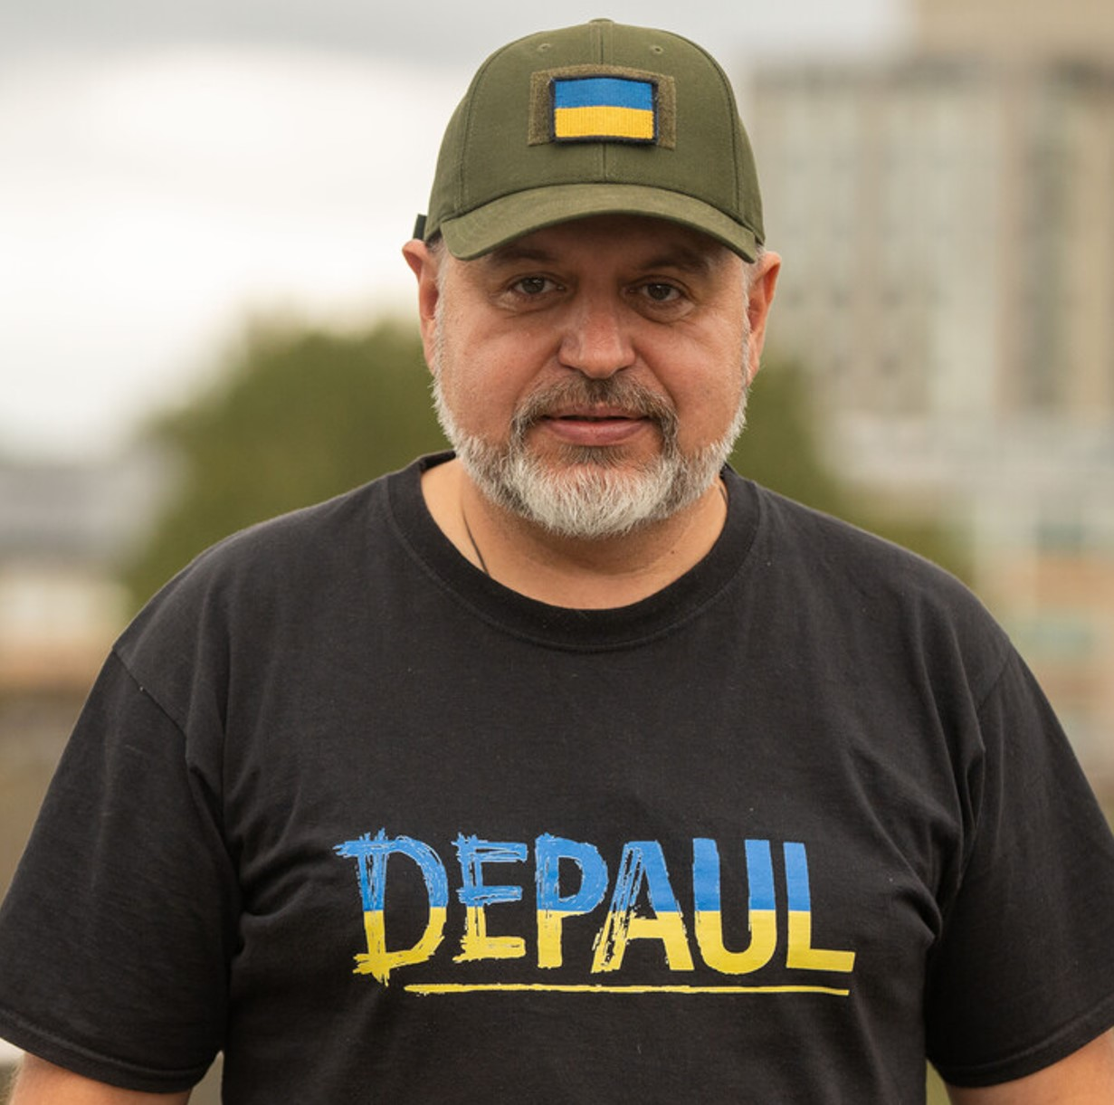
Tuesday 12 December
“‘Console my people,
console them,’
says your God.”
Isaiah 40:1
  Consolation
  This is Father Vitaliy, the CEO for DePaul Ukraine, one of CAFOD’s partners. He oversees all programmes including humanitarian distribution, family accommodation, emergency shelters, day centres, welfare rights support, and programmes that support vulnerable people during winter.
  Today we are reminded that we should console all people. In Ukraine consolation looks like practical support in the form of food baskets.
12
Notes:
Picture credit: Joe Newman, CAFOD

Slide 18
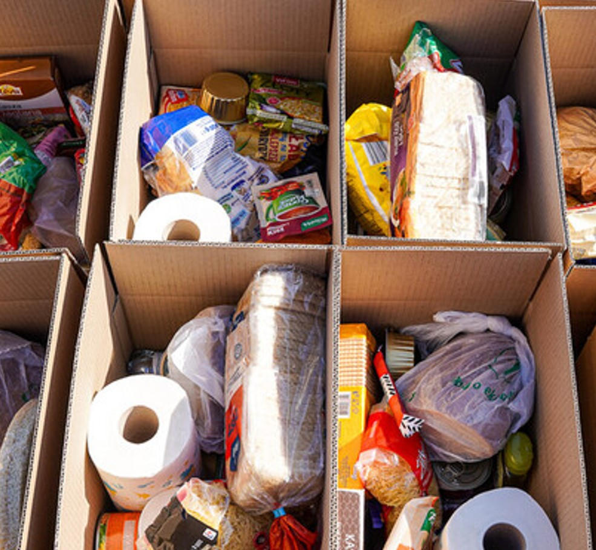
  Think about somebody you know who is struggling today. How could you console them with words and practical support?
  Here are some ideas…
  - offering to make lunch/dinner for them
  - taking time to write a card or a letter instead of just sending a text
  Can you think of other ideas?
  Lord, help me to be present to the needs of others; bearing one another's burdens and consoling them in their hour of need.
  Amen.
“‘Console my people,
console them,’
says your God.”
Isaiah 40:1
12
Continue to pray with us for peace in Ukraine.
Notes:
Picture credit: Caritas Poland

Slide 19
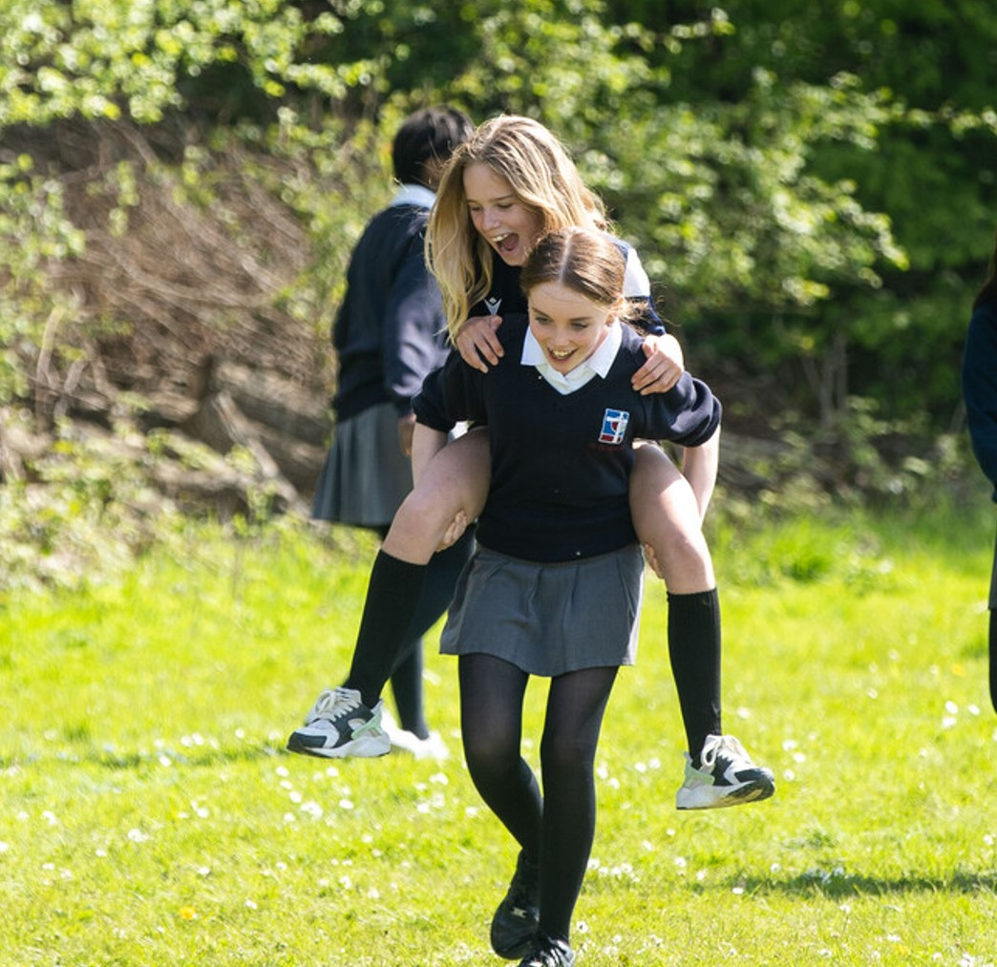
Wednesday 13 December
“Shoulder my yoke, and learn from me...”
Matthew 11:28-30
  Miles of commitment
  During Lent, CAFOD asked schools to take part in the Big Lent Walk.
  St Gregory’s School in Tunbridge Wells were one of the 100 secondary schools that took part. Does a piggy-back count?!
  650 schools signed up which means around 250, 000 students took part and raised money for CAFOD. Thank you everyone!
  Did your school get involved?
13
Notes:
Picture credit: Thom Flint

Slide 20
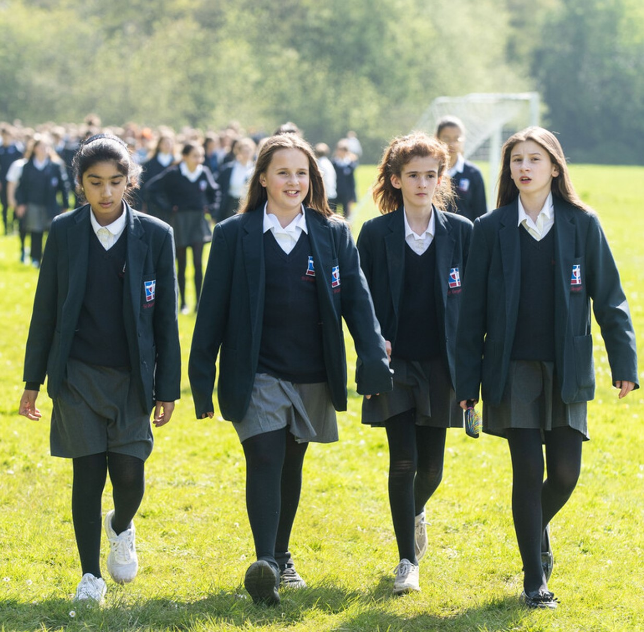
“Shoulder my yoke, and learn from me...”
Matthew 11:28-30
  In today’s gospel, Jesus tells us that his yoke (an ancient way to carry a burden) is easy and light. In other words, if we are trying to follow Jesus, the things we do will feel less difficult.
  Thousands of you ‘shouldered your yoke’ during Lent to walk.
  CAFOD want to be like Christ’s hands and feet in the world, unburdening those who face heavy burdens. Will you support Big Lent Walk in 2024? Use the link below to sign up your school.
  Lord, sometimes I feel like I am carrying many burdens, which means walking through life feels exhausting. I name them silently in my heart now as I look to you. Amen.
13
Sign up for Big Lent Walk by clicking here.
Notes:
Picture credit: Joe Newman, CAFOD

Slide 21
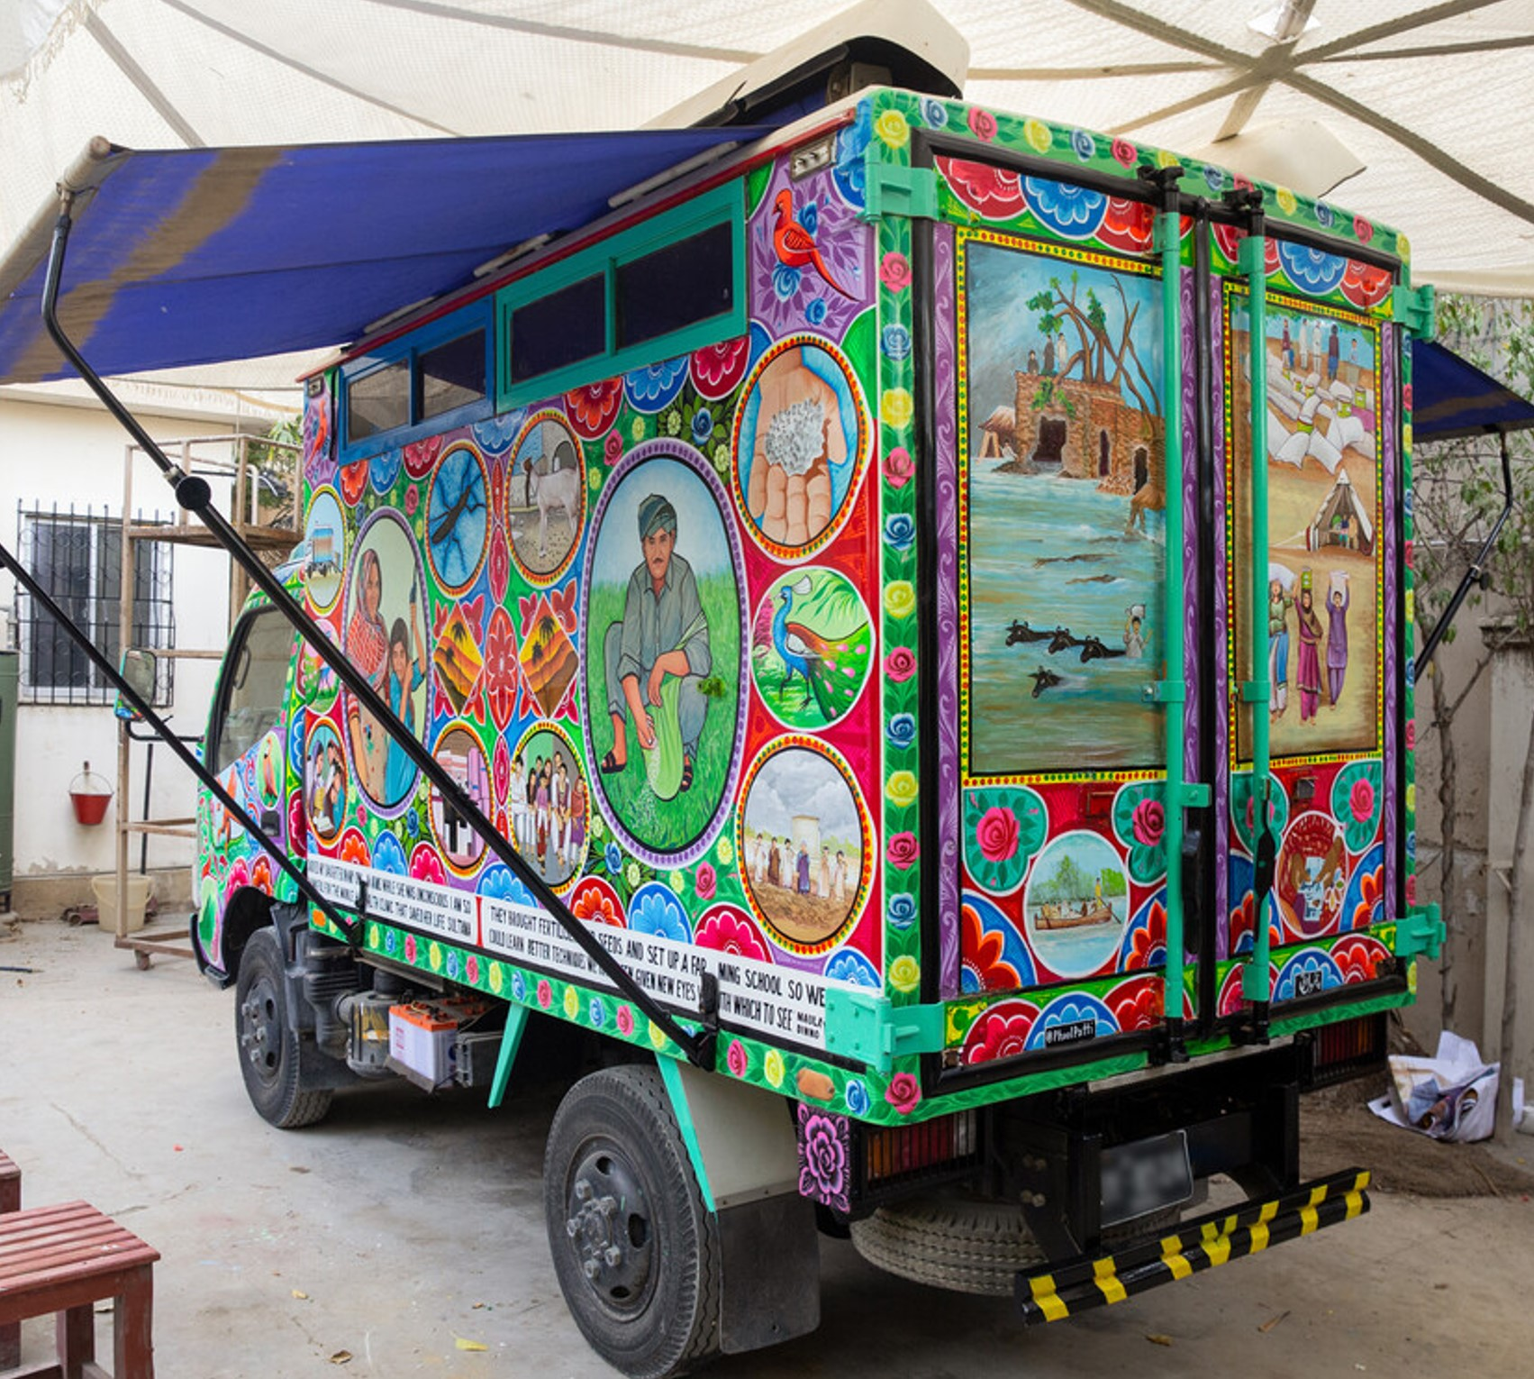
Thursday 14 December
“Do not be afraid,
I shall help you.’’
Isaiah 41: 13
  A helping hand
  Did your school Brighten Up Harvest? We shared the story of the amazing mobile health unit which travels around helping those affected in the Pakistan floods. The custom in Pakistan is for vans to be painted bright colours and and this one includes pictures illustrating the stories of families supported by the van.
  Can you imagine what it must be like for people who are in desperate need to see this colourful van? They know help is on the way. Apparently, there are often queues as people wait to see Dr Nasha.
14
Notes:
Picture credit:
Community World Service Asia (CWSA)

Slide 22
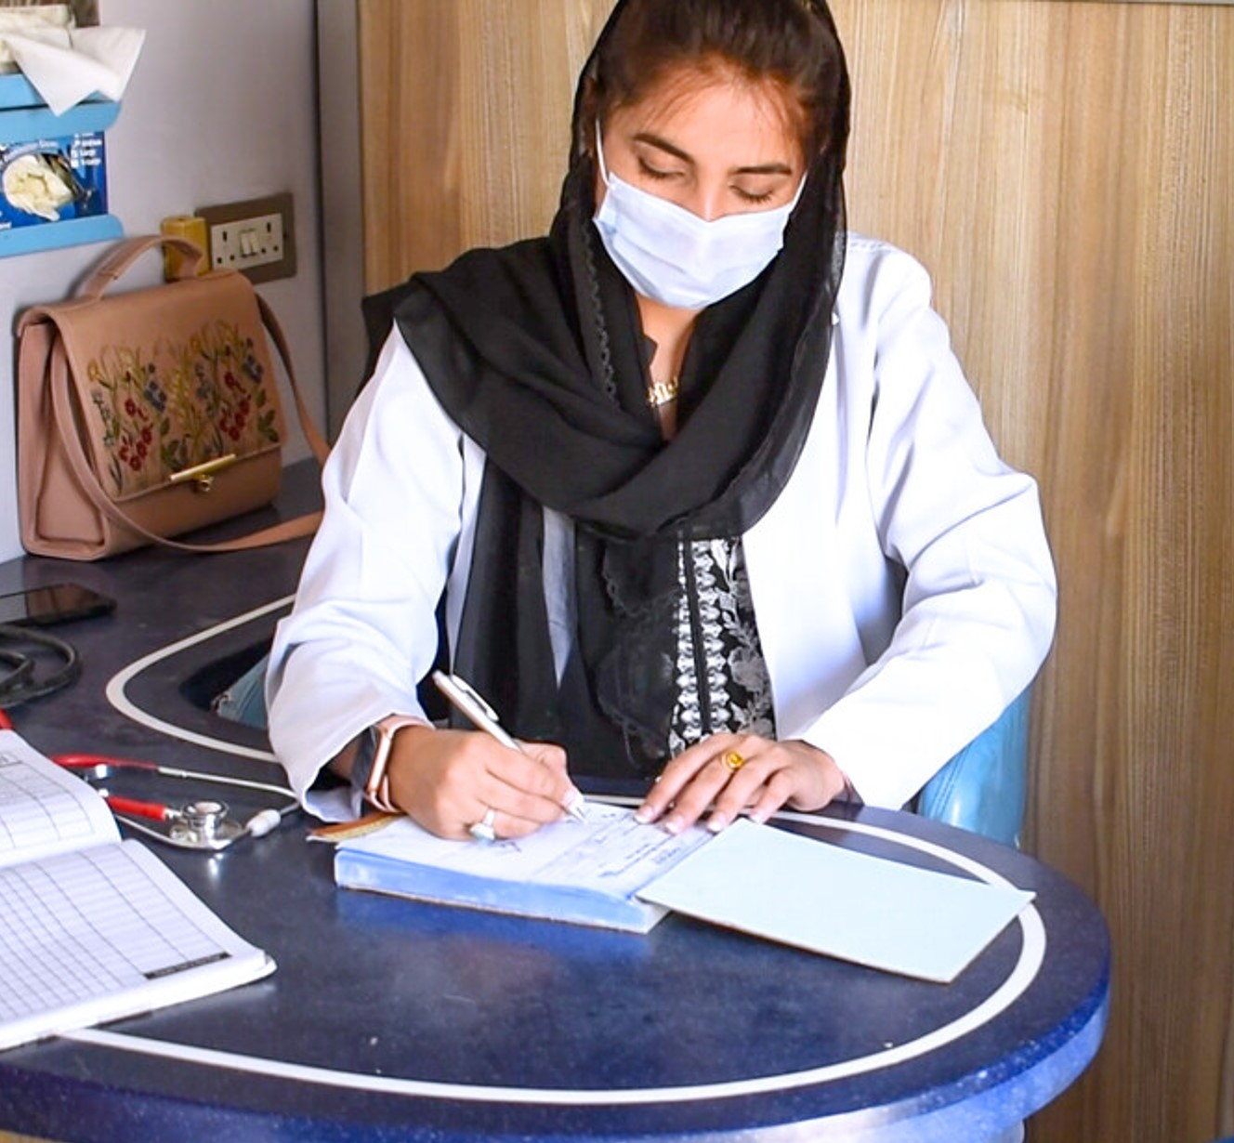
  The global organisation that supported Pakistan is called the Disasters Emergency Committee. CAFOD is a member. When a country experiences a very complex disaster the DEC helps co-ordinate the response between charities. This committee exists to provide help.
  Today’s reading tells us not to be afraid. God will help us. He often directs other people to provide this help, globally and locally. If you are someone needing a bit of extra support, do tell a trusted adult.
  Lord, thank you for all those that provide help in times of crisis. Amen.
“Do not be afraid,
I shall help you.’’
Isaiah 41: 13
14
Watch our Harvest video again to remind yourself of Dr Nasha’s story.
Notes:
Picture credit: Louise Norton

Slide 23

Friday 15 December
“I, the Lord your God… lead you
in the way that you must go.”
Isaiah 48:17
  Finding the way
Rooted in the teachings of Jesus and Catholic Social Teaching, the LiveSimply Award is encouraging children and young people to live simply, live sustainably and live in solidarity with the world’s poorest communities.
Over 600 schools, from 20 different dioceses, are taking faith inspired actions to achieve the award. Their achievements will impact the lives of their school, local, and global communities and they are encouraging the wider community to join them in their endeavours.
15
Notes:
Illustrations: Kieran O’Brien

Slide 24
Responding to Pope Francis’ encyclical Laudato Si’, schools are “hearing the cry of the earth and the cry of the poor” and putting their faith into action as global citizens of our common home.
Can you live simply, sustainably and in solidarity this Advent and beyond?
“I, the Lord your God… lead you
in the way that you must go.”
Isaiah 48:17
15
  Lord, as I spend some time in prayer, lead me to an area of my life which I might need to adapt so I can respond to “the cry of the earth and the cry of the poor”. Perhaps it’s how I spend my money, the products I buy or the way I use technology. Help me to follow your way.”
Find out about the LiveSimply Award for schools.
Notes:
Illustrations: Kieran O’Brien

Slide 25
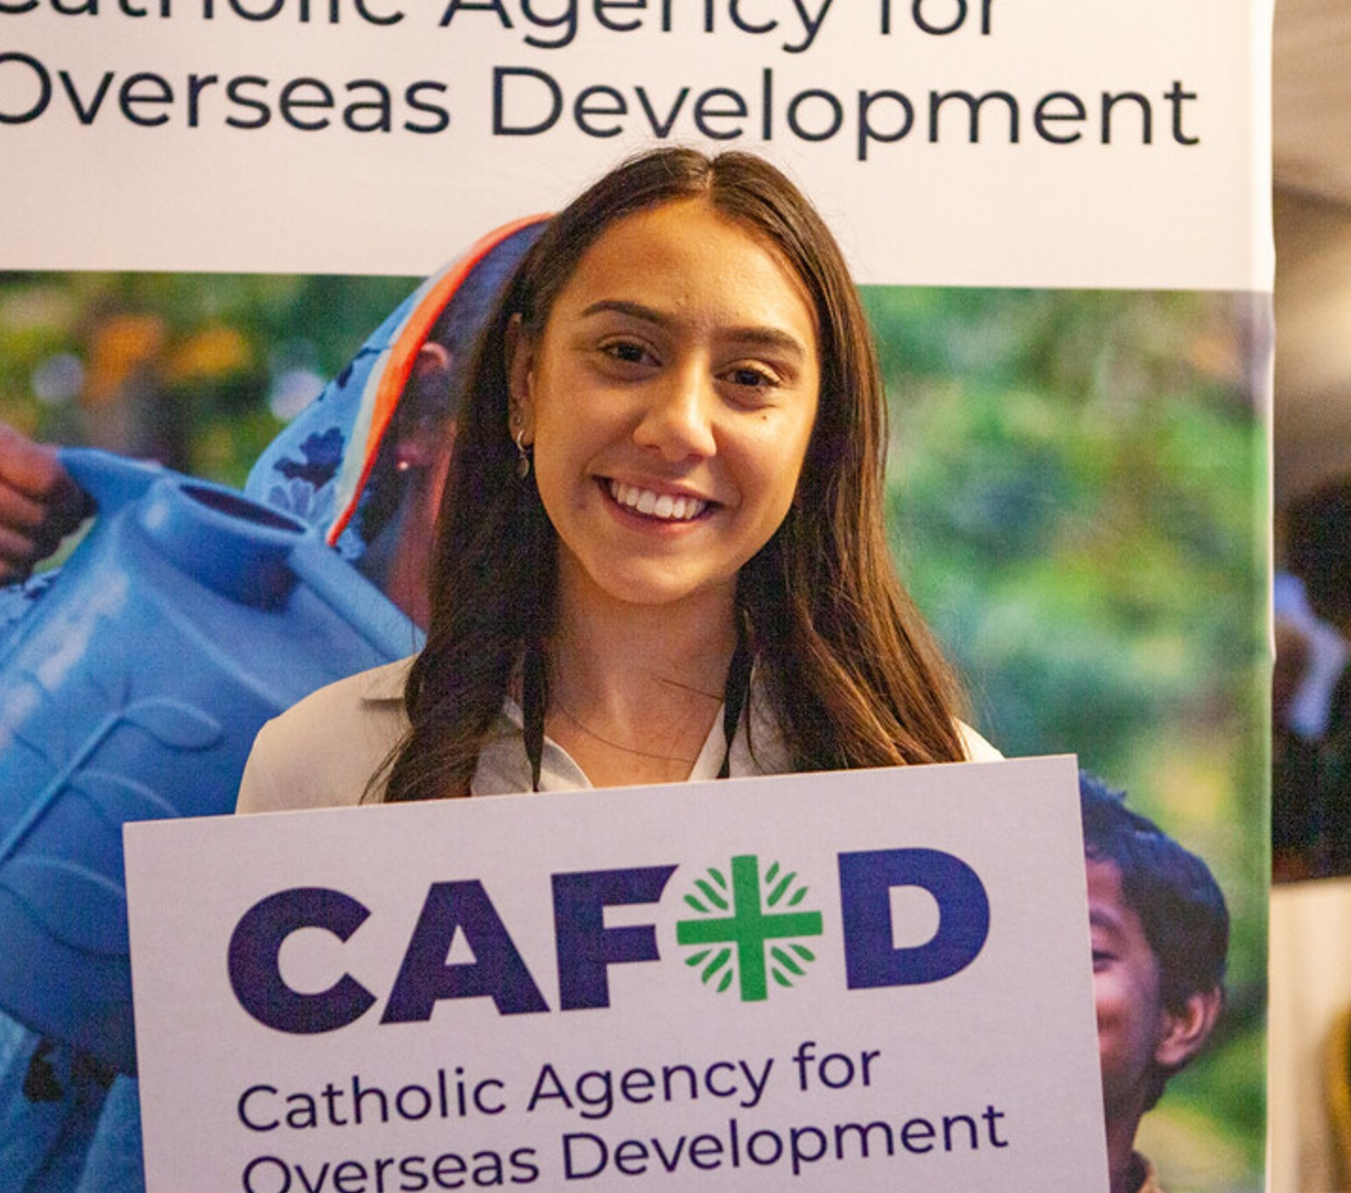
Monday 18 December
International Migrants’ Day
“I will raise a virtuous Branch for David who will reign as true king and be wise.”
Jeremiah 23:5
  Looking to the future
  Ciara is CAFOD’s parliamentary assistant. She is working with CAFOD, via the Catholic Bishops’ Conference Faith in Politics internship scheme, to give young people the opportunity to explore their vocation in public life.
  She says “CAFOD gives a platform to young people, taking the time to engage with schools and not only listening to them but amplifying their voices.”
18
Notes:
Picture credit: Louise Norton, CAFOD

Slide 26
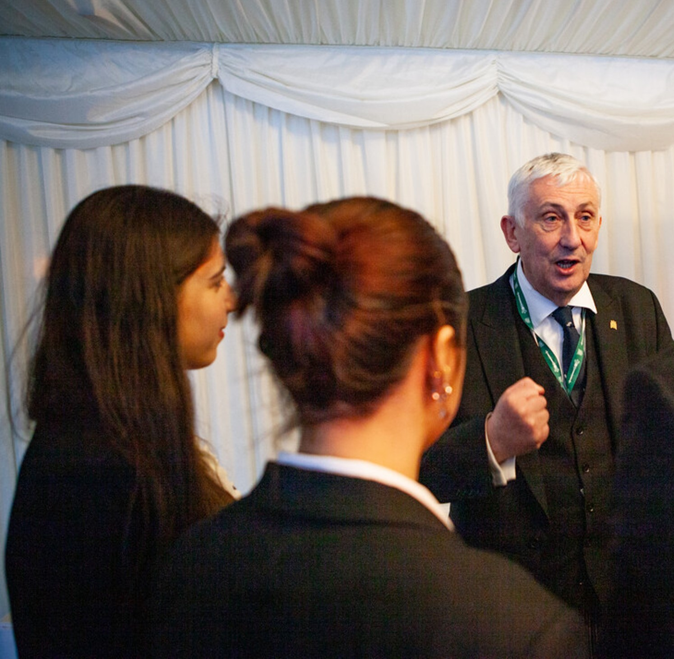
  The reading reminds us that Jesus was exalted as the true King. God raised him up.
  Ciara recently gave a keynote address at a parliamentary reception. Lindsey Hoyle, Speaker of the House of Commons, spoke to our young leaders. Ciara wants young people to know, “We can make a difference”.
  What might God be calling for you to speak up about?
  Lord, how we use our voice matters to you. Help us to speak truth and wisdom to all we meet. Amen.
“I will raise a virtuous Branch for David who will reign as true king and be wise.”
Jeremiah 23:5
18
Is CAFOD's agenda for change similar to your vision for the world?
Notes:
Picture credit: Louise Norton, CAFOD

Slide 27
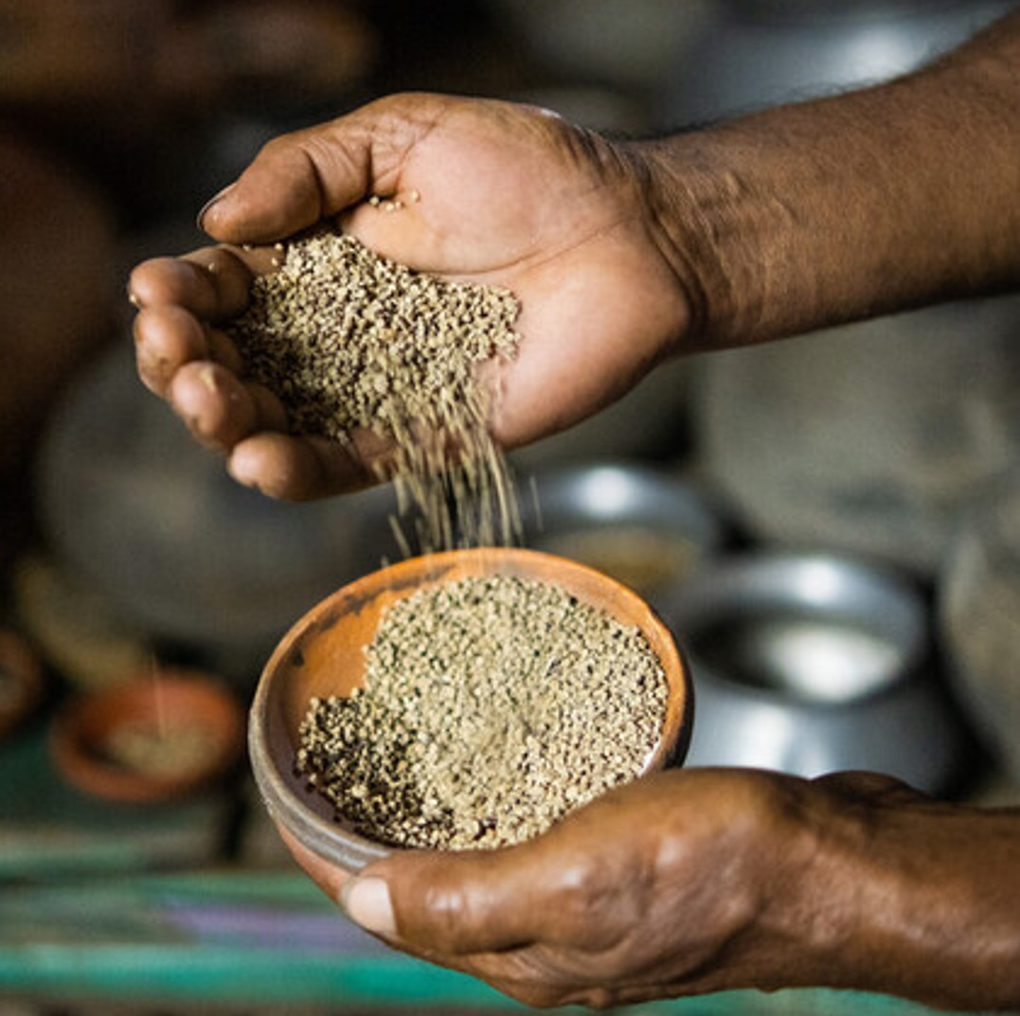
Tuesday 19 December
“The Lord has done this
for me...”
Luke 1:25
  Faithful prayers
  They might be small but seeds are the starting point for food production.
  Farmers need a wide diversity of seeds to grow the food that is needed for the world’s population. But the current seed system is not working for low- and lower-middle income countries. CAFOD has been researching and writing to the UK government about this issue.
19
Notes:
Picture credit: Amit Rudro

Slide 28
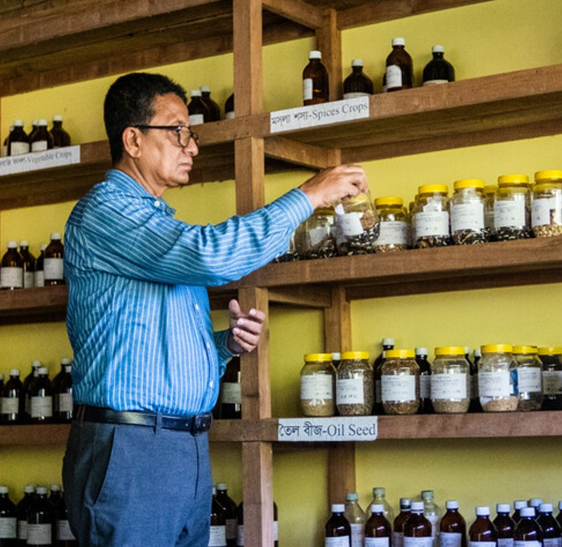
  Agriculture is a key sector for many countries. Seeds can change lives.
  Jony works for CAFOD partner UBINIG which runs a Community Seed Wealth Centre in Tangail, Bangladesh. They conserve and distribute native seeds to farmers using ecologically friendly methods. This means farmers can take back control from large companies, grow more reliable crops in adverse climates, and earn more for their produce.
  Living God,
  ‘In the seed uncurling and the sparkle of fast water, we feel the flourishing of our own lives’. Amen.
  Lord, I’m sorry I sometimes avoid your call. Help me to change course and serve others as you did. Amen.
“The Lord has done this
for me...”
Luke 1:25
19
Watch CAFOD’s seed sovereignty video to learn more.
Notes:
Picture credit: Amit Rudro
Prayer credit: Pascale Palmer, CAFOD

Slide 29
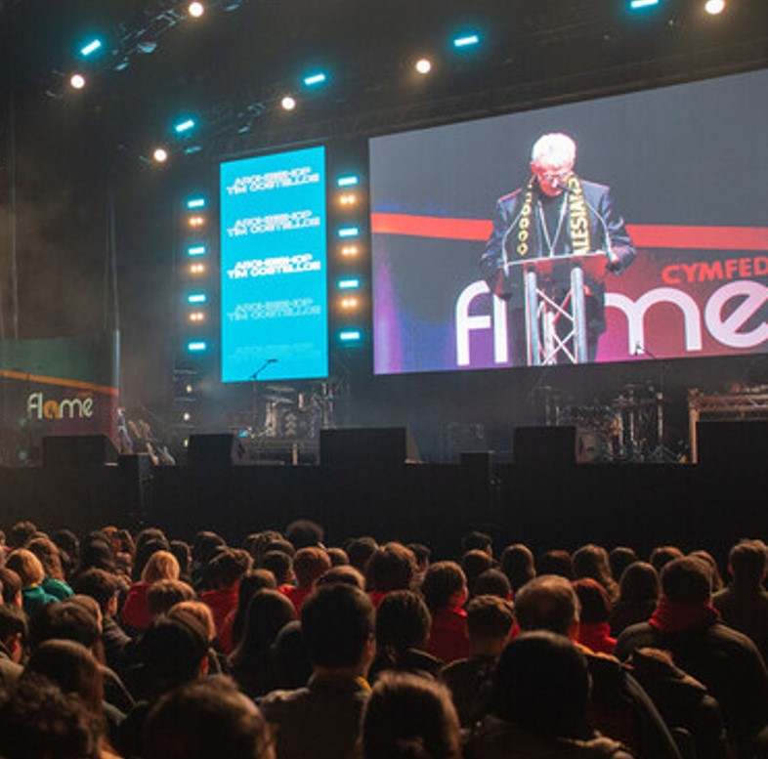
Wednesday 20 December
“Nothing is impossible to God.”
Luke 1:37
  Rise Up
  CAFOD were at the Flame conference organised by CYMFed. The theme was ‘Rise Up’, reminding us that when we are willing God can use us to do wonderful things.
  Around 8,000 young people attended Wembley Arena in London. There were activities, music and speakers. Imagine the positive impact 8,000 young people could have in their local communities and worldwide.
20
Notes:
Picture credit: Joe Newman

Slide 30
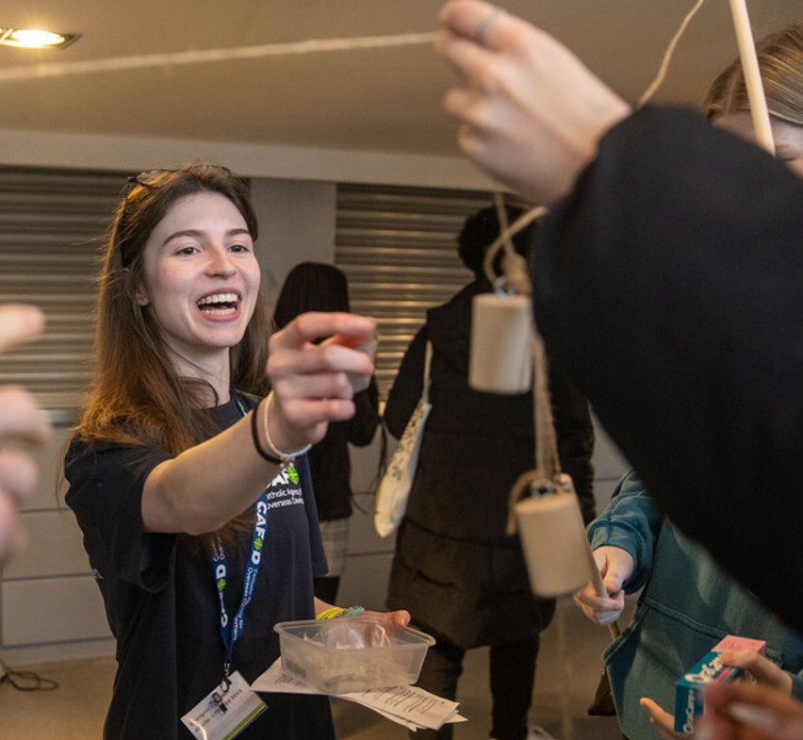
  In today’s passage we are reminded that nothing is impossible to God.
  Do you have a story when something you thought was impossible suddenly changed?
  Pope Francis says “May we carry out our responsibility of building an authentic peace, attentive to the real needs of individuals and peoples, capable of preventing conflicts through a cooperation that triumphs over hate and overcomes barriers through encounter and dialogue… Nothing is impossible if we turn to God in prayer.”
  Lord, thank you for reminding us nothing is impossible when we seek you.
  Amen
“Nothing is impossible to God.”
Luke 1:37
20
Notes:
Picture credit: Joe Newman
Source: Pope Francis Visit to Assisi for the World Day of Prayer for Peace “Thirst for Peace. Faiths and Cultures in Dialogue” (20 September 2016) | Francis (vatican.va)

Slide 31
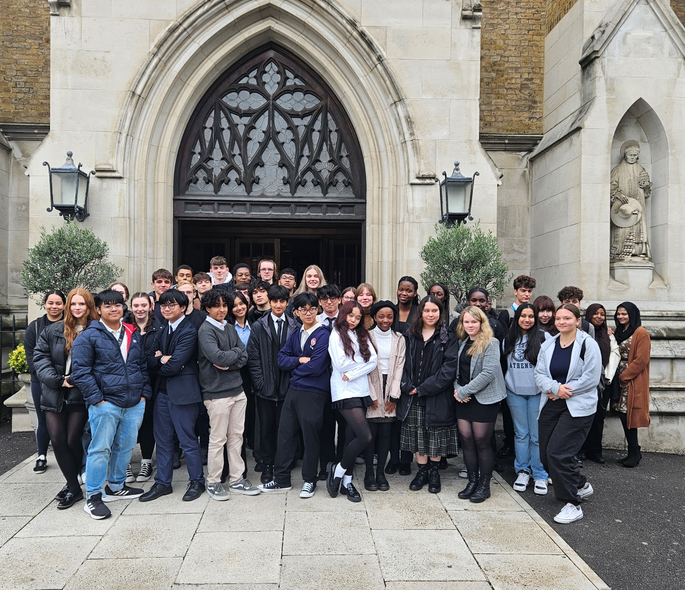
Thursday 21 December
“Blessed is she who believed that the promise made her by the Lord would be fulfilled.”
Luke 1:45
  Young leaders
  This term CAFOD’s young leadership programme started again.
  Brentwood, Southwark and Westminster dioceses came to Romero House for their initial training.
  During our “Match the stats” activity where students are asked to estimate global figures relating to poverty, one student said “These are big numbers.” Sometimes the situation can seem very dire.
  But CAFOD believes that God has promised this is not the end of the story.
21
Notes:
Picture credit: CAFOD

Slide 32
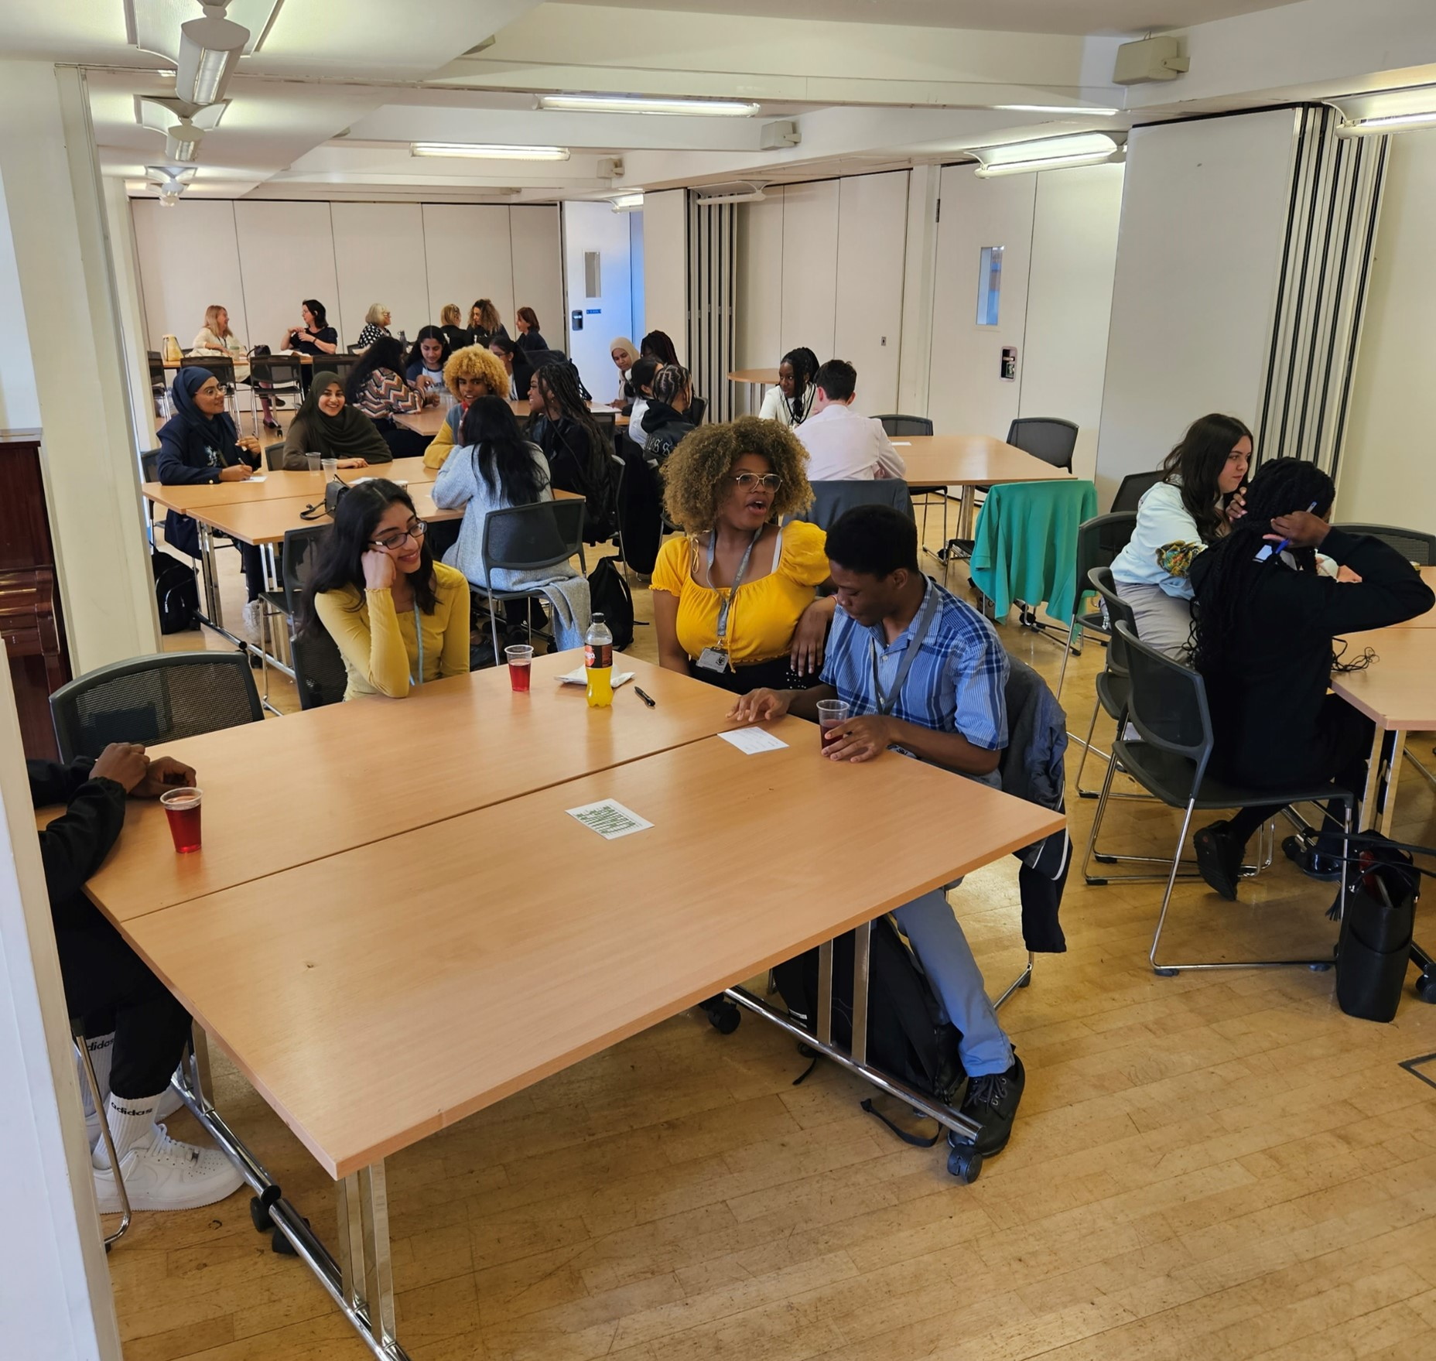
  God has promised he will make all things new, but he needs us to respond – like Mary – and to believe this promise.
  The angel told Mary that Elizabeth was pregnant. When she travelled to Elizabeth’s home she did so in faith – remember she didn’t have a phone to ring and check! Mary had to get up and go. Today’s Bible verse is what Elizabeth said to Mary when she saw her. She congratulated Mary on her faith.
  It’s not easy to believe God is at work – that’s what faith is!
  Lord, help me hold fast to your promises and to act in faith. Amen.
“Blessed is she who believed that the promise made her by the Lord would be fulfilled.”
Luke 1:45
21
The statistics are slowly changing. Watch the Global goals video.
Notes:
Picture credit: CAFOD

Slide 33
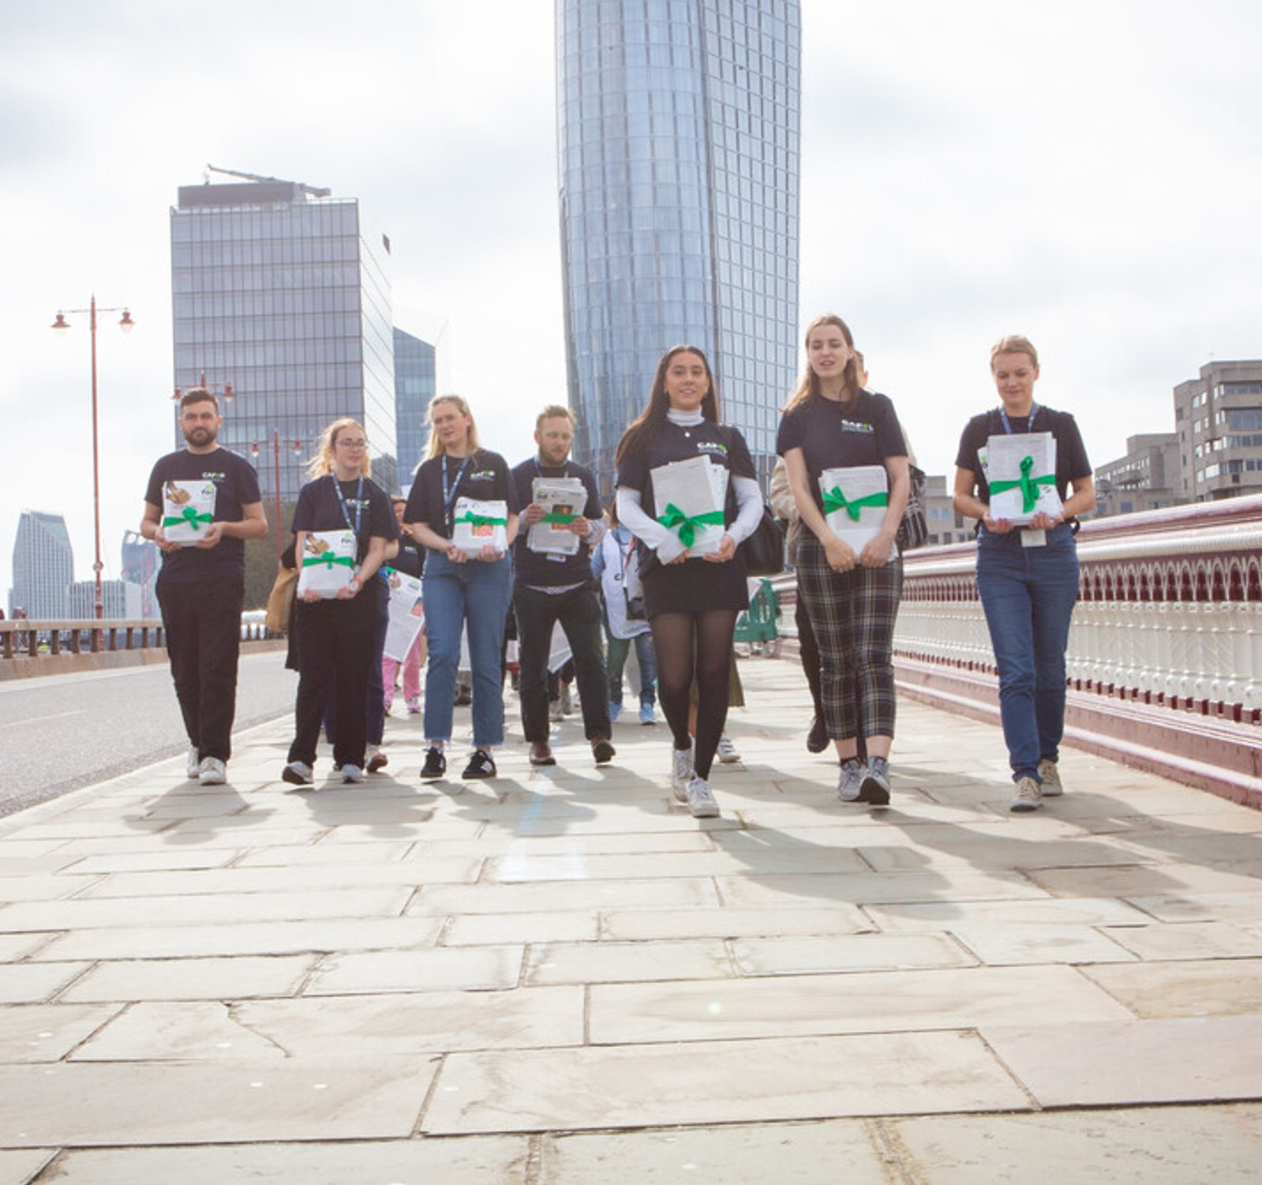
Friday 22 December
“He has pulled down princes from their thrones and exalted the lowly.”
Luke 1:52
  Earlier on in our Advent journey we learnt about how important seeds were to farmers.
  This year CAFOD delivered petitions to the World Bank headquarters. 70,000 Catholics signed the petition to stop big corporations capturing the seeds.
  As today’s scripture reminds us big companies often overpower smaller businesses. Can you think of an example of this happening?
  Fix the food system
22
Notes:
Salma is a pseudonym.
Picture credit: Louise Norton, CAFOD

Slide 34
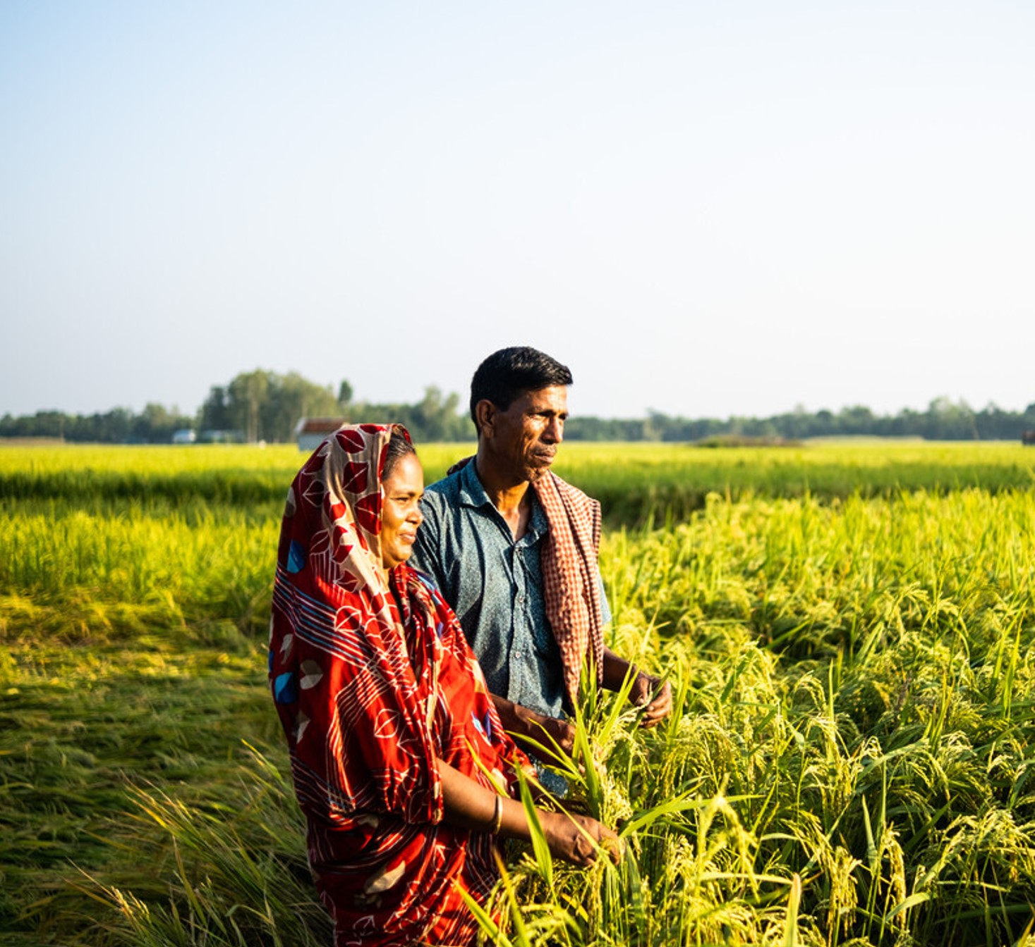
  In this photograph we can see Salina and her husband.
  Small farmers like Salina are using seeds banks to let them choose what crops are most appropriate for them. Her methods have allowed her to grow healthier, more sustainable food that provides for her family and goes for a higher price at her local market.
  Jesus, we live in a world where corporations make eye-watering amounts of money every year. Help us as we campaign for distributive justice. Amen.
“He has pulled down princes from their thrones and exalted the lowly.”
Luke 1:52
22
Why not use our Young People Demand Change assembly in your school.
Notes:
Picture credit:

Slide 35
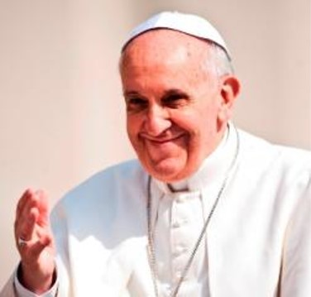
Sunday 24 December
Fourth Sunday of Advent
Christmas Eve
“…the child will be holy and will be called Son of God.”
Luke 1:35
  Living Word
  In October Pope Francis released Laudate Deum. An apostolic exhortation is a teaching document from the pope, which often aims to encourage a virtue or activity.
  Pope Francis says, “Let us stop thinking, then, of human beings as autonomous, omnipotent and limitless, and begin to think of ourselves differently, in a humbler but more fruitful way.”
  By looking at Jesus, the Son of God, we see how human beings should act.
24
Notes:
Picture credit: Mazur/Catholicnews.org.uk

Slide 36
  Jesus was holy and humble. You might want to read Philippians 2 to learn more about this.
  What does humility look like in our modern world?
  In Laudate Deum Pope Francis suggests humans need to change the way we view ourselves in relation to the natural world.
  Holy Spirit, we want to make our mind like that of Christ Jesus who demonstrated humility throughout his life; from the humble stable to the humility of the cross. Today we come to worship him. Amen.
“…the child will be holy and will be called Son of God.”
Luke 1:35
24
Watch the Laudate Deum video here
Notes:
Picture credit: Mazur/Catholicnews.org.uk

Slide 37
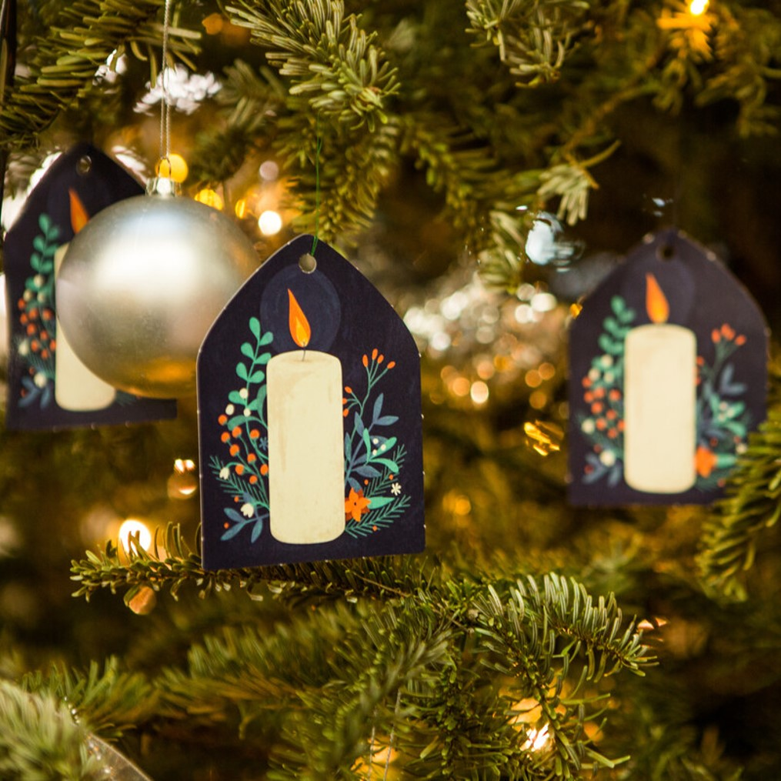
Monday 25 December
Christmas Day
“The people that walked in darkness has seen a great light.”
Isaiah 9:1
  Light of the world
  The central white candle is lit on the Advent wreath at church today to celebrate Christ’s birth and the hope that it holds for our world.
  The picture shows our Christmas tree at CAFOD’s office, Romero House, in London.
  Candlelight is a powerful image.
  Saint Francis of Assisi said:
  “All the darkness in the world cannot extinguish the light of a single candle.”
25
Notes:
Picture credit: Thom Flint

Slide 38
  Today we thank God for the light and hope he gives us in Jesus.
  We pray that God will help us to shine that light into situations of injustice so that, together, we can build a world where everyone can live life to the full.
  Like the shepherds – we rejoice!
  Infant Jesus, you embrace our poverty and transform it. Empower me with hope to live and share your good news for all.
  Amen.
“The people that walked in darkness has seen a great light.”
Isaiah 9:1
25
Say a grace before Christmas lunch to give thanks for all God’s blessings.
Notes:
Picture credit: Thom Flint

Slide 39
Thank you for journeying with us this Advent.
Everyone at CAFOD wishes you a happy and blessed Christmas.
Picture credits: See notes fields of the slides
Notes:
Picture credit: Thom Flint

