Slide 1
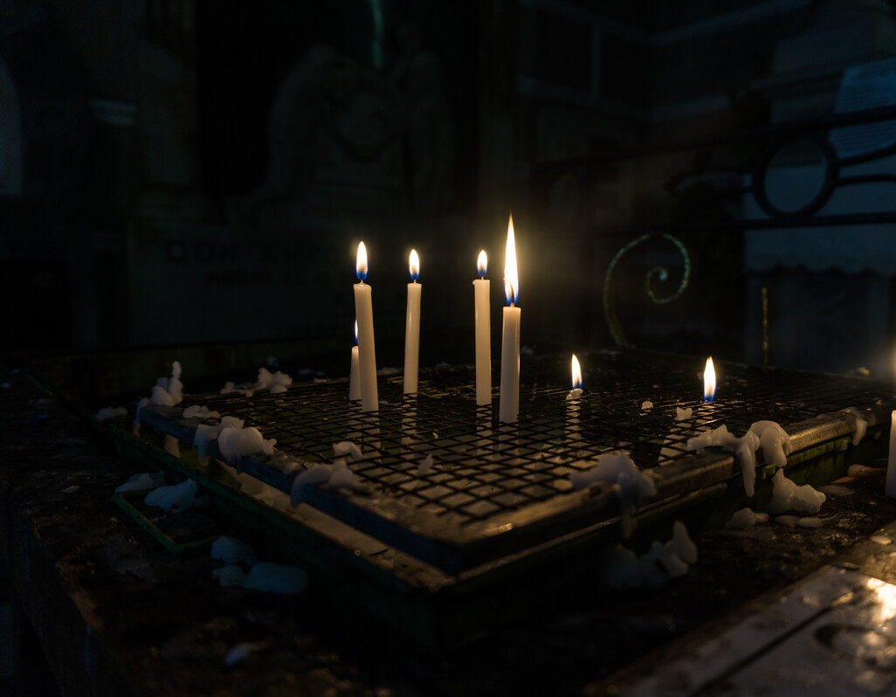
Notes:
Leader:
In the name of the Father, and of the Son, and of the Holy Spirit, Amen.
The four weeks of Advent are a time of preparation and of waiting – waiting for the return of Christ at the end of time; and waiting to celebrate once again the birth of Jesus in Bethlehem.
So, we gather to begin our time of waiting and preparation. Together we will share our story of God who - before time began – loved us, chose to come among us, and knew that we would gather here today. It is a story that ends in light but begins in darkness.
Photo credit: Hannah Caldwell, Candles in St Augustine Church Manila (2018)

Slide 2
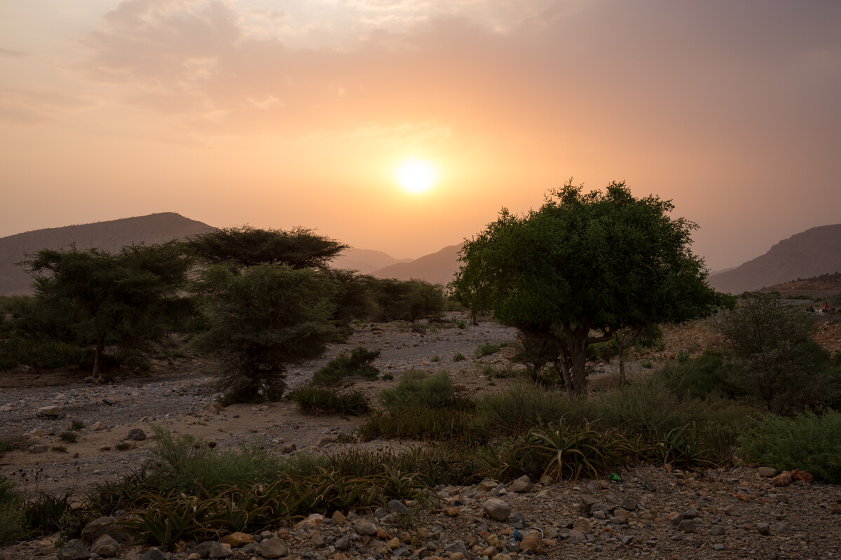
All:
We who watch for that day may inherit the great promise in which now we dare to hope.
Notes:
Prayer credit: Roman Missal
Photo credit: CAFOD

Slide 3
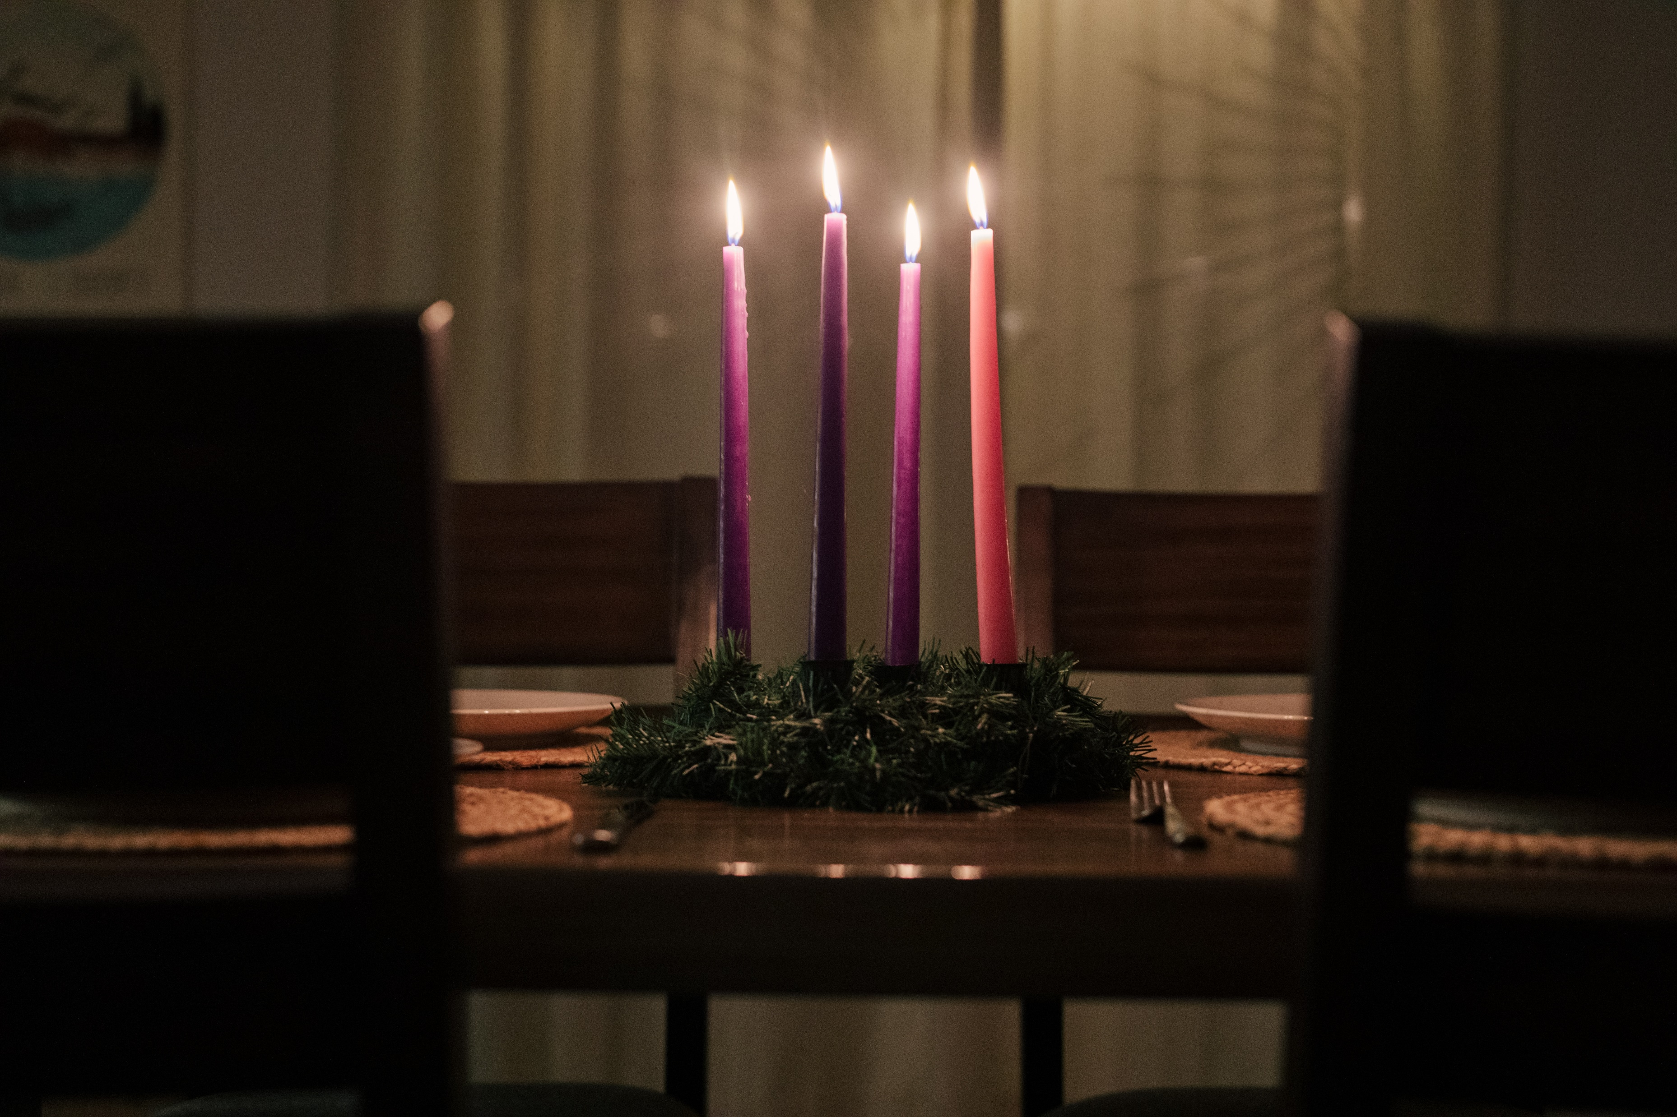
The lighting of the first candle
God of hope,
We look to you for our identity, our purpose and our fulfilment. We root ourselves in your love so we can reflect you in all that we do and say.
We pray for our friends, families and brothers and sisters across the world. May our words bring hope to desperate or uncertain situations. We might not always know the outcome but we faithfully bring it before you in prayer.
We surrender it to you, O God of hope. This Advent time we pray, ‘Come, Lord Jesus’.
Amen.
Notes:
Leader: (As the first purple candle is lit) As we light the first purple candle we are reminded that Advent is a journey from darkness to light and brings with it the reminder that even in the darkness of injustice, conflict and poverty there is always hope. Let us pray together:
All:
God of hope,
We look to you for our identity, our purpose and our fulfilment. We root ourselves in your love so we can reflect you in all that we do and say.
We pray for our friends, families and brothers and sisters across the world. May our words bring hope to desperate or uncertain situations. We might not always know the outcome but we faithfully bring it before you in prayer.
We surrender it to you, O God of hope. This Advent time we pray, ‘Come, Lord Jesus’.
Amen.
Prayer credit: Grant Whitty, Unsplash

Slide 4
We are waiting for our Lord Jesus Christ to be revealed.
1 Corinthians 1: 7
Notes:
Scripture Reading: 1 Cor 1:3-9
³ Grace to you and peace from God our Father and the Lord Jesus Christ.⁴ I am continually thanking God about you, for the grace of God which you have been given in Christ Jesus;⁵ in him you have been richly endowed in every kind of utterance and knowledge;⁶ so firmly has witness to Christ taken root in you.⁷ And so you are not lacking in any gift as you wait for our Lord Jesus Christ to be revealed;⁸ he will continue to give you strength till the very end, so that you will be irreproachable on the Day of our Lord Jesus Christ.⁹ You can rely on God, who has called you to be partners with his Son Jesus Christ our Lord.
Photo credit: Aaron Bird, Unsplash

Slide 5
Notes:
Leader: Advent is a journey that we each make, a journey that is often full of the bright lights of distraction – present buying, food shopping, decorating our homes. This year we have seen more and more people displaced through war, conflict and natural disasters. Pope Francis asks us to hold in prayer all people who are making journeys during Advent with a specific focus on migrants.
Now we shall watch this video and pray for International Migrants Day

Slide 6
Time for silent prayer to remember International Migrants.
Notes:
Suggested music: The Brilliance, Advent Collection.

Slide 7
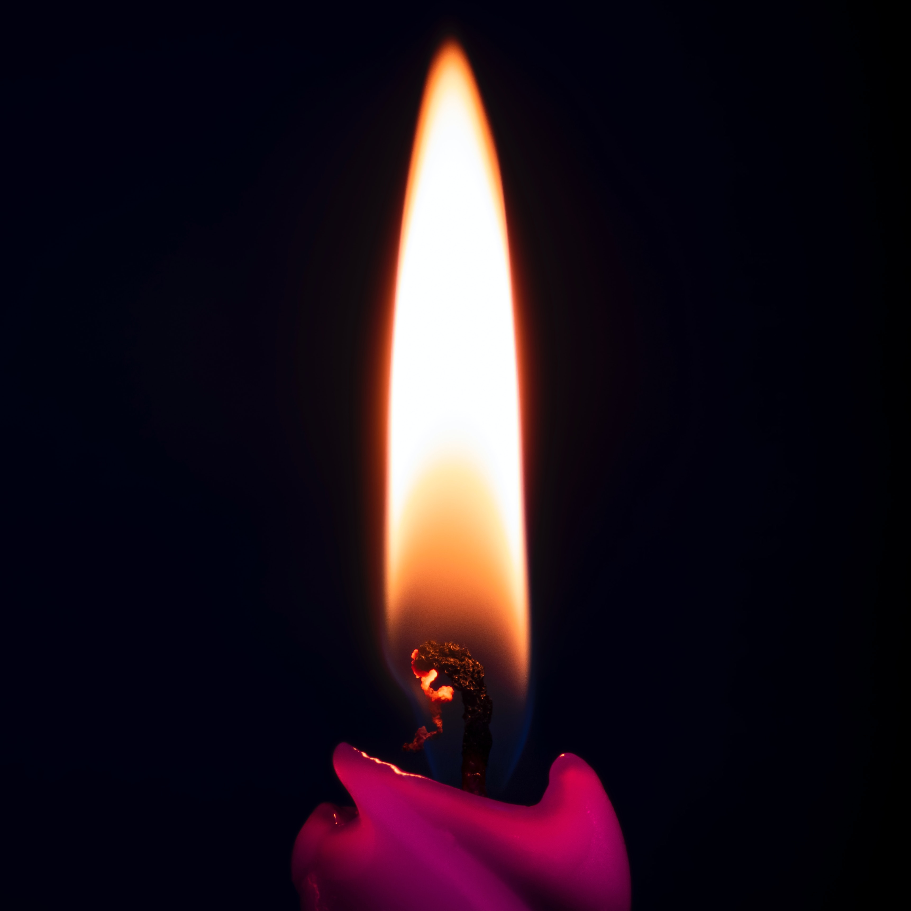
The lighting of the second candle
God of peace
As we prepare to celebrate your birth may we find time to quieten our hearts and our minds in this busy world.
We to look to you, the Prince of Peace.
Your peace informs us.
Your peace soothes us.
Your peace releases us.
Your peace blesses us.
Your peace passes all understanding. It can transform hearts and lives. It has the power to bring healing to communities that are deeply divided. It is a gift to a broken world.
Lord, may we be witnesses to this indescribable peace.
Amen.
Notes:
Leader: (As the second purple candle is lit) As we light the second purple candle we are reminded that our journey to the stable continues. We are still very much in preparation mode with the reminder that we should prepare our hearts and minds as well.
Let us pray together:
All:
God of peace
As we prepare to celebrate your birth may we find time to quieten our hearts and our minds in this busy world.
We to look to you, the Prince of Peace.
Your peace informs us.
Your peace soothes us.
Your peace releases us.
Your peace blesses us.
Your peace passes all understanding. It can transform hearts and lives. It has the power to bring healing to communities that are deeply divided. It is a gift to a broken world.
Lord, may we be witnesses to this indescribable peace.
Amen.
Photo credit: Alexander Fastovets, Unsplash

Slide 8
We are waiting for a new heaven and new earth
2 Peter 3: 8-14
Notes:
Scripture Reading: 2 Pet 3:8-14
⁸ But there is one thing, my dear friends, that you must never forget: that with the Lord, a day is like a thousand years, and a thousand years are like a day. ⁹ The Lord is not being slow in carrying out his promises, as some people think he is; rather is he being patient with you, wanting nobody to be lost and everybody to be brought to repentance. ¹⁰ The Day of the Lord will come like a thief, and then with a roar the sky will vanish, the elements will catch fire and melt away, the earth and all that it contains will be burned up. ¹¹ Since everything is coming to an end like this, what holy and saintly lives you should be living ¹² while you wait for the Day of God to come and try to hasten its coming: on that Day the sky will dissolve in flames and the elements melt in the heat. ¹³ What we are waiting for, relying on his promises, is the new heavens and new earth, where uprightness will be at home. ¹⁴ So then, my dear friends, while you are waiting, do your best to live blameless and unsullied lives so that he will find you at peace.
Photo credit: Aaron Bird, Unsplash

Slide 9
Time to pray silently about anything that might be worrying you.
Notes:
Suggested music: The Brilliance, Advent Collection.

Slide 10
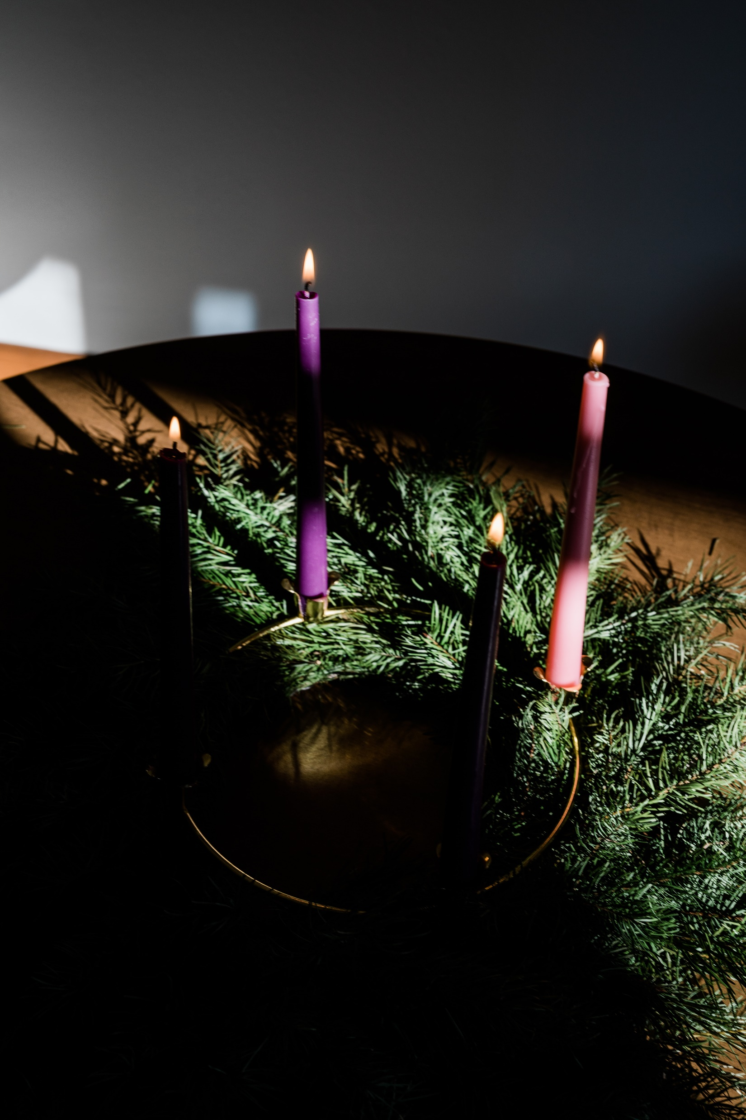
The lighting of the third candle
God of light,
Open our eyes to a new vision
Of a kingdom that centres around you.
Your radiant light breaking through the darkness and bringing joy.
Let your light touch all those who walk in darkness at this time. We pray for all those living in conflict and the injustice of poverty.
May they find comfort in your promises. May they find strength in your presence.
May they find direction through your word.
As we wait expectantly for you, O Lord, please heal the divisions of this world as we seek true and lasting peace.
We hold before you all who cry out for peace.
Amen.
Notes:
Leader: (As the third (pink) candle is lit) Let us pray together.
All:
God of light,
Open our eyes to a new vision
Of a kingdom that centres around you.
Your radiant light breaking through the darkness.
Let your light touch all those who walk in darkness at this time. We pray for all those living in conflict and the injustice of poverty.
May they find comfort in your word and promises. May they find strength in your presence.
May they find direction through your word.
As we wait expectantly for you, O Lord, please heal the divisions of this world as we seek true and lasting peace.
We name the countries who are experiencing war and conflict.
We hold before you all who cry out for peace.
Amen.
Photo credit: Grant Whitty, Unsplash

Slide 11
He has sent me to bring news to the afflicted, to soothe the broken-hearted…
Isaiah 6: 1
Notes:
Scripture Reading: Isaiah 61: 1-2a
¹ The spirit of The Lord is on me for The Lord has anointed me. He has sent me to bring the news to the afflicted, to soothe the broken-hearted,
² to proclaim liberty to captives, release to those in prison, to proclaim a year of favour from The Lord.
Photo credit: Aaron Bird, Unsplash

Slide 12
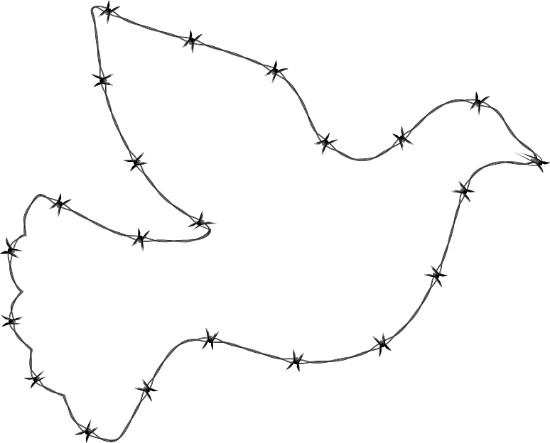
This dove has been drawn with an outline representing barbed wire. This is a reminder to pray for peace where there is division.
Write the names of countries or communities which need God’s peace.
You can keep them in your pocket as a reminder to pray throughout the day.
Notes:
Leader: This dove has been drawn with an outline representing barbed wire. This is a reminder to pray for peace where there is division. Write the names of countries or communities which need God’s peace. You can keep them in your pocket as a reminder to pray throughout the day.

Slide 13
Notes:
Leader: We are called to be prophetic voices bringing light to others. If we listen carefully enough we can hear the whisper of God in the lives of others. It gives us hope that God is at work bringing light to all situations. Let’s hear about how God is using Isacko to help the community he grew up in.

Slide 14
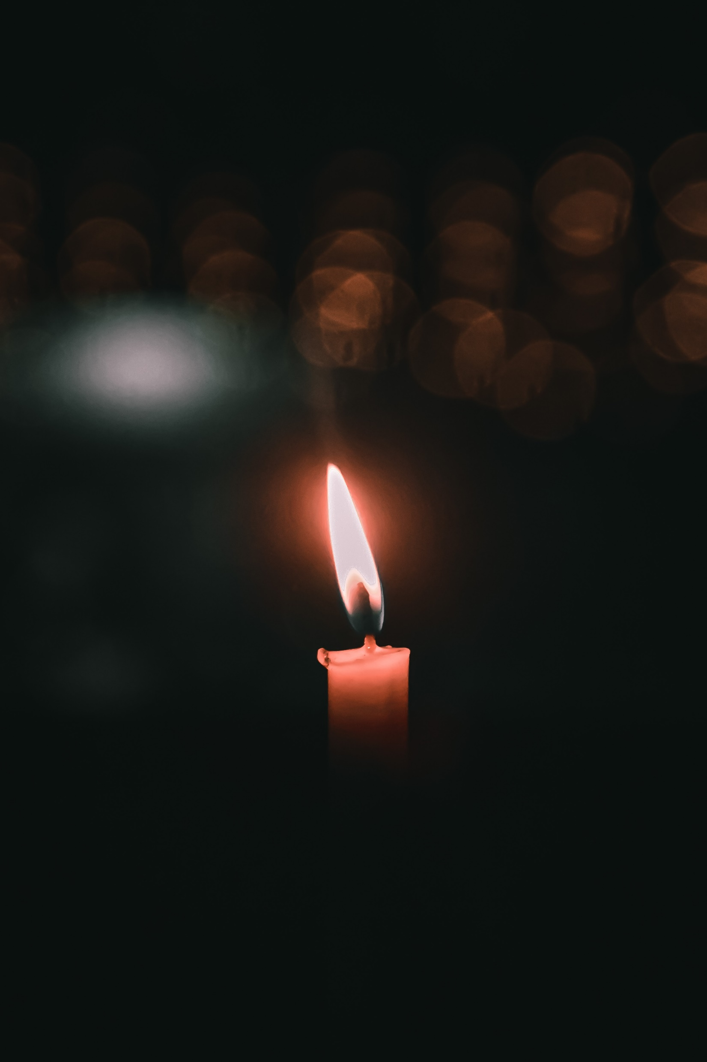
The lighting of the fourth candle
God of love and mercy,
You sent your son to be Emmanuel, God with us, and restored our relationship with you.
Merciful Lord, we pray for the natural world; the areas that are suffering because of our modern lifestyles. We cry out for our common home. May our lives convey the need to stand in solidarity with the whole of creation.
We long for a day when all of creation will be restored. We wait expectantly for you O Lord.
In your mercy, hear our prayer.
Notes:
Leader: (As the first purple candle is lit) Let us pray together:
All:
God of love and mercy,
You sent your son to be Emmanuel, God with us, and restored our relationship with you.
Merciful Lord, we pray for the natural world; the areas that are suffering because of our modern lifestyles. We cry out for our common home. May our lives convey the need to stand in solidarity with the whole of creation.
We long for a day when all of creation will be restored. We wait expectantly for you O Lord.
In your mercy, hear our prayer.

Slide 15
The mystery, which was kept secret for endless ages, is now made clear.
Romans 16: 27-28
Notes:
Scripture Reading: Rom 16:25-27
²⁵ And now to him who can make you strong in accordance with the gospel that I preach and the proclamation of Jesus Christ, in accordance with that mystery which for endless ages was kept secret ²⁶ but now (as the prophets wrote) is revealed, as the eternal God commanded, to be made known to all the nations, so that they obey in faith: ²⁷ to him, the only wise God, give glory through Jesus Christ for ever and ever. Amen.
Photo credit: Aaron Bird, Unsplash

Slide 16
Notes:
Leader: The Pope recently wrote Laudate Deum to remind us all of our obligations to care for our common home. We’ll now have a time of reflection using this prayer based on Laudate Deum.
Music credit: The Beat of Nature, Music by Olexy from Pixabay
Prayer credit: Catherine Gorman, CAFOD

Slide 17
All: God of light
God of hope
God of peace
God of love
Hear our prayer
Notes:
Leader: Let us say together our closing prayer.
All: God of light
God of hope
God of peace
God of mercy
Hear our prayer
Leader: We go out, taking with us the light of the world.
All: In the name of the Father, and of the Son, and of the Holy Spirit. Amen

