Slide 1
Sacramental Survey of Priests in the Killaloe Diocese

Slide 2
Diocese of Killaloe Sacramental Group
Maureen Kelly Pastoral Development
Noreen Spain former Principal…… National School
Mary Curley former Principal Doora National School
Sr Essie Hayes Diocesan Advisor
Joe Searson Diocesan Advisor

Slide 3
Sacramental Survey results
59 priests surveyed 30 responses
181 Teachers surveyed 68 responses
Responses of 60 Young people who received the Sacramental of Confirmation in the Killaloe Diocese 2021

Slide 4
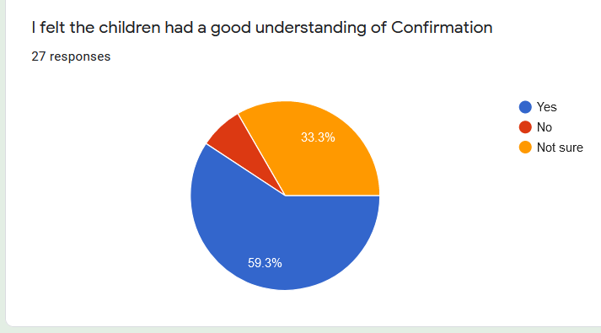
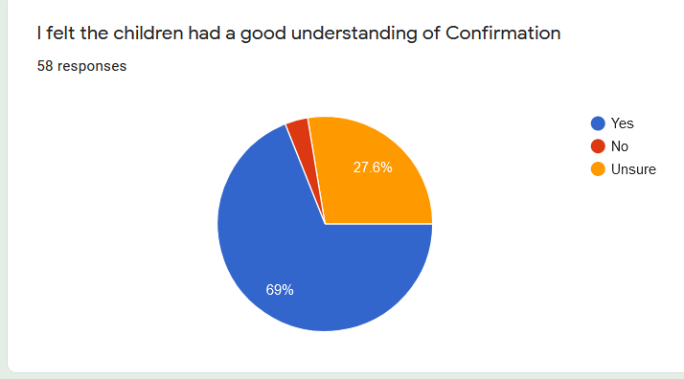
Sacramental Survey of Priests and Teachers in the Killaloe Diocese
I felt the children had a good understanding of Confirmation
Priest Response
Teacher Response

Slide 5
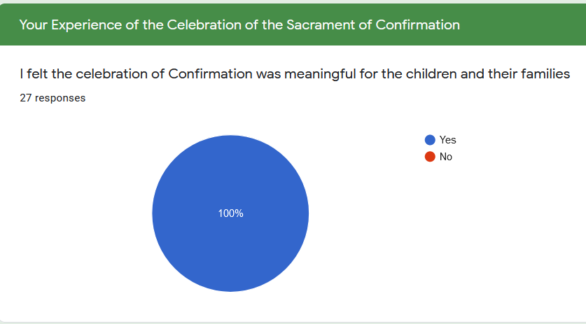
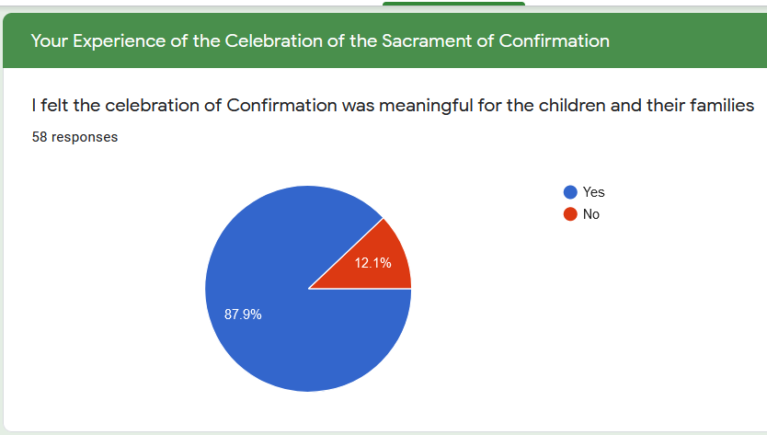
Sacramental Survey of Priests and Teachers in the Killaloe Diocese
I felt the celebration of Confirmation was meaningful for the children and their families
Priest Response
Teacher Response

Slide 6
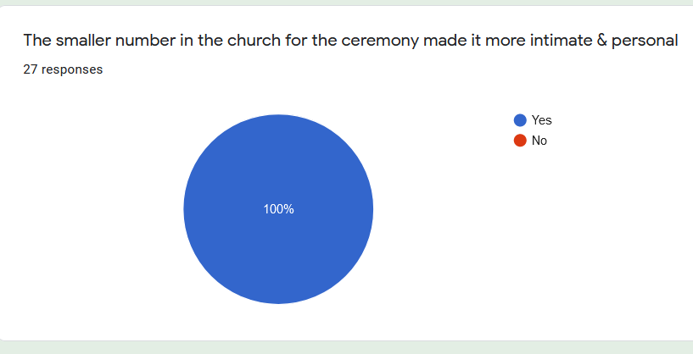
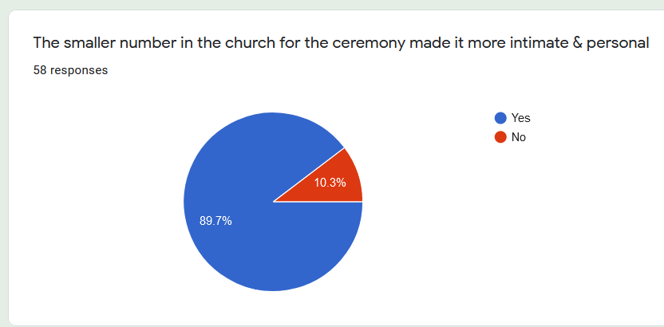
Sacramental Survey of Priests and Teachers in the Killaloe Diocese
The smaller number in the church for the ceremony made it more intimate & personal
Priest Response
Teacher Response

Slide 7
Sacramental Survey of Priests and Teachers in the Killaloe Diocese
The smaller number in the church for the ceremony made it more intimate & personal
TEACHER COMMENTS
There were 56 responses in total.
28 of these responses centred on the smaller numbers in the church. The opinion was that the smaller numbers meant:
The ceremony was simple, more intimate and meaningful for the children and families.
Focus was on the sacrament, and less of a “show”-less fuss overall.
There were no worries about families getting a seat in the church.
More opportunities for children to actively participate in the liturgy, without being under pressure.
Children sat with their families and sponsor- commitment of family.
PP was celebrant, not Bishop.
Less stressful for all involved.

Slide 8
Sacramental Survey of Priests and Teachers in the Killaloe Diocese
The smaller number in the church for the ceremony made it more intimate & personal
TEACHER COMMENTS
There were 56 responses in total.
28 of these responses centred on the smaller numbers in the church. The opinion was that the smaller numbers meant:
In addition
2 comments complimented specifically the ceremony by the PP.
1 response cited that the restrictions on singing was positive as pre-recorded singing was less pressurised.
6 of the responses commented on the involvement of the parish and the families. The fact that they took more “ownership” of the ceremony- not left totally to the school.
2 responses complimented Bishop Fintan’s ceremony and Dan’s webinar
1 teacher was glad that preparations could take place in school in Term 3.
1 teacher responded by saying it gave the pupils something positive to look forward to.
1 teacher found nothing positive about the experience.
13 responses concentrated on the fact that the ceremony actually happened. 3 of these also mentioned they were glad the pupils received the sacrament before they began secondary school/ at the immediate start of secondary school.

Slide 9
Sacramental Survey of Priests and Teachers in the Killaloe Diocese
The smaller number in the church for the ceremony made it more intimate & personal
PRIEST COMMENTS
MOST POSITIVITE ASPECT RE. CEREMONY
Smaller numbers: Simpler ceremonies:
Focus was on the sacrament itself.
More prayerful :
Reflective experience:
Very intimate & very personal:
More meaningful.
Local celebrations were smaller & safer:
There were 12responses in total.

Slide 10
Sacramental Survey of Priests and Teachers in the Killaloe Diocese
The smaller number in the church for the ceremony made it more intimate & personal
PRIEST COMMENTS
MOST POSITIVITE ASPECT RE. CEREMONY
Ceremonies had less hype and less fuss.
Less performance & not circus like that of other years.
Less stress made ceremony simpler & not overly elaborate .
Good idea to keep ceremony away from weekend.
A more spiritual experience for all.
There were 5 responses in total.

Slide 11
Sacramental Survey of Priests and Teachers in the Killaloe Diocese
The smaller number in the church for the ceremony made it more intimate & personal
PRIEST COMMENTS
POSITIVITY RE. ENGAGEMENT OF PARENTS & CHILDREN
Parents engaged reasonably well.
Appreciated that ceremony actually happened before Secondary school.
Overcame adverse circumstances.
Parents supportive of immediate arrangements.
All children opted to receive sacrament.
Children were involved and each child was able to contribute individually to ceremony because of smaller numbers.
Opportunity for individual family photos at end of ceremony .

Slide 12
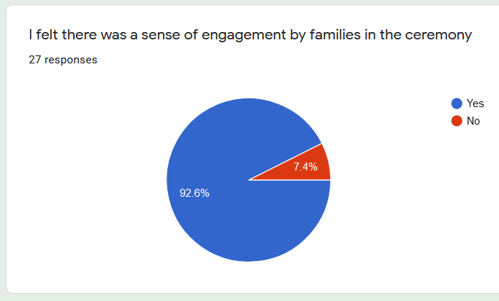
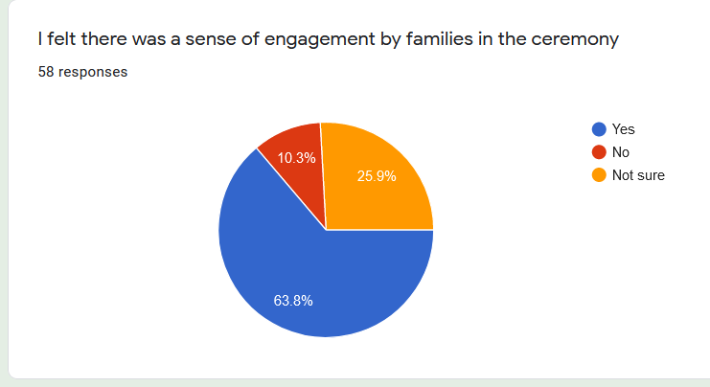
Sacramental Survey of Priests and Teachers in the Killaloe Diocese
I felt there was a sense of engagement in the ceremony
Priest Response
Teacher Response

Slide 13
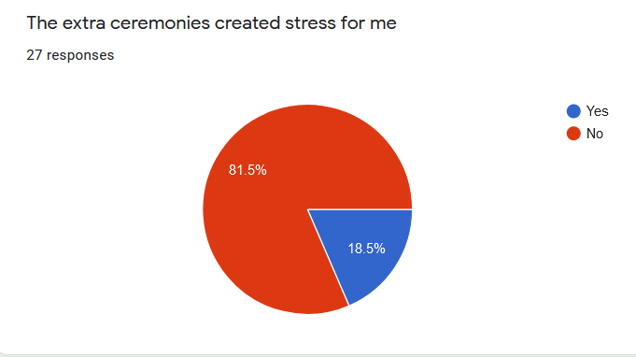
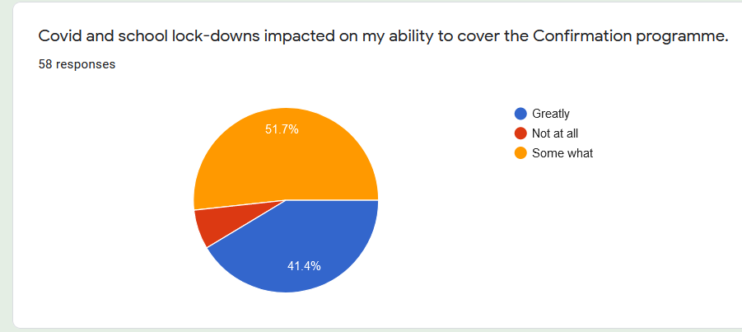
Sacramental Survey of Priests and Teachers in the Killaloe Diocese
Covid impact
Priest Response
Teacher Response

Slide 14
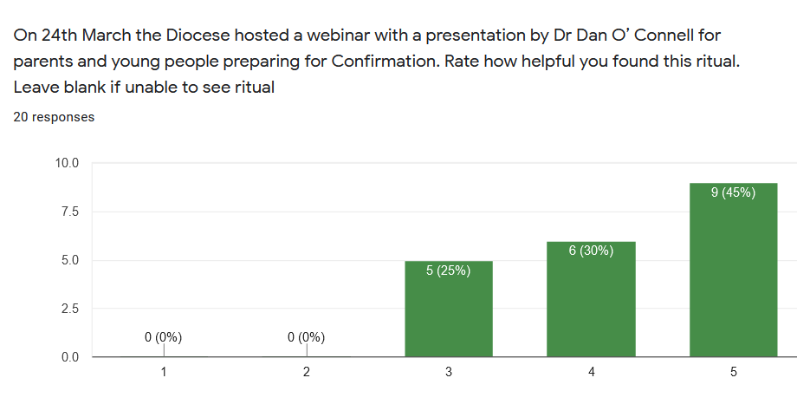
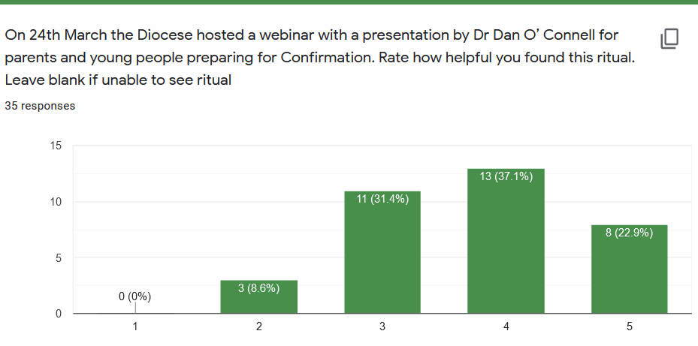
Sacramental Survey of Priests and Teachers in the Killaloe Diocese
Webinar with Dan O’Connell
Priest Response
Teacher Response
Unhelpful 0 1 2 3 4 5 Helpful

Slide 15
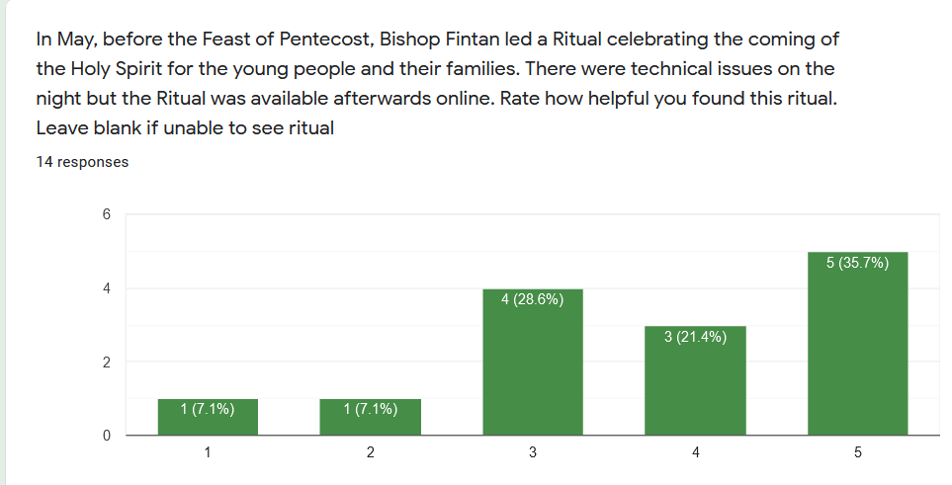
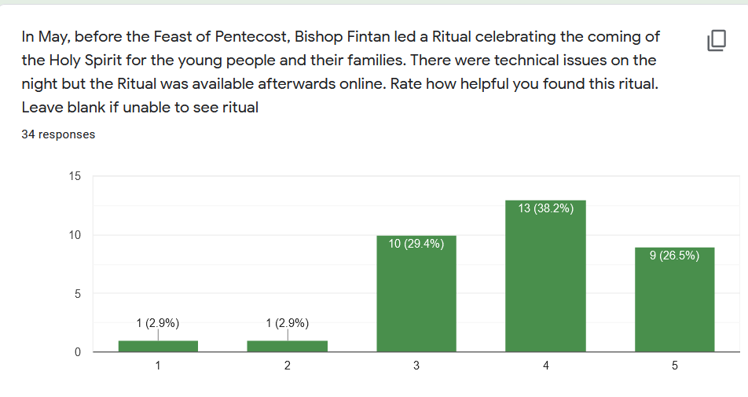
Sacramental Survey of Priests and Teachers in the Killaloe Diocese
Unhelpful 0 1 2 3 4 5 Helpful
Priest Response
Teacher Response

Slide 16
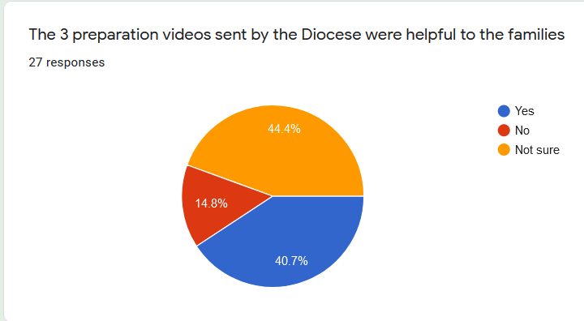
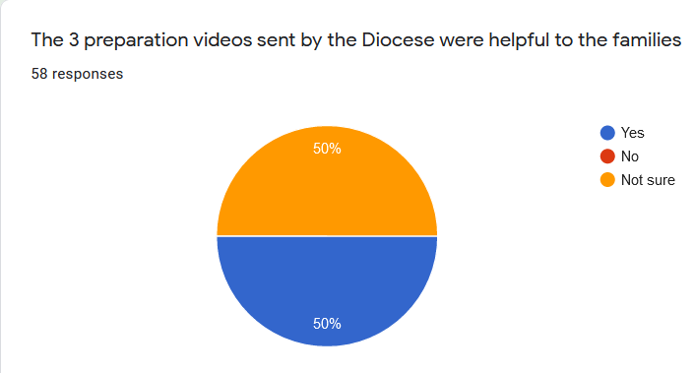
Sacramental Survey of Priests and Teachers in the Killaloe Diocese
The 3 preparation videos sent by the Diocese were helpful to the families
Priest Response
Teacher Response

Slide 17
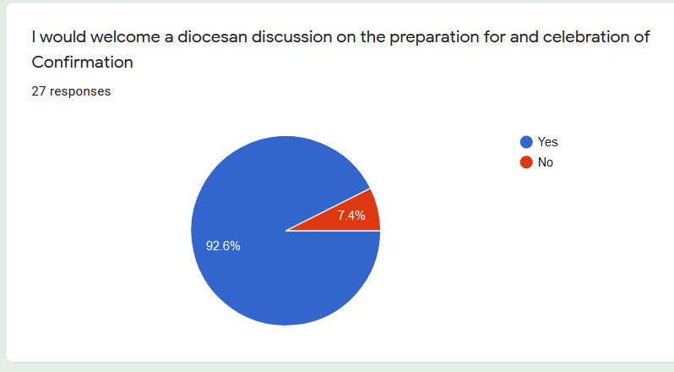
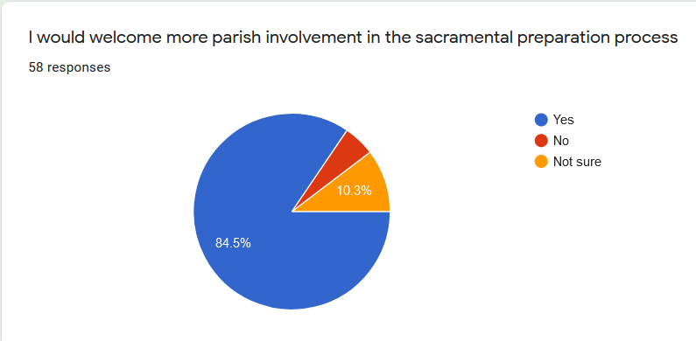
Sacramental Survey of Priests and Teachers in the Killaloe Diocese
I would welcome a diocesan discussion on the preparation for the celebration of Confirmation
Priest Response
Teacher Response

Slide 18
Sacramental Survey of Priests and Teachers in the Killaloe Diocese
Teacher Response
“Teachers new to celebrating the sacraments with their class need more guidance - even teachers with experience who have moved from a different diocese need guidance and support. Some input from the celebrant of the ceremony would be greatly appreciated”
“I think the Be My Witness program (or similar) should be run in all parishes. Too much for schools alone to cover and prepare children”
“It would be most beneficial for all if parents were to bring their children to evening sessions in the church where they were facilitated to discuss the importance of the sacrament with their child and sang the songs for the mass together in a communal atmosphere. I think it is also vital that schools still prepare pupils for the sacrament through the work in the Grow In Love books. This work should be focused on the significance of the sacrament itself, what it means for the child and how they can use the Holy Spirit to empower their lives and add value to the world.”
“I do feel that the videos were beneficial to families to help prepare for Confirmation but there can be families who aren’t as tech savvy as other families and therefore didn’t engage with the videos and activities. Maybe those videos would be more beneficial if candidates and families met as a group together with the parish to engage better with the material.”
“It would be a pity if Confirmation were to be celebrated after the children have left primary school ever again when preparation has taken place in the primary school context.”

Slide 19
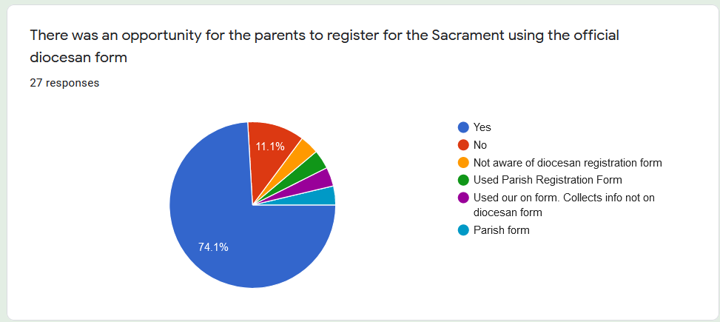
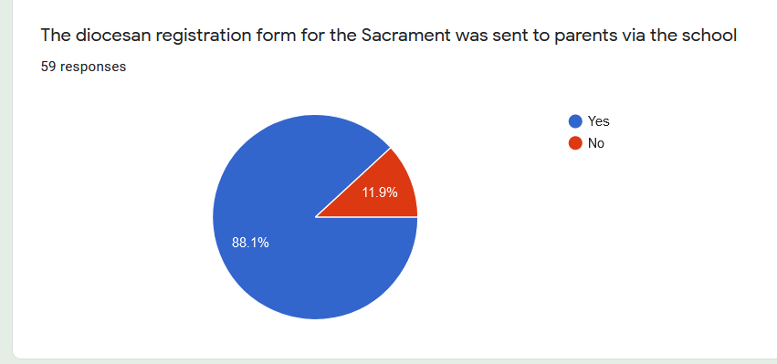
Sacramental Survey of Priests and Teachers in the Killaloe Diocese
Registration Form
Priest response
Teacher Response

Slide 20
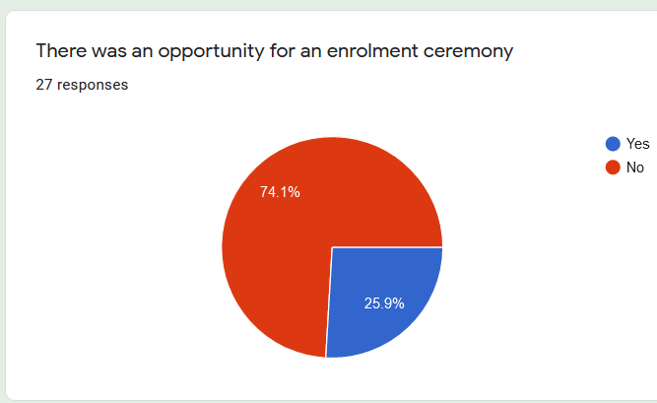
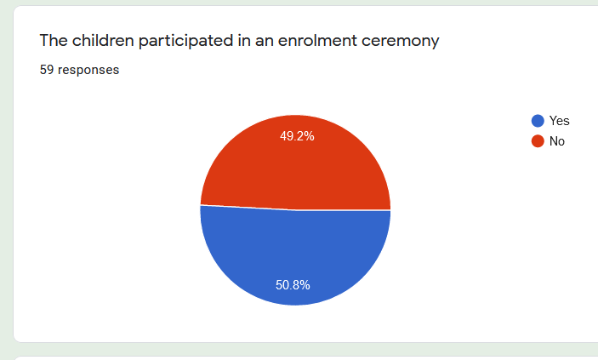
Sacramental Survey of Priests and Teachers in the Killaloe Diocese
Priest Response
Teacher Response

Slide 21
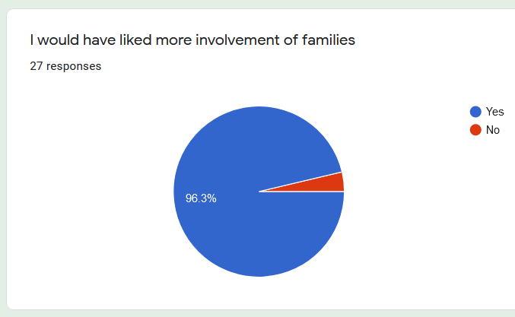
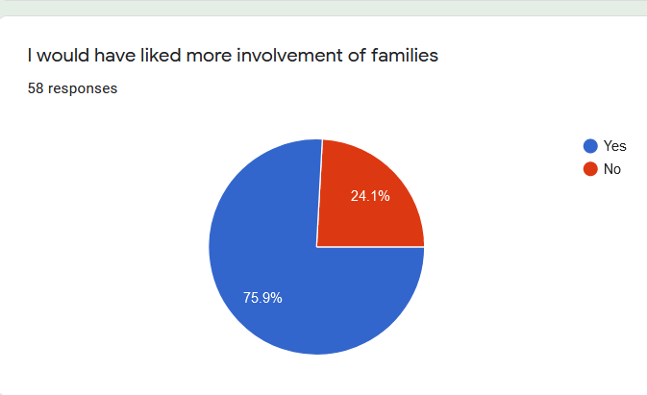
Sacramental Survey of Priests and Teachers in the Killaloe Diocese
I would have liked more involvement of families
Priest Response
Teacher Response

Slide 22
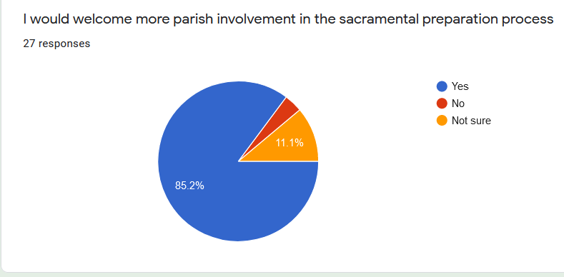
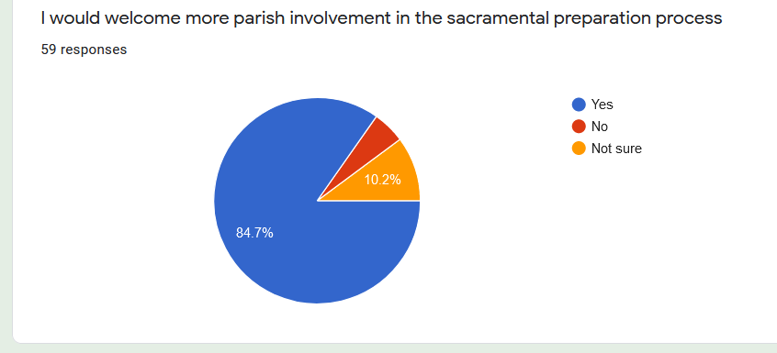
Sacramental Survey of Priests and Teachers in the Killaloe Diocese
I would welcome more parish involvement in the sacramental process
Priest Response
Teacher Response

Slide 23
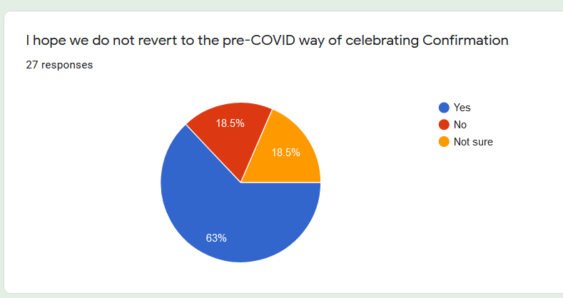
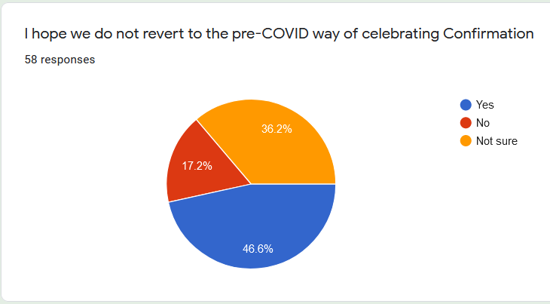
Sacramental Survey of Priests and Teachers in the Killaloe Diocese
I hope we do not revert to the pre-COVID way of celebrating Confirmation
Priest Response
Teacher Response

Slide 24
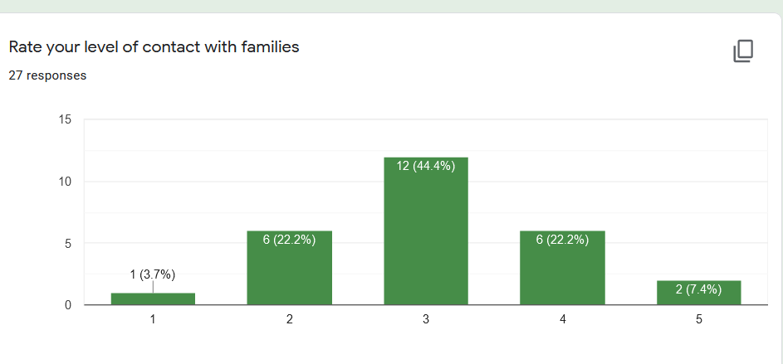
Sacramental Survey of Priests and Teachers in the Killaloe Diocese
Priest Response

Slide 25
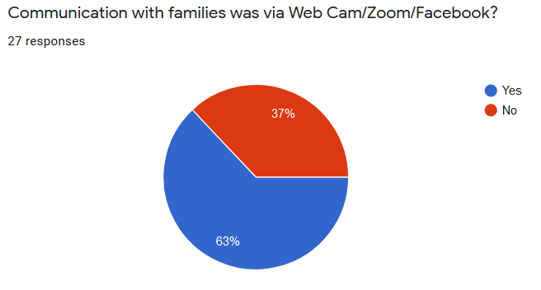
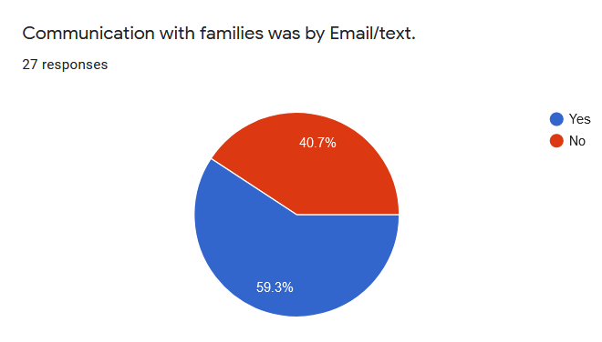
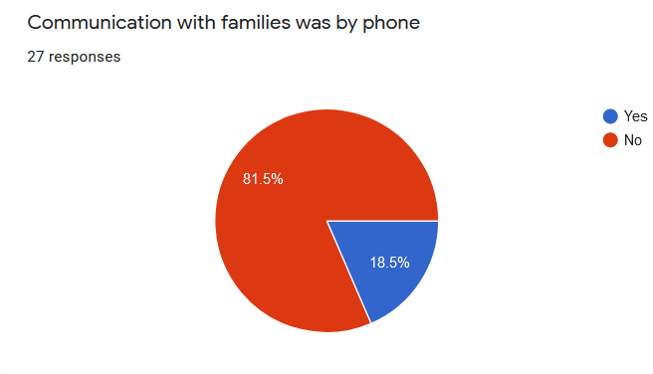
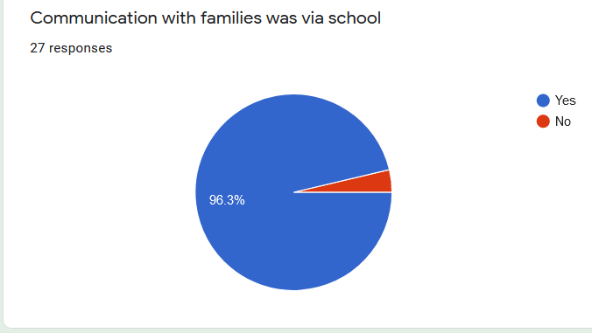
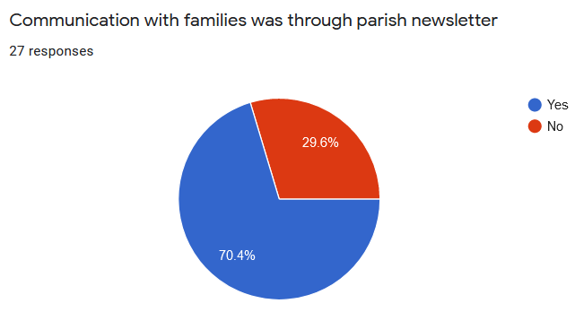
Sacramental Survey of Priests and Teachers in the Killaloe Diocese
Communication with families
Priest Response

Slide 26
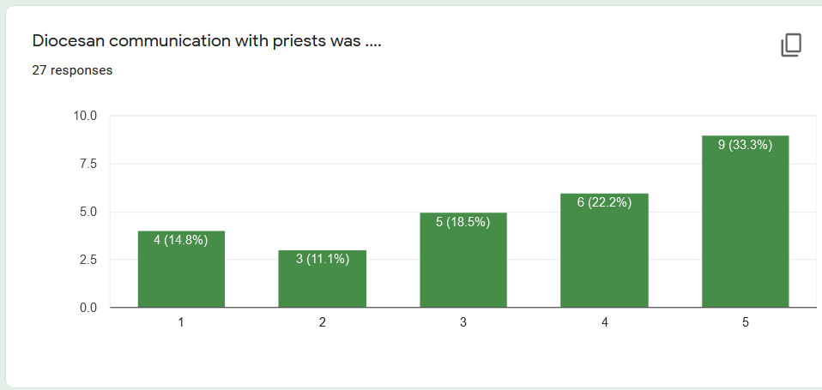
Sacramental Survey of Priests and Teachers in the Killaloe Diocese
Unhelpful 0 1 2 3 4 5 Helpful
Priest Response

Slide 27
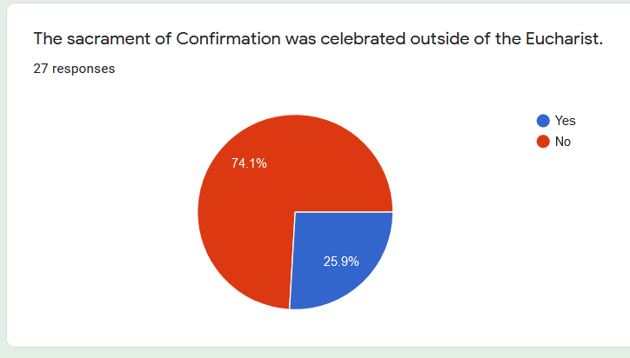
Sacramental Survey of Priests and Teachers in the Killaloe Diocese
Priest Response

Slide 28
Sacramental Survey of Priests and Teachers in the Killaloe Diocese
Teacher Comments about Confirmation 2021- 28 responses.
13 responses asked for less (but not no) involvement of schools and more involvement of parents and parish.
1 comment raised concern re age of pupil.
9 respondents stated that the ceremony should continue to be small and meaningful.
There is a very strong feeling that now is the time for change:
2 teachers that they would like to see children going to Mass regularly in preparation, and not just “on the day”.
2 teachers commented that there was previously too much stress on the schools in regard to the practices needed.

Slide 29
Sacramental Survey of Priests and Teachers in the Killaloe Diocese
Teacher comments
“I feel now is the time for change. Parents are expecting change also so please do not waste the opportunity!”
“I never thought my thinking would change but these are different times and I think the church has a unique window of opportunity to make positive changes in our church.”
“Pre-COVID, there was a lot of pressure on schools to create a spectacle out of the Confirmation through music, song and art. I think it is important that we do not return to this. I think it is important that the Confirmation becomes more parish and family led. It is important that the preparation is on the meaning and significance of Confirmation. The focus for many families appears to be on the gathering after the ceremony itself. The mass is not the main focus of the day for them and many are unsure of when to sit, kneel and stand. It is vital that the focus is on the sacrament. I feel by having a more parish/family-led preparation that families would be encouraged to engage more with the meaning and spiritual significance of the occasion.”

Slide 30
Sacramental Survey of Priests and Teachers in the Killaloe Diocese
Teacher comments
“I think there should be less involvement by schools in the ceremony. The parish and parents need to work together more in preparing for Confirmation. This was very difficult this year due to Covid.”
“It would be helpful to get more support from the parish on preparation for sacraments. Is the parish going to take it out of schools?”
“I would welcome more parental involvement.”
“Families must be encouraged to be involved in the preparation of their children and in the preparation of the mass itself.”
“There needs to be more parish involvement with Confirmation. That happens with sacrament of Communion but I think it would add to Confirmation if it was more than just school preparation.”

Slide 31
Sacramental Survey of Priests and Teachers in the Killaloe Diocese
Teacher Comments
“I think there should be more engagement from families in the preparation. I think there should be specific tasks for them to complete to ensure this happens. Other than what took place in school, there were some families who did not engage with homework materials and lessons. I felt this impeded on their overall experiences and took away from the importance of the day and what the sacrament is actually about.”
“I hope we never go back to the levels of Confirmation preparation that were expected in schools pre Covid. 2021. While I don't necessarily think the preparations for Confirmation should be taken out of schools I think there is a need to ensure it doesn't become a burden on schools.”

Slide 32
Sacramental Survey of Priests and Teachers in the Killaloe Diocese
Teacher Comments
“It is both sad and frustrating to see in many instances how much the school and its teachers are expected to do to cover the religious education of the pupils. The lack of involvement by families in the regular activities of church life has created a provision of service mentality by many parents to church engagement. I hope that in future there will be less emphasis on the production that has become the actual mass and ceremony and greater involvement by families in the organisation of the ceremony.”
“Family took much more responsibility and chose to present their child for Conformation or NOT- it wasn't done for the sake of doing or simply because it is 'custom' 'tradition' in sixth class. I feel that the children were better prepared and feel more part of the occasion when they were prepared for Confirmation pre Covid. There was a build up tithe Confirmation day which made it all the more special. I understand the last two years have been very challenging when scheduling the sacraments.”

Slide 33
Sacramental Survey of Priests and Teachers in the Killaloe Diocese
Teacher Comments
“If we return to a situation where schools are to prepare the pupils with the weight of practicing the singing and readings and the mass, then this will be a lost opportunity and the meaning of the sacrament will be as diluted as before.”`
“Due to schools not being able to sing as a result of COVID it took a lot of pressure having to prepare the hymns and songs. As a small school this can be quite stressful and also take up a lot of teaching time. The parish organised a singer for the ceremony and in my opinion this took a lot of stress out of Confirmation preparations. It allowed more time to focus on the actually ceremony itself with the children.”

Slide 34
Sacramental Survey of Priests and Teachers in the Killaloe Diocese
Teacher Comments
“They should have to attend a weekly/bi-weekly mass with a specific aspect of Confirmation. How many children are making Confirmation because ‘it’s the done thing in school’? If preparation was taken out of schools you’d get a true reflection of how important the ceremony is for children and families.”
“We would like more opportunities for the children to attend mass throughout the school year and attend as a school. Currently most children only attend mass when it’s time for their confirmation or communion. Whilst I do understand our priests are under pressure as they have so many parishes to look after but I feel children need more opportunities to attend mass as the vast majority do not attend mass outside of school.”

Slide 35
Sacramental Survey of Priests and Teachers in the Killaloe Diocese
Teacher Comments
“We enjoyed our confirmation ceremony this year and last. There wasn't the same pressure as other years to have it "perfect" and our priest was so helpful in the preparation of the ceremony and so relaxed that it reduced the pressure and nerves for all! It was definitely more meaningful and reverent. However we did miss the addition of music and song to make it more of a celebration without it being a "performance”.
“Confirmation was very simple but all of the parents I spoke to felt it was a far more personal and intimate ceremony. It took a lot of the pressure off the school and this is extremely positive. Confirmation had become a performance and this is not what it should be about.”

Slide 36
Sacramental Survey of Priests and Teachers in the Killaloe Diocese
Teacher Comments
“I strongly believe the celebration of the Sacrament of Confirmation with limited numbers or even in an evening ceremony is far more meaningful than ceremonies prior to Covid. Confirmations prior to this had turned into virtual fashion shows with people walking in and out of a packed church, babies crying and a myriad of distractions for the Confirmation candidates. A simple ceremony with limited numbers and less fanfare is far more meaningful. It also takes pressure off schools to put in a performance for a congregation. (Singing etc). The simpler the ceremony the better in my opinion. Far, far more meaningful with smaller numbers.”

Slide 37
Sacramental Survey of Priests and Teachers in the Killaloe Diocese
Teacher Comments
“We would like to see very, very simple, meaningful ceremonies going forward where family has a much bigger role than school.”
“Confirmation ceremony over the last two years has been more intimate and as a result much more meaningful. The rituals around confirmation and the 'performance' were not laboured.”
“The confirmation was a very special and intimate ceremony. Confirmation is a time to celebrate for families. This was different for many this year due to COVID-19.”
“I 'm teaching 33 years and this year’s ceremony was the nicest by far and I think most parents would agree. We had a past pupil singing and it was beautiful. Do we need to put children (who do not go to mass) through weeks of practice just because they are in the school? The parish organised a singer for the ceremony and in my opinion this took a lot of stress out of Confirmation preparations. It allowed more time to focus on the actually ceremony itself with the children.”

Slide 38
Sacramental Survey of Priests and Teachers in the Killaloe Diocese
Teacher Response
“I found that Covid has taught us all to stop putting a show on. The lack of art and all the extras we usually had in the church are not important. The meaning of the day is the important part for the child and I think this was much more of a focus this year. Our priest Fr Donagh was fantastic.”
“I have said here that I would welcome more parish involvement but I would like to commend the Nenagh Parish team for all that they do with our school. We have a terrific partnership with the Parish team and even during COVID times the team was always on hand to help out. The Parish team go above and beyond and we as school are delighted with the help and resources provided as we prepare children for the sacraments.”

Slide 39
Sacramental Survey of Priests and Teachers in the Killaloe Diocese
Teacher Response
General Comments:
“Everyone did their best to ensure the children were prepared and involved in the sacrament.
I wonder also is 12 years of age too young to be deciding for yourself if you want to be an adult member of the church. At 12 it’s all about the party and bouncing castle. Would we be better off with a smaller number of practicing Catholics than large numbers who just show up for the day? I know my local church is empty of those under 50 and hardly any under 35. I think now is the time to look at the bigger picture.”

Slide 40
Sacramental Survey of Priests and Teachers in the Killaloe Diocese
Priest Response
10 Priest gave personal comments
“It was good that candidates had transitioned to Secondary school & matured a little after all the stops and starts. Pity the larger community of the faithful were not able to witness the occasion. However I enjoyed having the opportunity to speak more directly to the candidates & the parents in a more intimate setting.”
“ I would suggest a diocesan level formation and one day retreat with confession before candidates are confirmed”.

Slide 41
Sacramental Survey of Priests and Teachers in the Killaloe Diocese
Priest Response
“The biggest difficulty is the age and the lack of any likely contact with the young people afterwards until they are getting married. Confirmation is a goodbye ceremony and there is no real chance of a committed Christian response in terms of worship. Could we have it in Transition year & even if 10% opted for it –would it mean more “?
“One or two chose not to be confirmed in this parish. Do we need to look at Confirmation in the context of all the sacraments of initiation especially Baptism which has no serious preparation & is mostly seen as a celebration of birth- the blessing of new life?”

Slide 42
Sacramental Survey of Priests and Teachers in the Killaloe Diocese
Priest Response
“ Sense of relief after the celebration due to the uncertainty right up to the end. Momentum was lost over the summer and was hard to rebuild . A blend of the old & the new is probably the way forward. I would still like the bishop to do Confirmation. It makes it more memorable & special”.
“Confirmations 2020 & 2021 were really lovely , & that has been the response from the candidates themselves and their parents , families and teachers. They all feel that without the “razzmataz”that went on in former years, the candidates and families could actually focus & concentrate on celebrating the sacrament, and also enjoy the experience! It is definitely the way to go in the future”.

Slide 43
Sacramental Survey of Priests and Teachers in the Killaloe Diocese
Priest Response
“The tight gatherings , talking and fashion parade was absent. The crowd gatherings around doors was a welcome absence. The simplicity of the gathering outside the church was impressive after the ceremony . Families had their own arrangements for after, which left the church ceremony more of a sacramental celebration. We need to explore ways to involve some of the candidates in the ceremony to pump more positive energy into it . The big plus in this method of celebrating the sacrament is that the focus is on the spiritual side of the day.”
“Having Confirmation in Secondary school worked well for us ,primarily due to the fact that we have a very good school chaplain”.

Slide 44
Sacramental Survey of Priests and Teachers in the Killaloe Diocese
Priest Response
“Confirmation to be celebrated at parish level by local priests. Fixture of dates and times could be similar across a pastoral area which would highlight a sense of unity. A discussion to take place at pastoral area level in our diocese in relation to best practice after the Covid experience. A move away from the school based sacrament with a definite emphasis on parents and parish working together. In saying this , the input , support and wisdom of teachers must always be included”.
“To be honest it’s made me to know more about the families of candidates.”

Slide 45
Responses of young people who received the Sacramental of Confirmation in the Killaloe Diocese
Q1 – Most difficult thing about confirmation this past year?
Change of dates was confusing
Reading the prayer out loud
Not having everybody there that they wanted
Not being able to practice
Not knowing if/when it would go ahead
It felt rushed and therefore not important
Not getting the chance to prepare properly
Midweek confirmation not convenient

Slide 46
Responses of young people who received the Sacramental of Confirmation in the Killaloe Diocese
Q2 – Most positive memory?
To receive the sacrament
Meeting up with friends & family
Having fun with classmates/friends
Being supported by family
Putting the hand on your shoulder
Hearing the story of my grandfather’s confirmation

Slide 47
Responses of young people who received the Sacramental of Confirmation in the Killaloe Diocese
Q3 – What confirmation means to them?
It’s important – it will help me during my life & help me to be kind
You become an adult member of the church – confirmed as a Christian
It means I am now part of God’s family
Special occasion in their life
To live a good life
Brings them closer to God as Christians
Makes them a more mature member of the parish
5 students believe it didn’t mean anything to them

Slide 48
Responses of young people who received the Sacramental of Confirmation in the Killaloe Diocese
Q4 – When have you seen the holy spirit in action?
In making new friends
Teachers and staff helping pupils
Kindness from other people
Courage to talk to people
Wisdom in my tests
Patience for others to finish their work
Knowledge learning from fellow students
Understanding in teachers patience with students
Wisdom in teachers sharing their experiences over the years

Slide 49
Responses of young people who received the Sacramental of Confirmation in the Killaloe Diocese
Q5 – Which gift is most important to them?
Wisdom & Understanding
Fortitude (Courage) many students felt this was very important to be brave and courageous and also to show gratitude for all they have in life

Slide 50
Responses of young people who received the Sacramental of Confirmation in the Killaloe Diocese
Q6 – Comments from Chaplain/RE Teacher
Main issues were the uncertainty around dates and not having loved ones there.
It was a positive experience overall
Mixed views about different aspect of the sacrament in the class.
I got the impression that preparation for confirmation varied considerably in different primary schools

Slide 51
Responses of young people who received the Sacramental of Confirmation in the Killaloe Diocese

