Slide 1
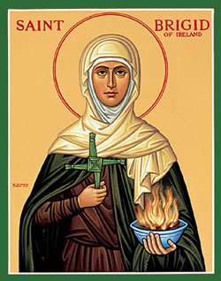
St. Brigid

Slide 2
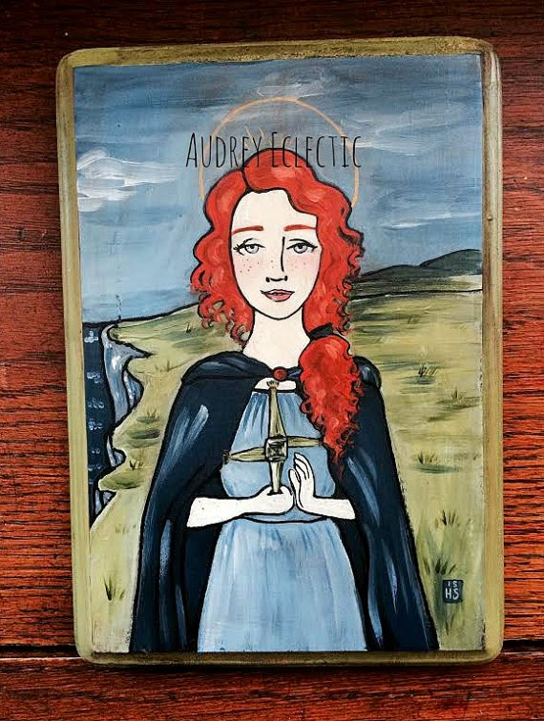
Her early life
Brigid was born sometime between 452 and 456 AD in Faughart, a few miles from Dundalk in Co. Louth.
It is thought by some people that Brigid’s mother, Brocseach was a slave in Dubtach’s household.
Brigid spent her time cooking, cleaning, washing and feeding the animals on her father’s farm.

Slide 3
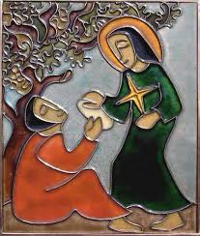
Her early life
Brigid’s father was a wealthy pagan chieftain called Dubtach. It is said that Brigid really annoyed her father because she was so generous. She kept giving away his valuable goods to the poor and needy.

Slide 4

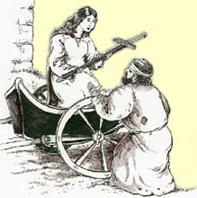
Her early life
Eventually, Dubtach got very frustrated with Brigid and went to the King of Leinster and offered to sell Brigid to him.
However, while Dubtach was working out a deal with the king, Brigid, who was waiting outside, managed to give away his valuable sword to a beggar.

Slide 5
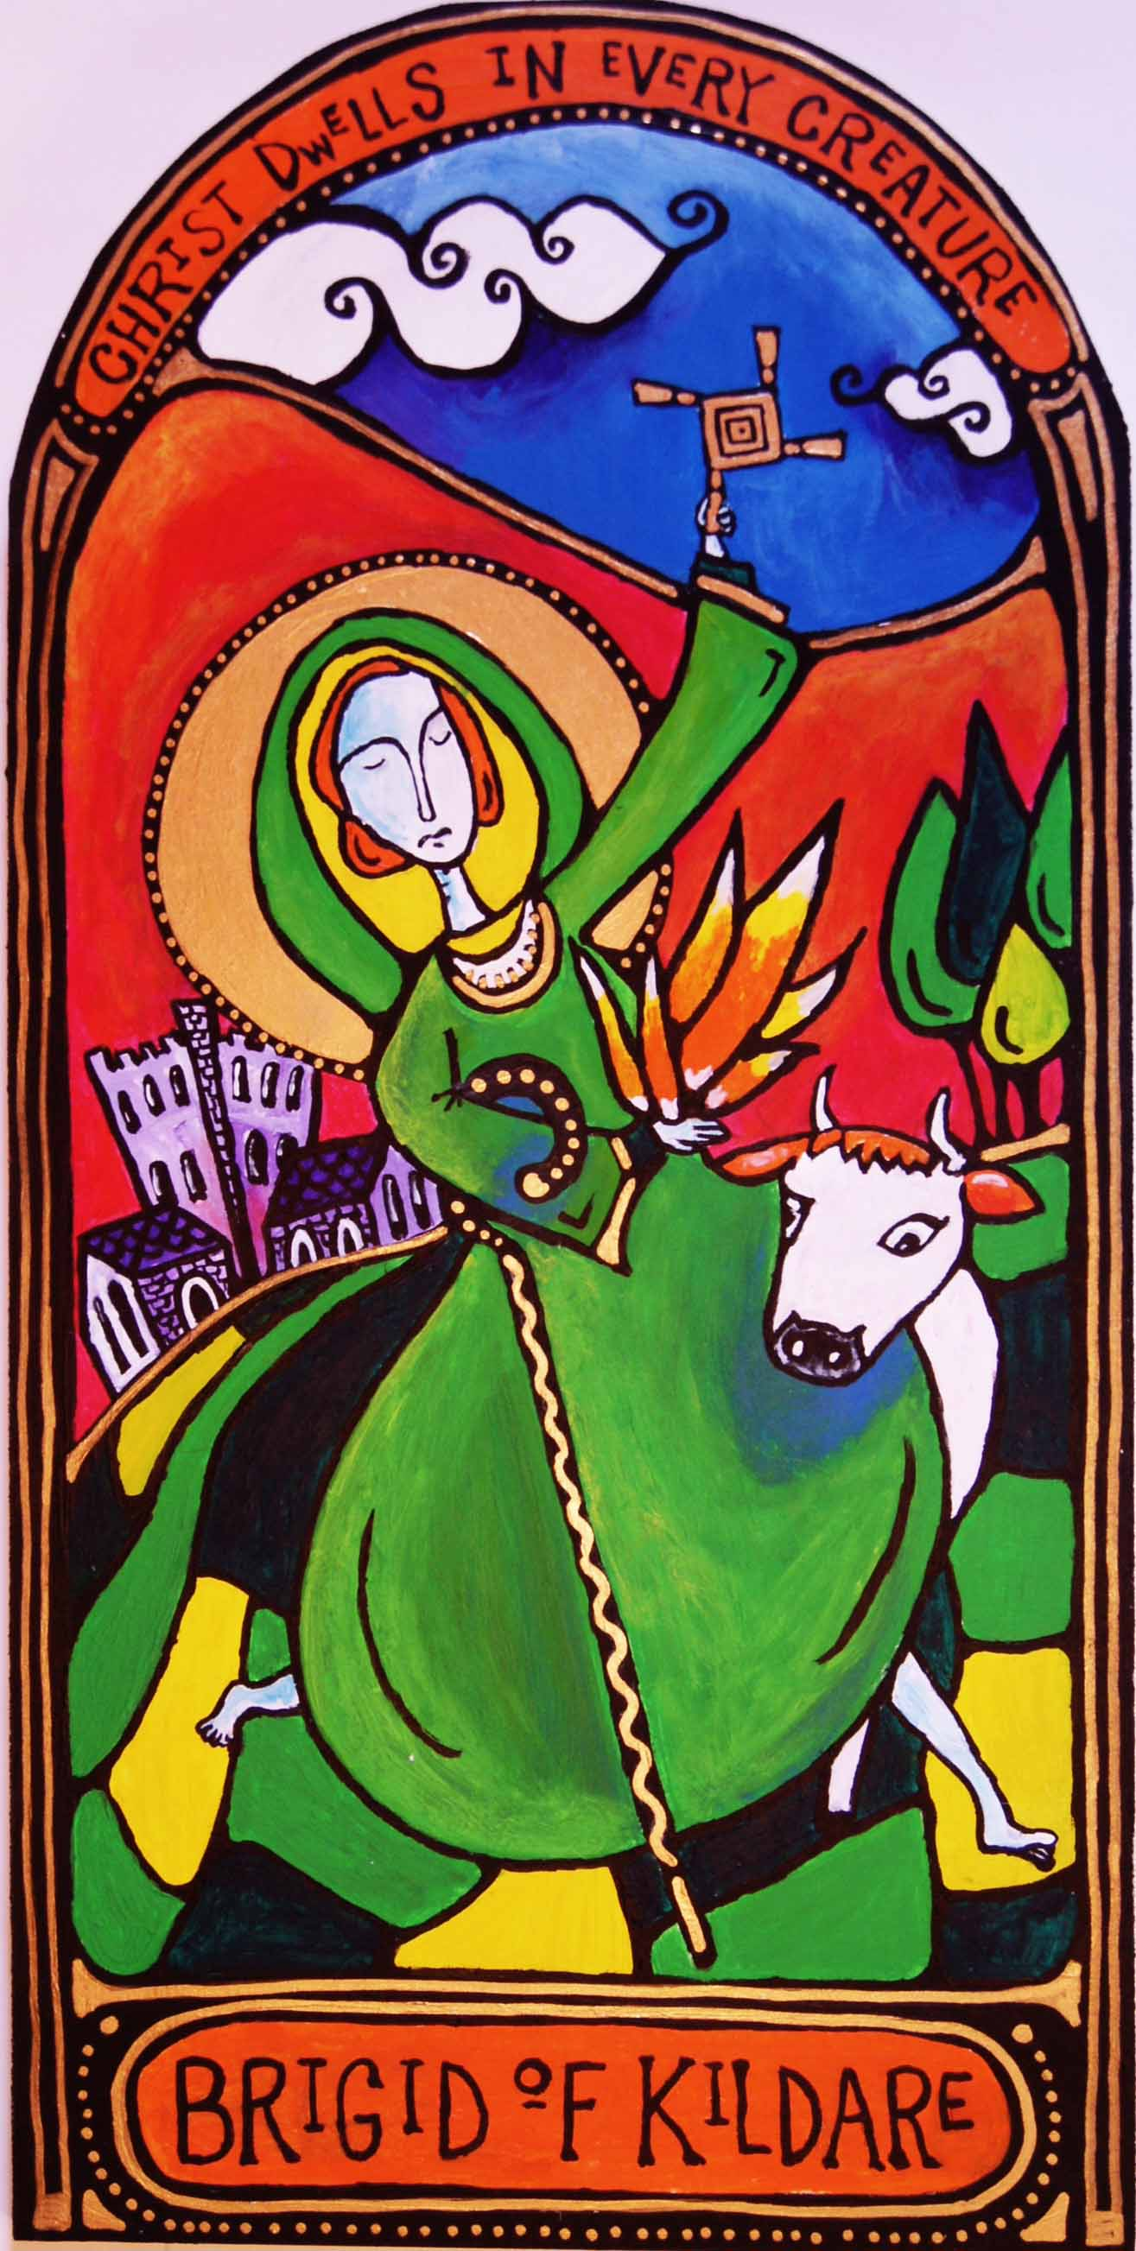
Her early life
When the King learned of what Brigid had done, he admired her courage and determination. He decided to let her go free.
Brigid was a very holy woman and spent a lot of time in prayer. She decided to become a nun. She wanted to spend her life working for God by looking after poor, sick and elderly people.
Legend has it Brigid prayed that her beauty be taken so no one would want to marry her and her prayer was granted. It was not until after she made her final vows as a nun that her beauty was returned.

Slide 6
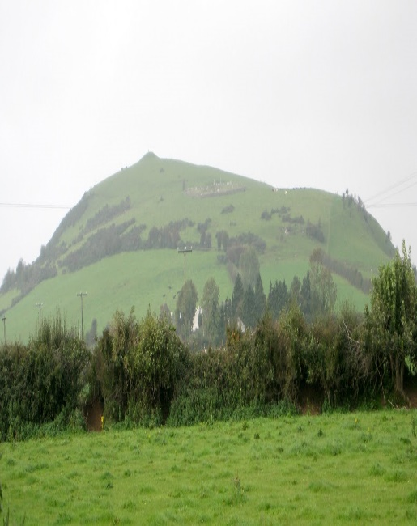
She travelled to Croghan hill in Co. Offaly and asked St. Mac Caille who was a bishop there to admit her into religious life.
St. Mac Caille granted her request.
Croghan Hill, the remains of an extinct volcano and also where St. Mac Caille had his church. It is said that St. Mac Caille’s mother was St. Darerca-a sister to St. Patrick

Slide 7

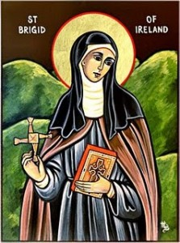
St. Brigid’s Cloak
St. Brigid went to the King of Leinster to ask for land to build a convent. She told the king that the place where she stood was the perfect place for a convent. It was beside a forest where they could collect firewood. There was also a lake nearby that would provide water and the land was fertile. The king laughed at her and refused to give her any land. Brigid prayed to God and asked him to soften the king’s heart. Then she smiled at the king and said “will you give me as much land as my cloak will cover?” The king thought that she was joking and because Brigid’s cloak was so small he knew that it would only cover a very small piece of land.

Slide 8
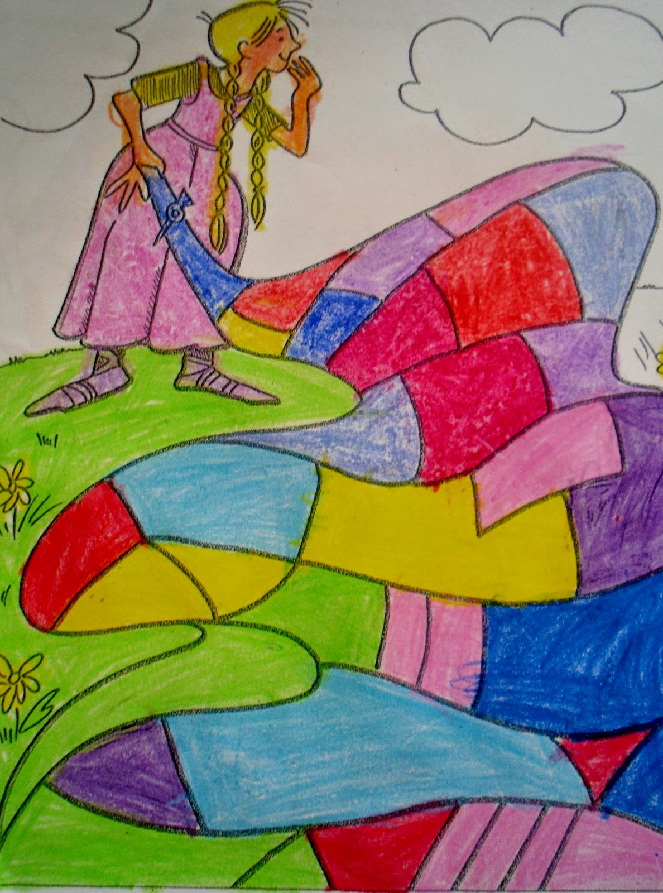
The king agreed and Brigid spread her cloak on the ground. The cloak grew immediately and began to cover many acres of land. The king was astonished and he realized that she had been blessed by God. The king fell to the ground and knelt before Brigid and promised her money, food and supplies. Soon afterwards, the king became a Christian and also started to help the poor. Brigid’s miracle of the cloak was the first of many miracles that she worked for the people of Ireland.

Slide 9
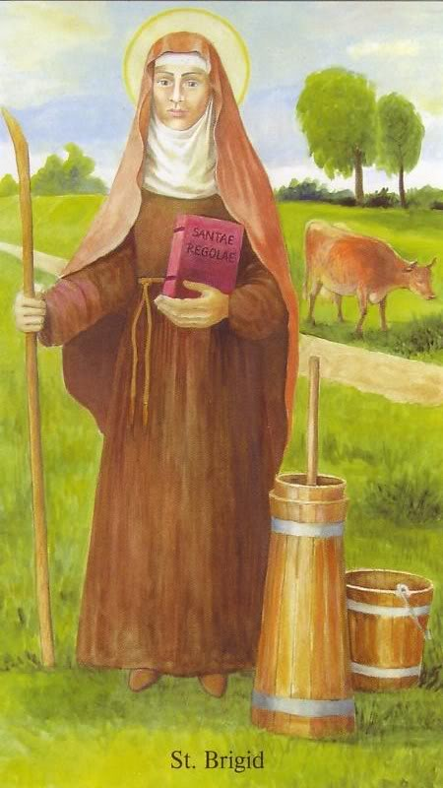
Brigid’s Convent at Kildare
Brigid founded many convents all over Ireland. Her most famous convent was in Co. Kildare. Kildare comes from cill-dara, meaning “the church of the oak“ - Brigid's cell being under a large oak tree.
Her convent at Kildare was very popular. Many young women wanted to join. People travelled from near and far to ask Brigid for advice.
Men also wanted to join the community Brigid founded. Men and women lived and worked together there.

Slide 10
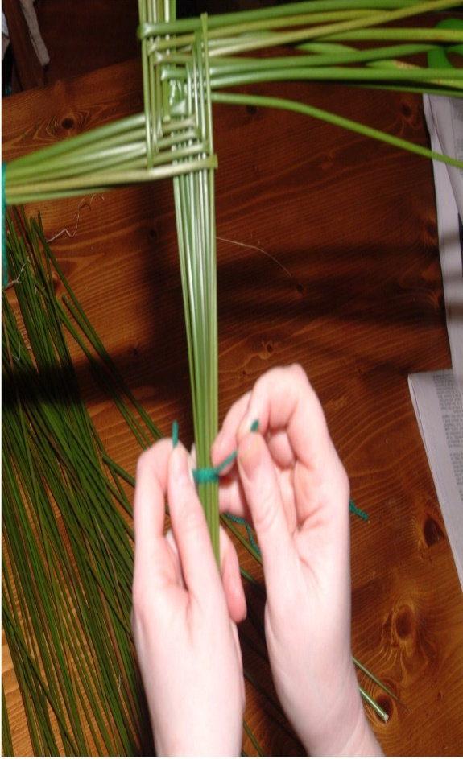
St. Brigid’s Cross
Many people make St. Brigid crosses on her feast day-1st February.
The crosses are made out of rushes that are pulled rather than cut. St. Brigid and her cross are linked together by the story that she wove this form of a cross at the death bed of a pagan chieftain. The sick man asked Brigid what she was doing. She began to explain the meaning of the cross and how Jesus died on it out of love for us. The man who was dying believed in God at that moment and asked to be baptized.
Link: How to make a St. Brigid’s cross https://www.youtube.com/watch?v=1eDUXepmNLY

Slide 11
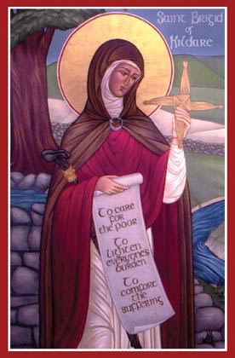
Poem about how the pagan chieftain who came to know Jesus
Brigid wove a cross of rushes by a dying chieftain's bed" "Brigid what is that you're making From the rushes there?", he said. Brigid said, "A cross I'm weaving, like the cross where Jesus died." "Who was Jesus?" asked the chieftain, "Why was this man crucified?" Brigid told the gospel story to a dying pagan King. Lying silently he listened, Never saying anything. Then he kissed the cross of rushes Saying "Brigid, thanks to you, I have come to love this Jesus, I will follow his way too!"
By Emma Finnegan

Slide 12
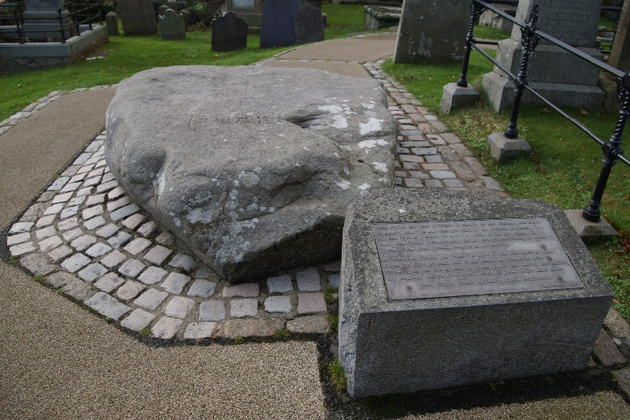
Brigid is thought to have died on 1 February 524 AD when she was in her early seventies. She was buried in a tomb before the High Altar of her Abbey church. After some time, her remains were exhumed and moved to Downpatrick to rest with the two other patron saints of Ireland, St. Patrick and St. Columcille. St. Brigid is the female patron saint of Ireland. She is also known as Muire na nGael or Mary of the Gael which means Our Lady of the Irish.

Slide 13
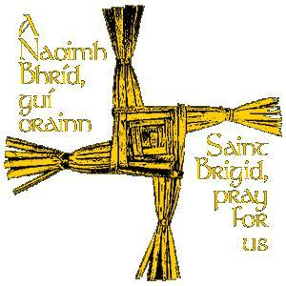
St. Brigid’s feast day is celebrated on 1st February every year, the first day of spring.

