Slide 1


IN NOVEMBER WE REMEMBER.

Slide 2
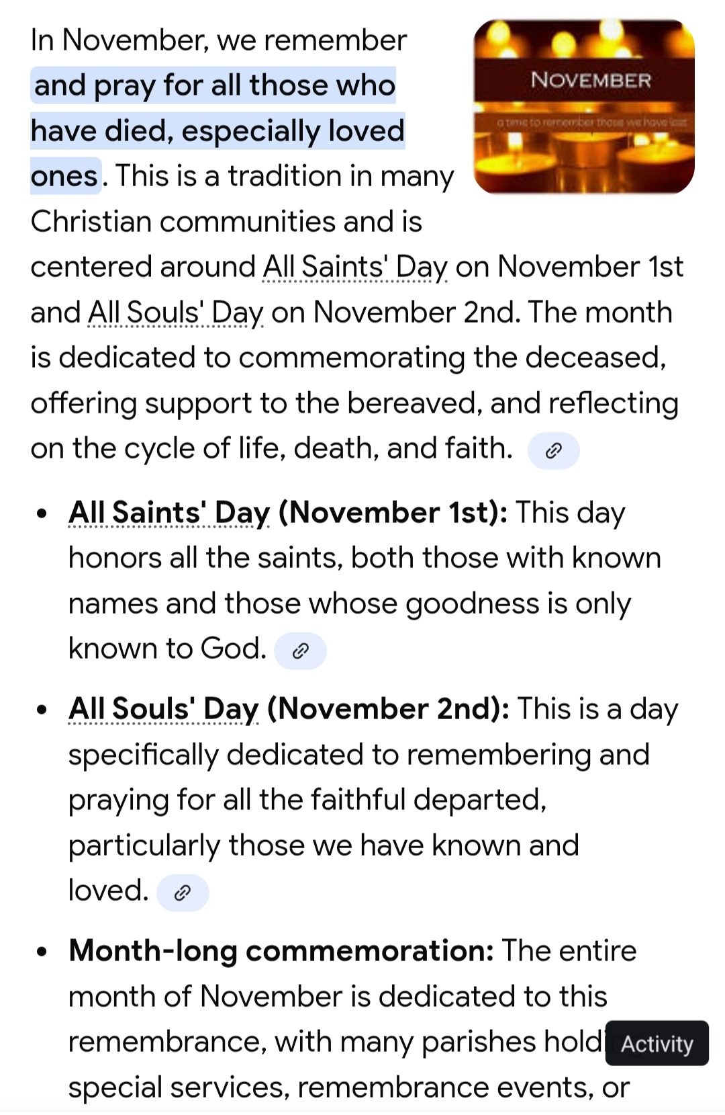

Slide 3
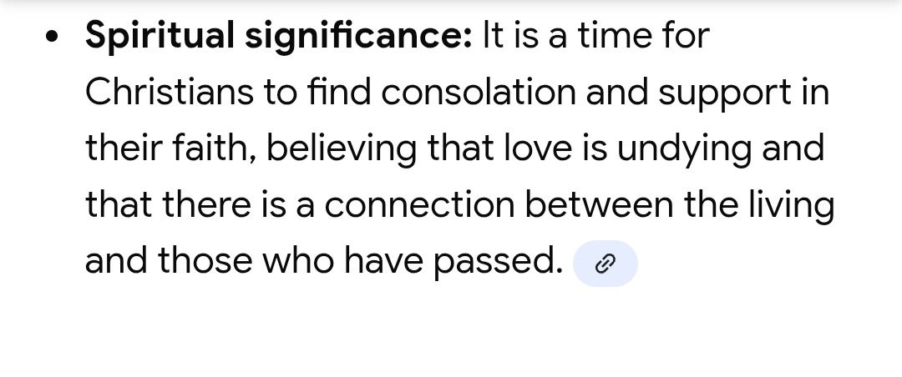
IN NOVEMBER WE REMEMBER

Slide 4
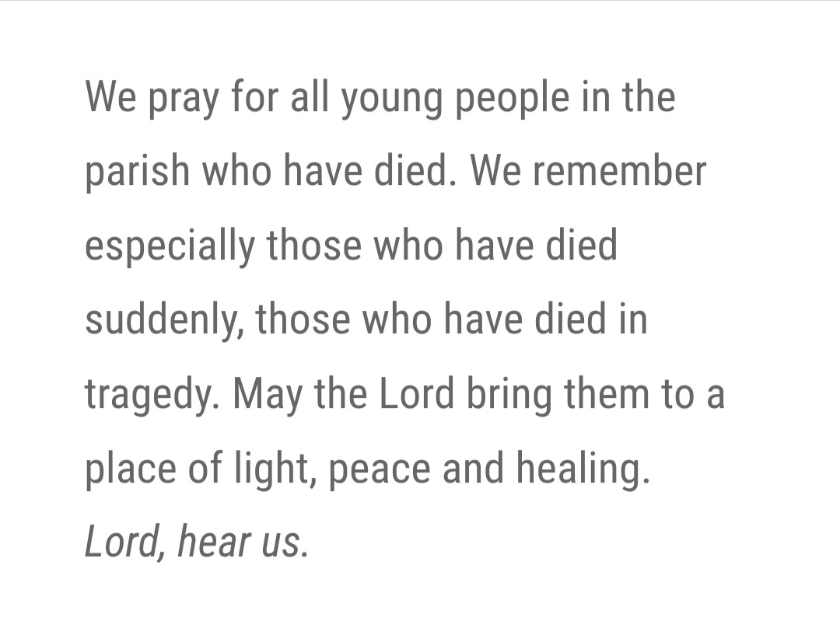
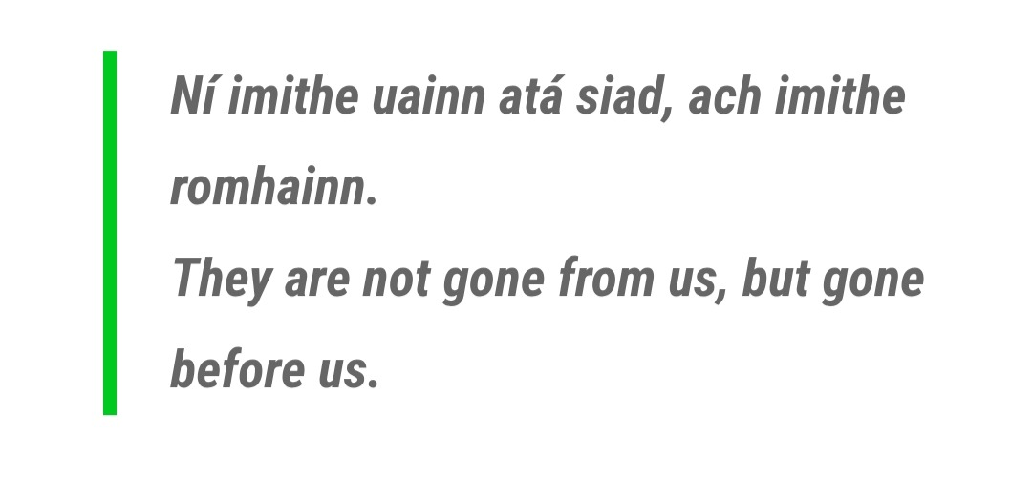
IN NOVEMBER WE REMEMBER.

Slide 5
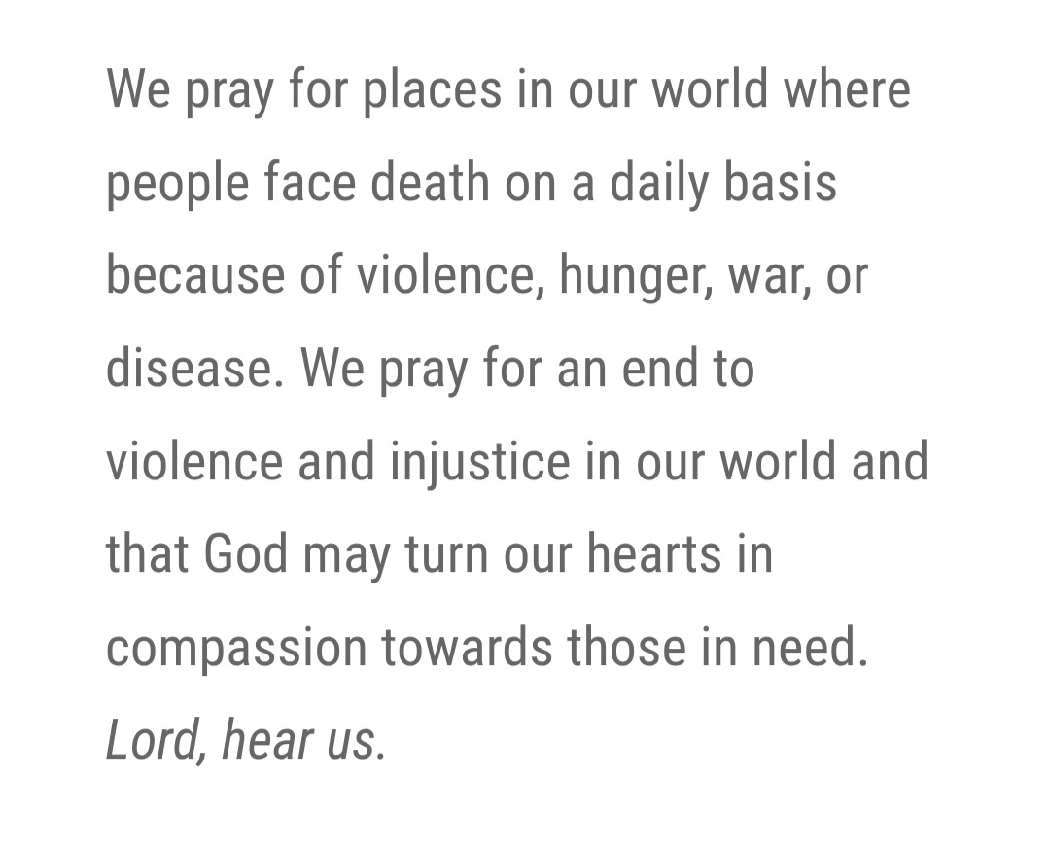

IN NOVEMBER WE REMEMBER.

Slide 6
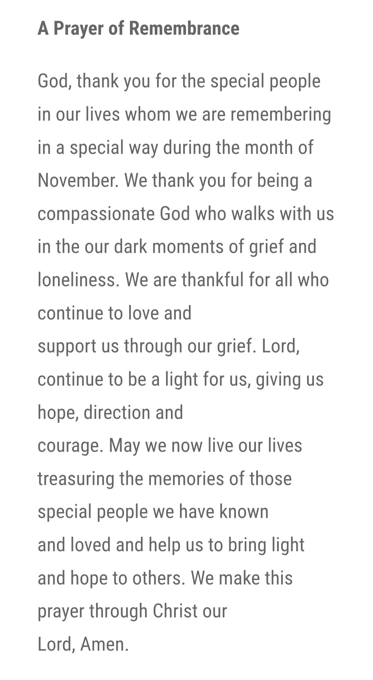

IN NOVEMBER WE REMEMBER.
This Photo by Unknown Author is licensed under CC BY-NC

Slide 7
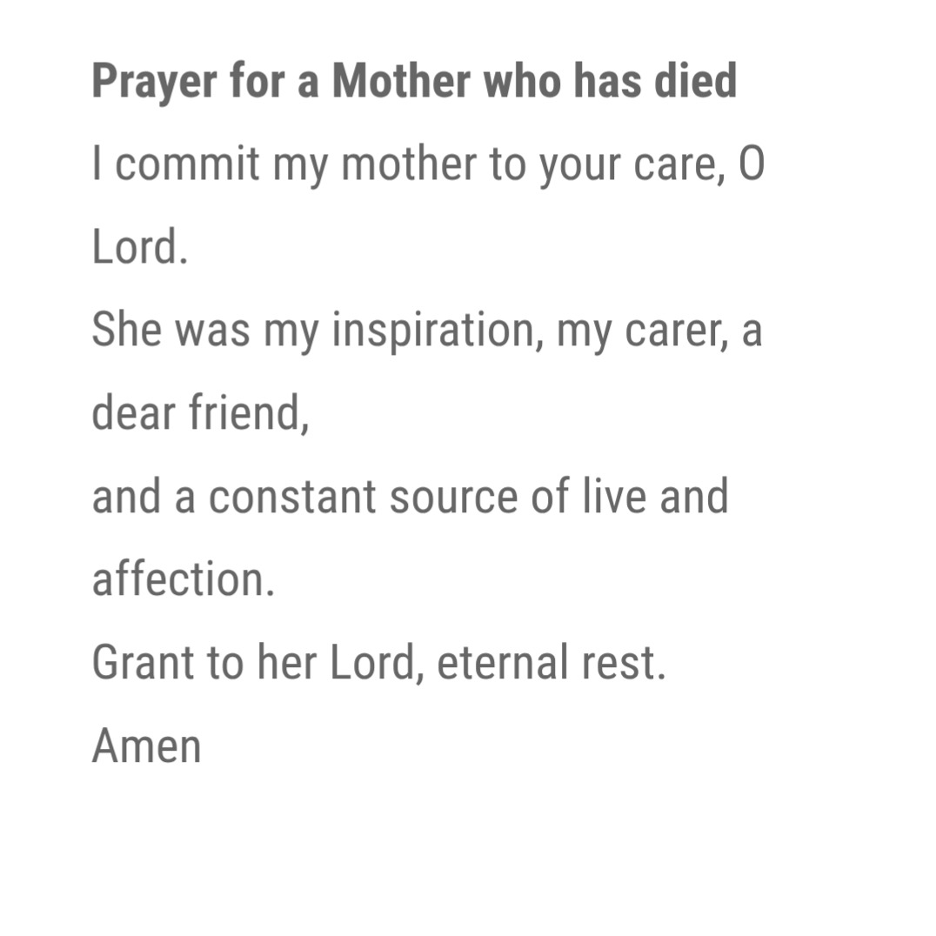
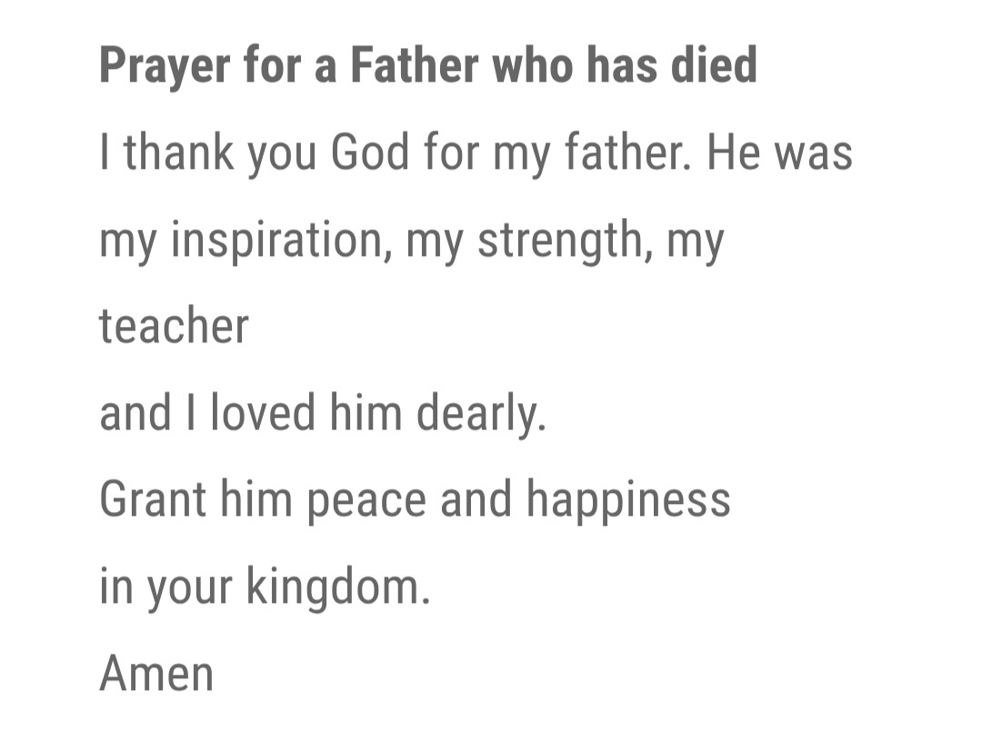

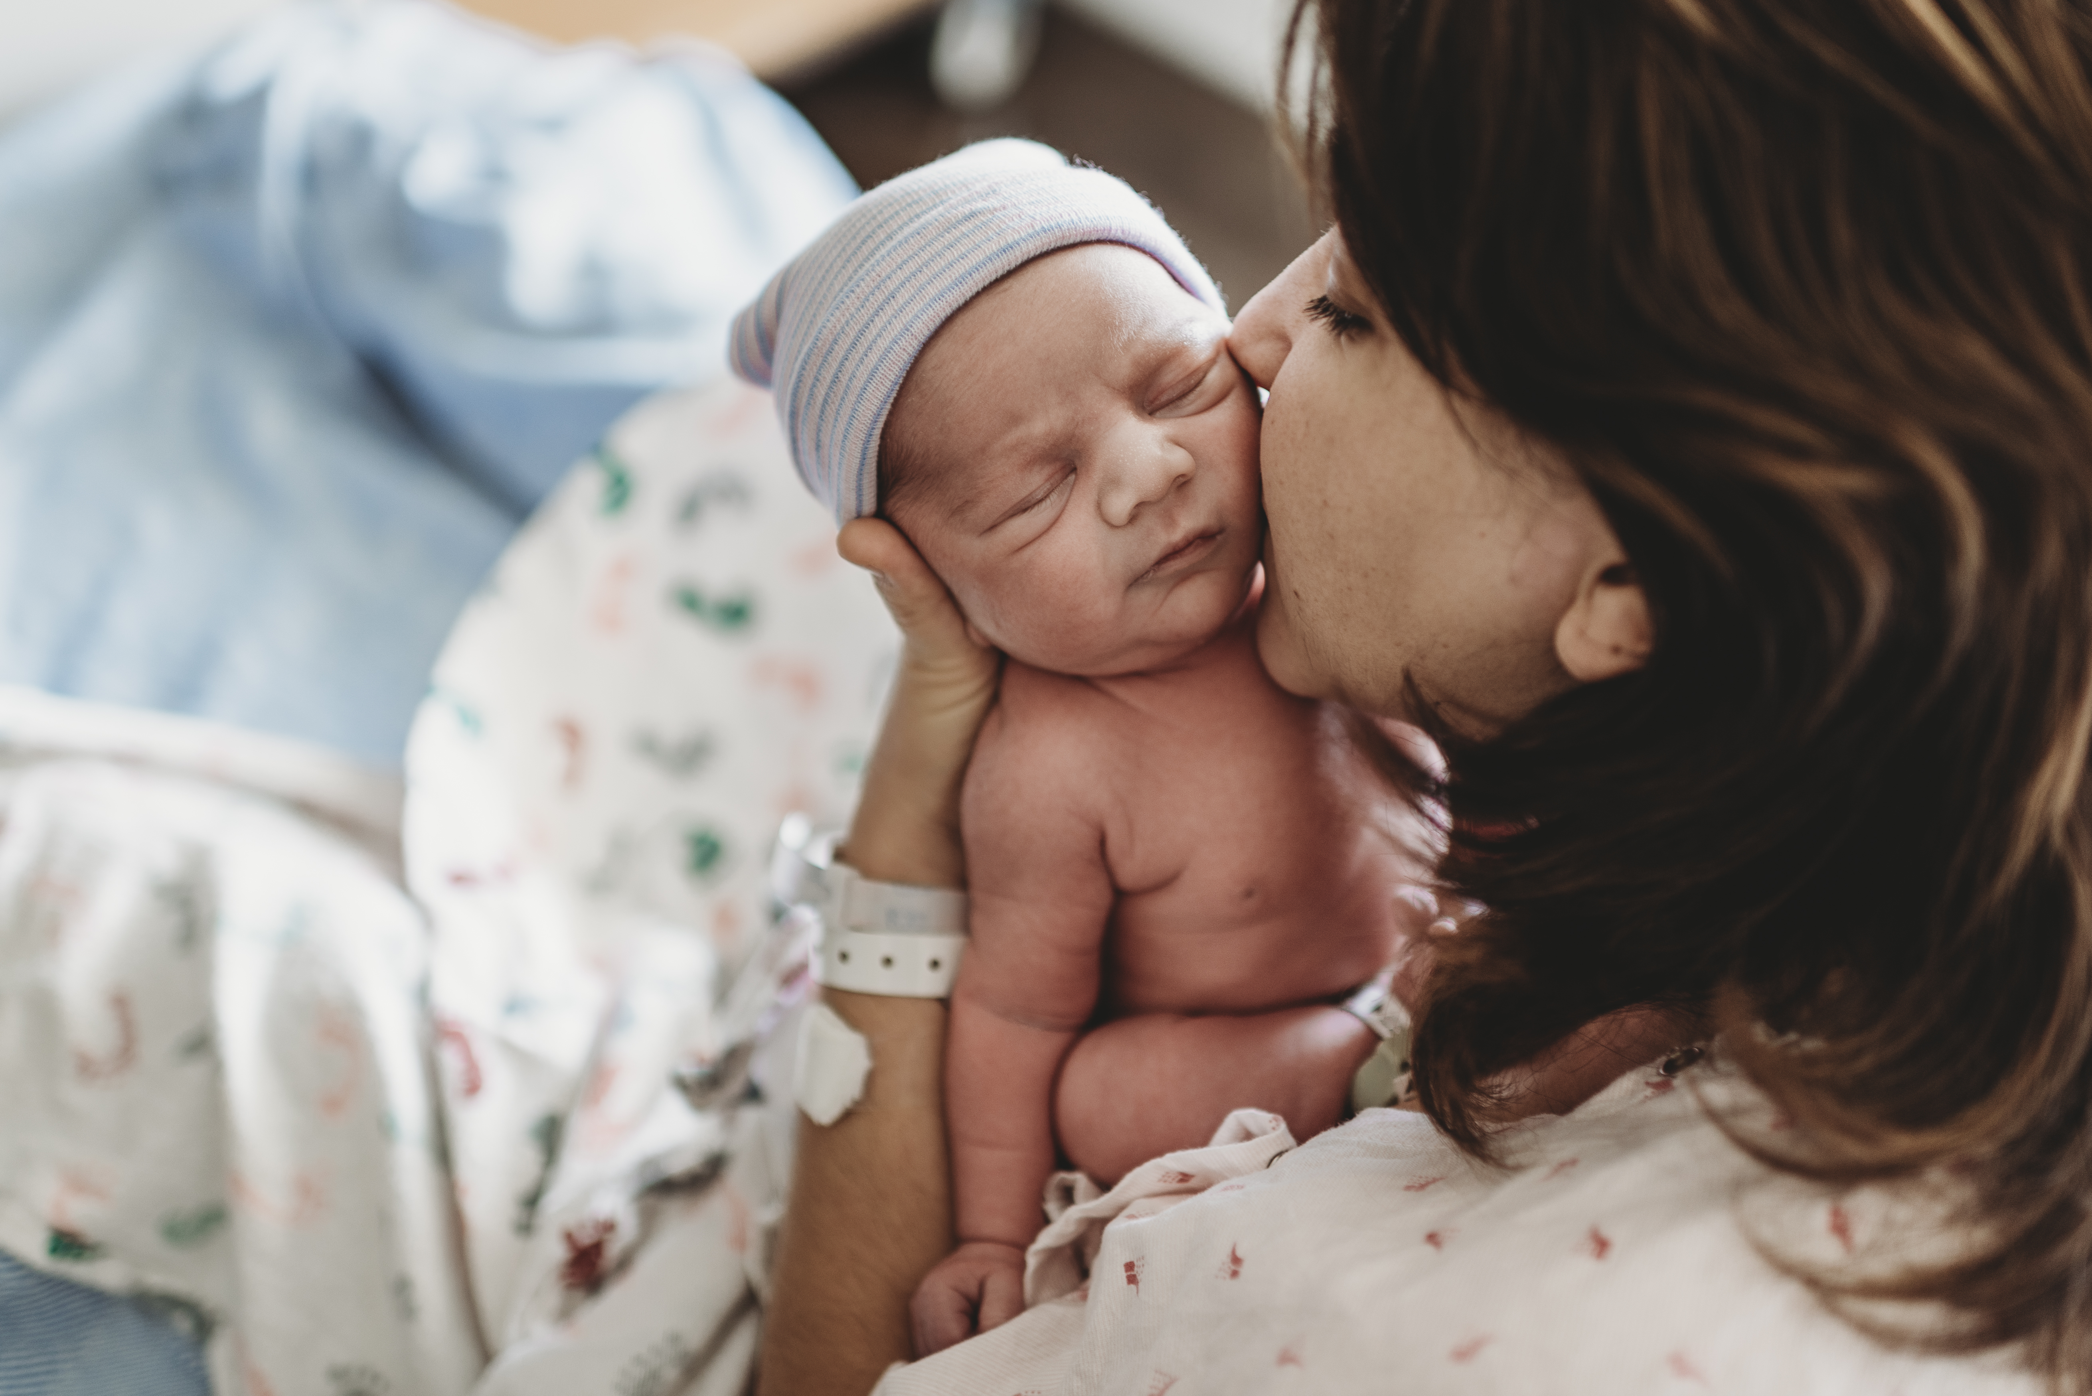
IN NOVEMBER WE REMEMBER.

Slide 8
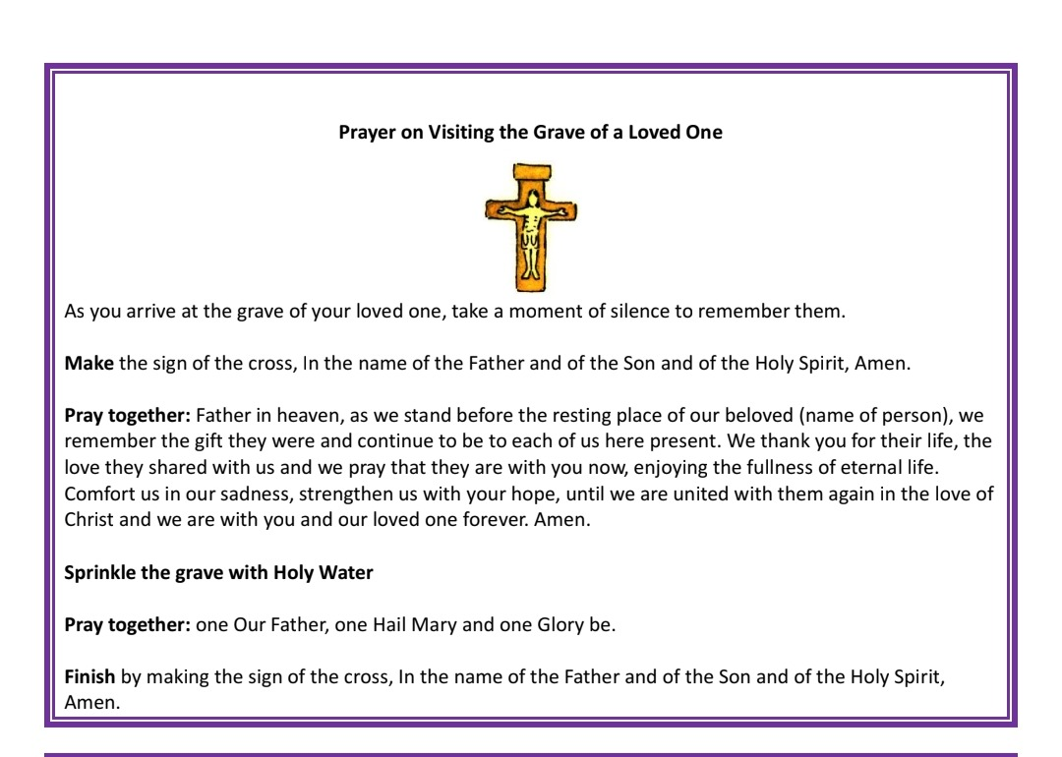

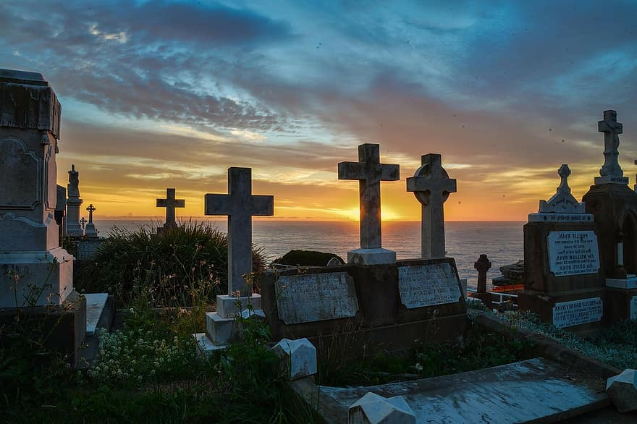
IN NOVEMBER WE REMEMBER.

Slide 9
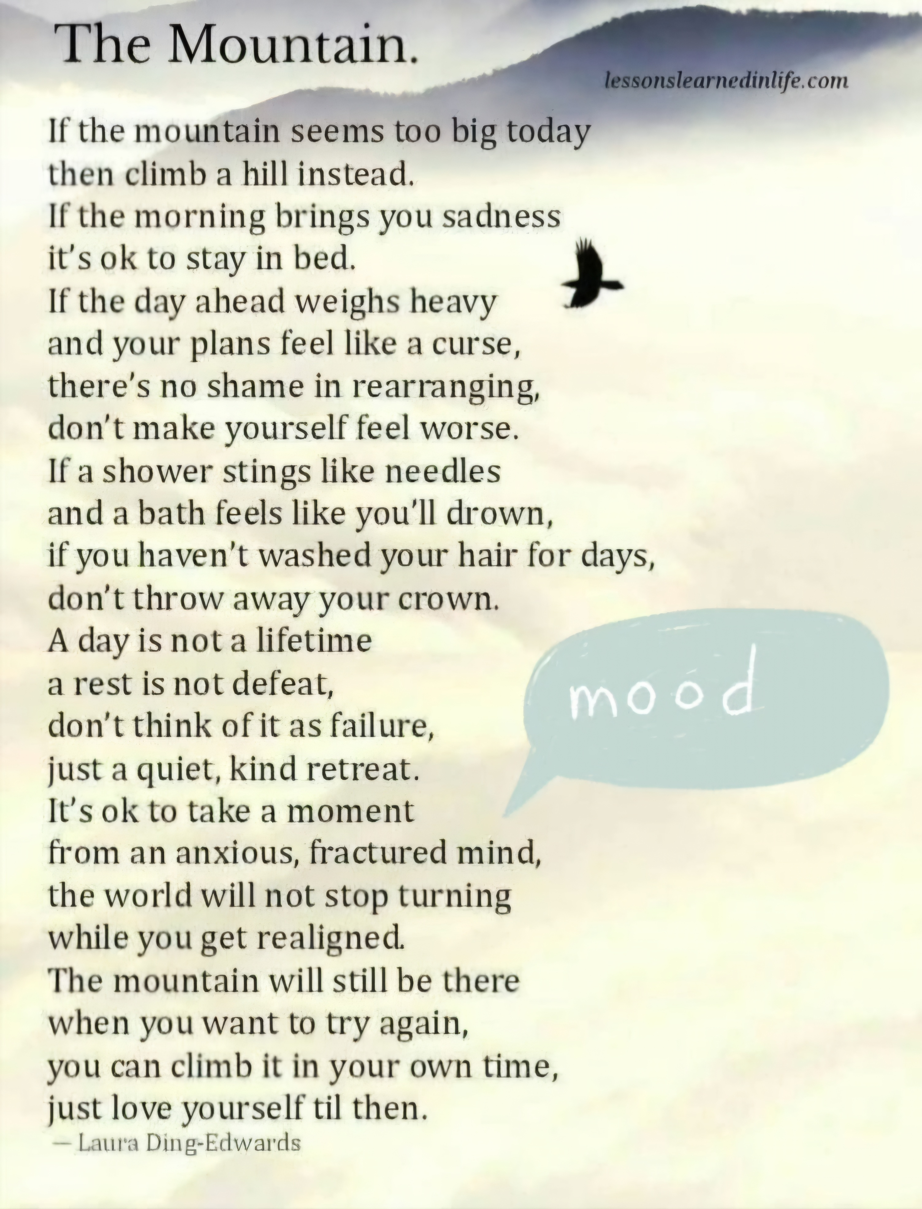

IN NOVEMBER WE REMEMBER.

Slide 10
IN NOVEMBER WE REMEMBER.
I WOULD LIKE TO REMEMBER AND PRAY FOR……………………..
In your heart and mind say a silent prayer for a family member, friend, loved one, neighbour or pet that you want to remember during the month of November.
Eternal Rest Grant Unto Them O Lord and May Perpetual Light ShineUpon Them. May Their Souls and The Souls of All the Faithful Departed Rest In Peace. Amen.
Notable Celebrity Deaths in 2025.
Val Kilmer (April 1, 2025) - The actor known for his roles in "Top Gun" and "Batman" died at age 65 due to pneumonia, following a long battle with throat cancer.
Gene Hackman (February 26, 2025) - The Oscar-winning actor was found dead at age 95 in his home, leaving behind a legacy of iconic performances.
Diane Keaton (October 2025) - The acclaimed actress known for her roles in "Annie Hall" and "The Godfather" passed away, marking the loss of a Hollywood legend.
Ozzy Osbourne (July 22, 2025) - The Black Sabbath frontman and rock icon died at age 76, leaving a significant impact on the music industry.
Robert Redford (September 2025) - The legendary actor and director passed away, remembered for his contributions to cinema and environmental activism.
Brian Wilson (June 11, 2025) - The Beach Boys co-founder and influential musician died at age 82, celebrated for his groundbreaking work in music.
Pope Francis (April 21, 2025) - The leader of the Catholic Church died at age 88.

